Slide 1
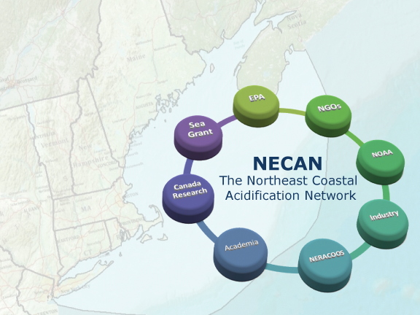
Northeast Shell Day 2019
Lauren Barrett, Penny Vlahos, & Katie O’Brien-Clayton
Presented to the 16th Annual Gathering of Shellfish Commissions
11 January 2020

Slide 2
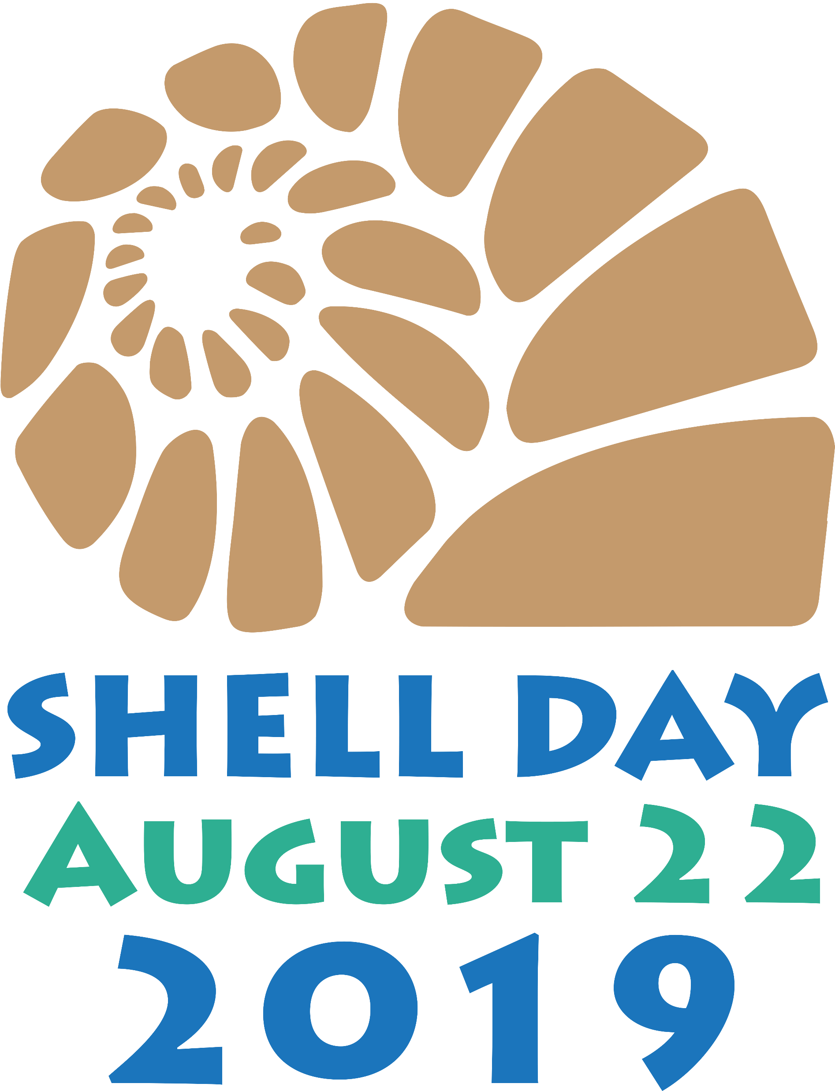
Shell Day
“Blitz” of ocean acidification monitoring in the northeast
Over 50 citizen science groups across New England simultaneously collected total alkalinity samples across a tidal cycle
7 participating groups from CT & NY
Answering the question: “What is the relationship between salinity and alkalinity?”
Source: NECAN

Slide 3
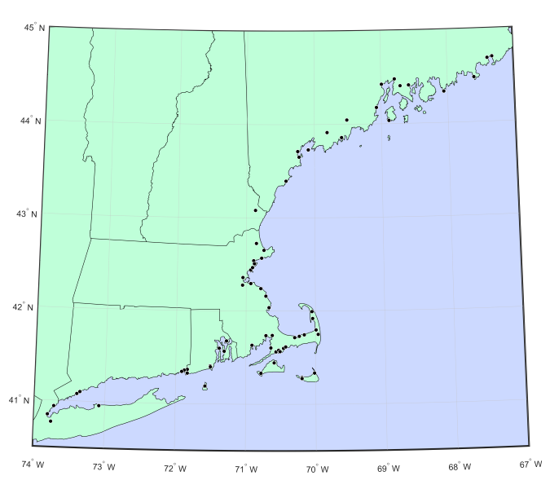
Shell Day 2019 Sampling Locations
Source: NECAN

Slide 4
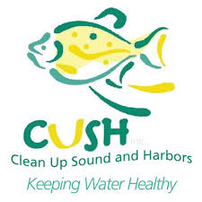
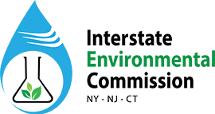
CT & NY Shell Day Participants
Save the Sound
New England Science & Sailing
Derecktor
Harbor Watch
Setauket Harbor Task Force
Clean Up Sounds and Harbors
Interstate Environmental Commission

Slide 5
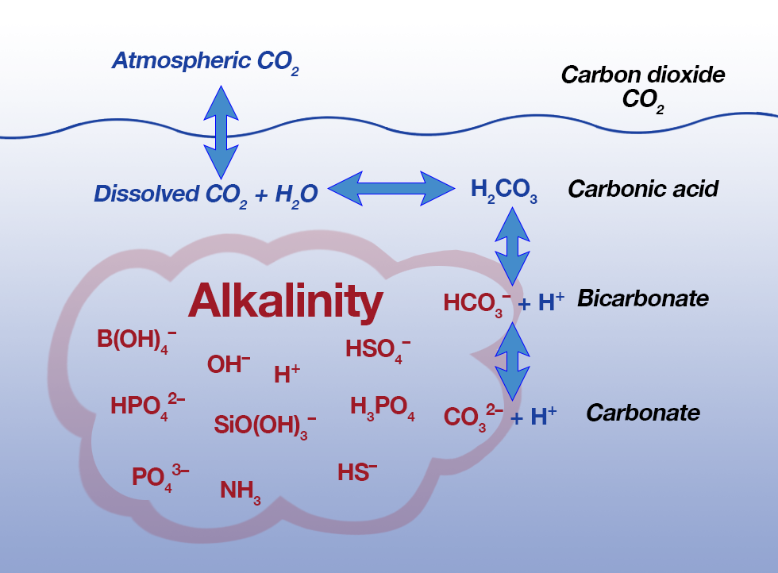
Alkalinity
The ability of a water body to neutralize acidity
Total alkalinity (TA) = [H⁺ acceptors] – [H⁺]
Average seawater TA ~ 1900 μmol/kg (EPA, 2006)
Source: WHOI

Slide 6
Ocean Acidification
Increase in CO₂ reduces ocean pH and carbonate ion concentration
Lower concentration of carbonate impedes calcification for organisms such as oysters and mussels
Source: NOAA
Notes:
This process does not change TA, but importance of decreasing carbonate ion conc & pH.

Slide 7
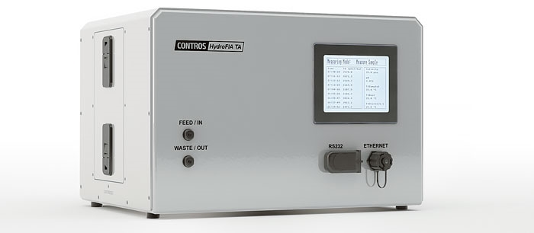
Analysis – Contros HydroFIA TA
Single point acid titration
Spectrophotometric pH determination using BCG indicator
Calibrated using Scripps CO2CRM’s & validated every 5 samples

Slide 8
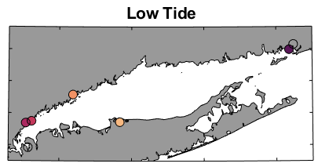
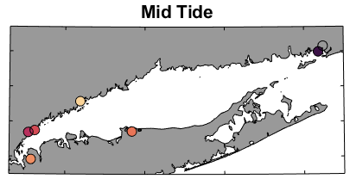
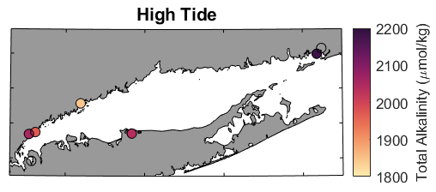
Shell Day LIS Results - Alkalinity
Stonington Harbor
Mamaroneck River
Milton Harbor
Norwalk Harbor
Port Jefferson
Notes:
Wequetequock Cove values below instrument DL

Slide 9
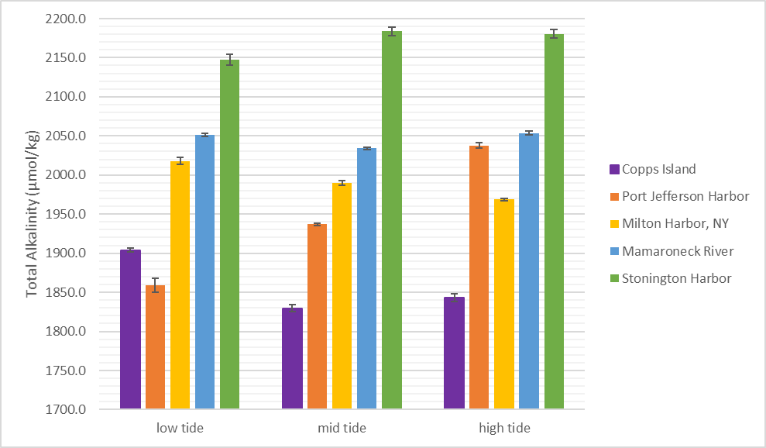
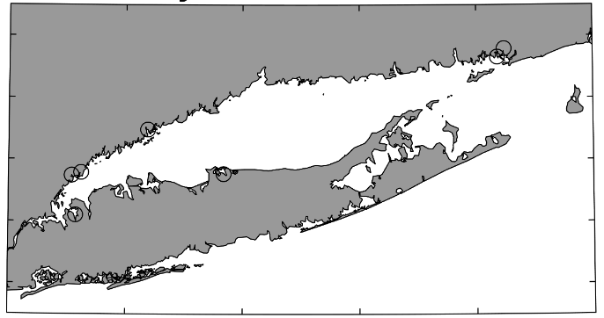
Shell Day LIS Results – Alkalinity and Tidal Cycle

Slide 10
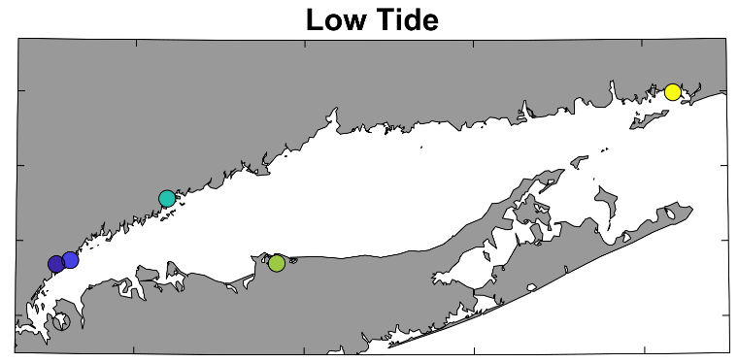
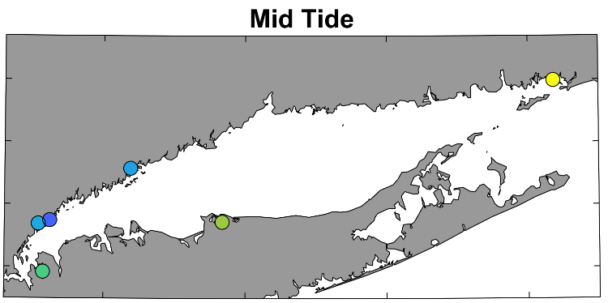
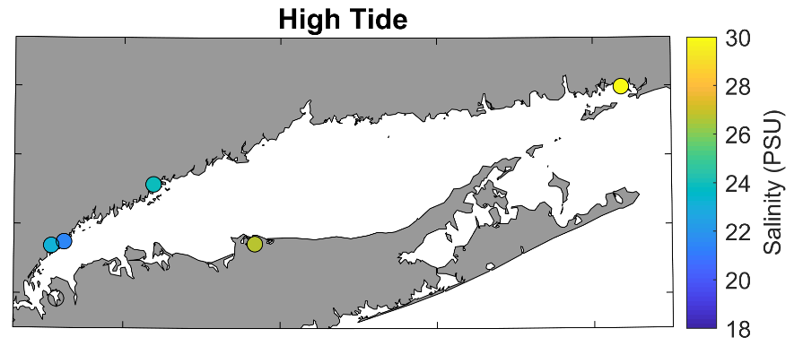
Shell Day LIS Results - Salinity
Stonington Harbor
Mamaroneck River
Milton Harbor
Norwalk Harbor
Port Jefferson

Slide 11
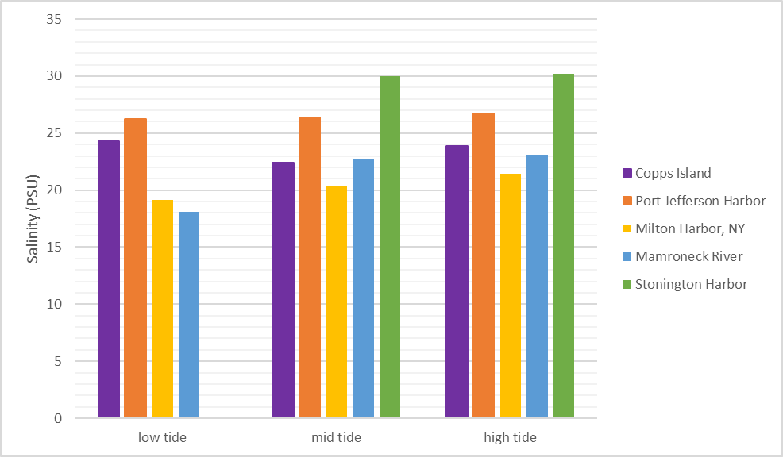
Shell Day LIS Results – Salinity and Tidal Cycle

Slide 12
Tracking rivers
Other
Models water currents, temperatures, and salinities
Passive tracers added to each river to track their plumes
CT and Housatonic are largest freshwater sources in WLIS
Southwest
Connecticut
Housatonic
WLIS
WLIS
Deignan-Schmidt and Whitney (2018)
Notes:
12
For another project, Steve and I have tagged each river with a separate model tracer. This allows us to isolate each river’s contributions. We can look at some of these results.
Here we see the percent of freshwater due to the Housatonic – the plume covers a large area and varies over time.
Now here’s the Connecticut River – it’s waters reach the Housatonic area
Now here are all other rivers – at times they significantly contribute to the freshwater in the area.
This analysis suggests half the freshwater near the Housatonic is from other sources. These likely contribute to the observed contaminant concentrations.

Slide 13
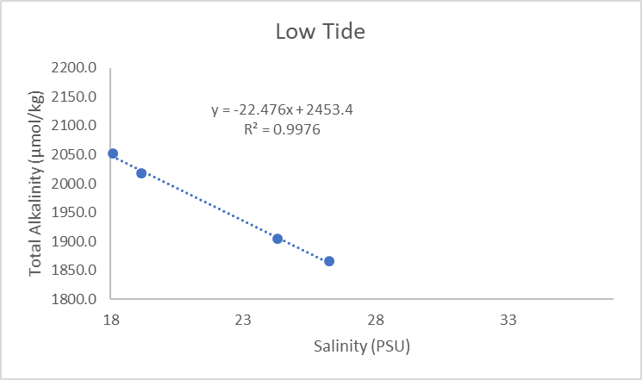
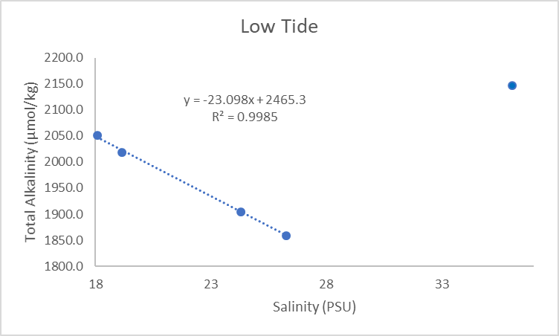
LIS Results – Salinity vs. Alkalinity

Slide 14
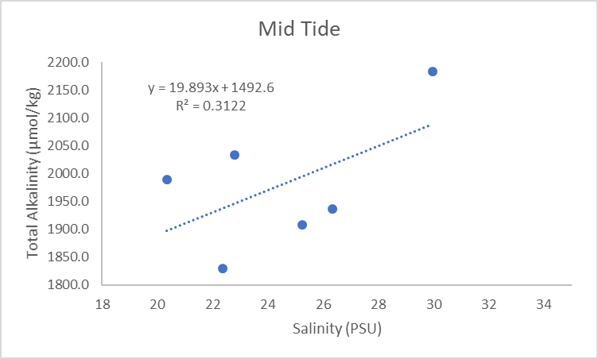
Shell Day LIS Results – Salinity vs. Alkalinity

Slide 15
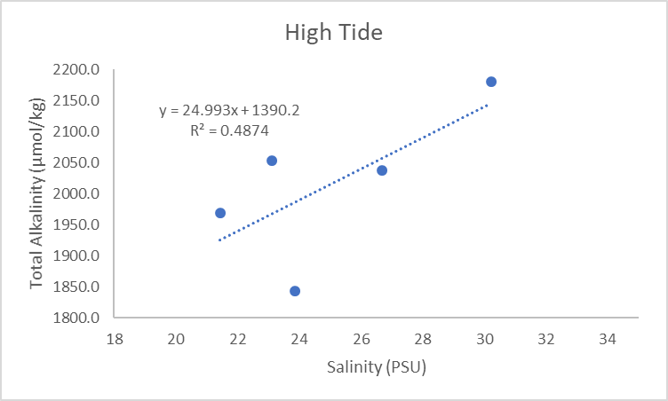
Shell Day LIS Results – Salinity vs. Alkalinity

Slide 16
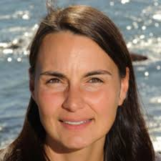
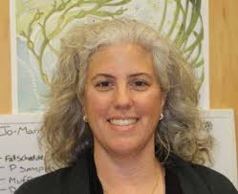
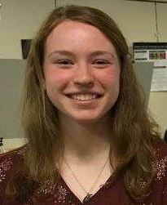
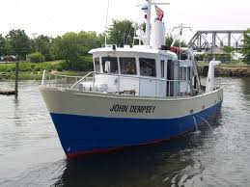
The Long Island Sound Respire Program R/CMC-15-CTNY
Research Team
Penny Vlahos
Chemical Oc.
UConn
Jamie Vaudrey
Biological Oc.
UConn
Michael Whitney
Physical Oc.
UConn
Lauren Barrett
Doctoral candidate
UConn
Matthew Lyman
All Oc.
CT DEEP - LISS

Slide 17
The Long Island Sound Respire Program
Objectives
To measure respiration rates and biological oxygen demand (BOD) at 10 Long Island Sound (LIS) water quality stations over the project period.
To measure key biogeochemical parameters at these stations (pCO₂ and total alkalinity (TA)), in addition to those already measured in the LIS surveys (pH, nutrients, dissolved oxygen (DO), chlorophyll a and organic carbon).
To conduct incubations on dissolved and particulate organic carbon (DOC, POC) that measure degradation rates at 10 sites across LIS to complement respiration studies.
To evaluate the above values across LIS spatially and temporally to begin the foundational work for a combined LIS biogeochemical model that considers respiration in terms of season (i.e. temperature (T), salinity (S), stratification), location, depth, DOC and POC lability and important biogeochemical parameters.
To conduct a LIS DO balance for LIS from 1991 to present.
To ascertain the utility of adding respiration and/or inorganic carbon components to the Long Island Sound Water Quality Monitoring Program.

Slide 18
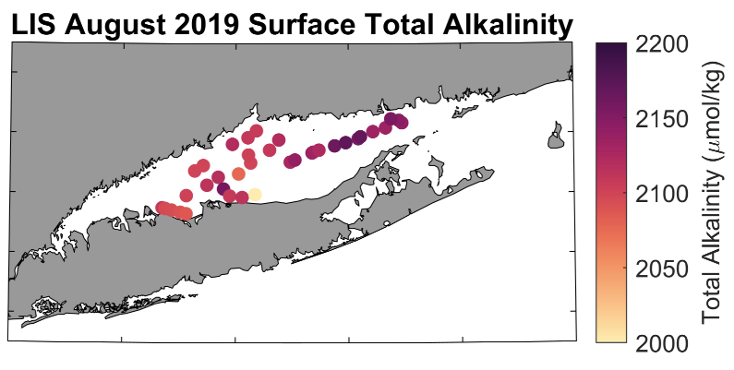
LISS Respire Program
8 cruises completed since June 2019 on CT DEEP R/V Dempsey

Slide 19
Conclusions
Alkalinity generally decreased from the mouth to the head of LIS
Alkalinity decreased from low to high tide except at Port Jefferson & Stonington Harbor
Salinity generally increased from low to high tide
Need further data to assess relationship between salinity and alkalinity
Hydrodynamics will complicate Shell Day interpretation (Copps Island)

Slide 20
Future LIS Alkalinity Research
Continue LISS Respire program – PI Penny Vlahos
Measuring TA, pCO₂, and pH monthly from 2019-2021
Alkalinity of LIS embayments (internal UConn seed proposal PI Vlahos pending)
Shell Day 2020 TBD

