Slide 1
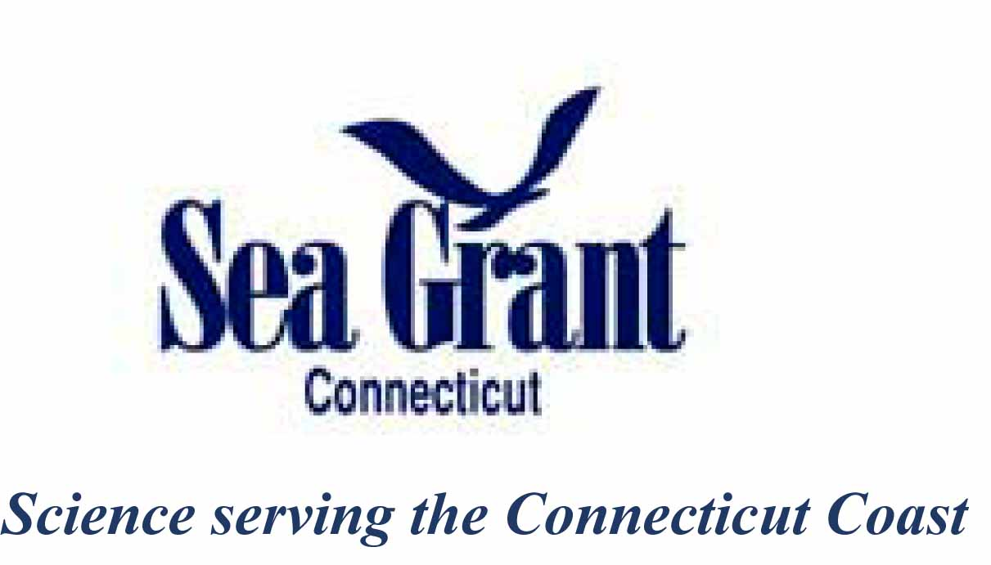
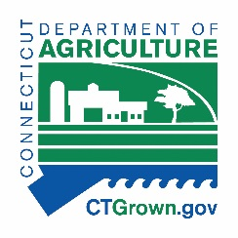
Shellfish Restoration Planning in Connecticut Shellfish Gathering Update 1/10/2020

Slide 2
Background and context
Bivalve shellfish are part of a healthy Long Island Sound and play a role in improving impaired estuarine waters of Connecticut.
Natural shellfish beds, especially oyster and mussel reefs, provide numerous ecosystem services e.g. habitat and food provision for aquatic organisms, water filtration and erosion control.
Shellfish production provides jobs and recreation. Aquaculture is valued at over $30 million dollars in the state and sales of recreational shellfishing permits are in excess of $100,000 annually (with a multiplier effect of millions of dollars)

Slide 3
The problem
Shellfish populations and the environment have historically been impacted by pollution, development, severe storms and overfishing.
Changing environmental conditions may further affect shellfish populations.
Many of these habitats are not optimal condition to support ecosystem services, fisheries and aquaculture.
Concerns exist about how restoration can occur and be compatible with existing uses, and how funding is best spent.
No plan is in place to guide the development of projects.

Slide 4
What is “shellfish restoration”
Conservation: protecting existing shellfish beds from human and environmental threats;
Management: rehabilitating historic shellfish beds for fisheries and aquaculture purposes;
Restoration: creating or enhancing shellfish beds for ecosystems services such as providing habitat, improving water quality, stabilizing shorelines against erosion
Goal: to develop a plan that addresses barriers and recommendations for high priority restoration projects and practices for Connecticut.

Slide 5
Goals and Objectives
Objective 1. Conduct analysis environmental conditions and human use maps/data to inform the process of identifying potential sites and practices for shellfish restoration in Connecticut;
Objective 2. Engage key players to review GIS analysis, and refine by identifying priority sites, practices, restoration resources and funding;
Objective 3. Conduct site visits to at least three high priority potential restoration sites and create a GIS data layer containing descriptive physical, biological, regulatory and logistical characteristics of the areas;
Objective 4. Share draft plan with key players and solicit input;
Objective 5. Develop a guidance document on the state/federal regulatory requirements for restoration; and
Objective 6. Submit final shellfish restoration plan to USDA NRCS.

Slide 6
Outcomes:
Ideally, shellfish restoration projects occur in a coordinationed manner involving key players. This project will help overcome existing barriers, specifically:
Provide applicants/restoration practictioners with a better understanding of what is available vs. what is suitable, and of regulatory requirements
= facilitate permitting
Provide funding agencies with confidence that they are funding high priority, state-supported efforts
= facilitate investment

Slide 7
Who’s involved?
Facilitation:
Connecticut Sea Grant
Connecticut Department of Agriculture
Connecticut Department of Environmental Protection
Key players (includes but not limited to):
Shellfish industry
Shellfish / harbor management commissions
State/Federal regulators
Coastal engineers
Environmental groups
Restoration practictioners

Slide 8
Timeline
Project Task | Q4 2018 | Q1 2019 | Q2 2019 | Q3 2019 | Q4 2019 | Q1 2019 | Q2 2020 | Q3 2020
Obj. 1. GIS analysis | x | x
Obj. 2. Engage partners |  |  | x | x
Obj. 3. Engage stakeholders |  |  |  |  |  | x
Obj. 4. Site Visits |  |  |  |  |  | x | x
Obj. 5. Outreach |  | x | x | x | x | x | x | x
Obj. 6. Regulatory guidance |  |  |  |  |  | x | x | x
Obj. 7. Restoration plan |  |  |  |  |  | x | x | x

Slide 9
Instructions:
Identify the purpose, project potential, target species, area size (if known) and label each area accordingly using the following keys:
Purpose (choose one):
HR = habitat restoration (e.g. areas where harvest does/will not occur)
FSE = fisheries stock enhancement (e.g. recreational shellfishing)
AQ = aquaculture bed management (e.g. public oyster beds)
B = bioextraction (e.g. nutrient removal)
SEC = shoreline erosion control (e.g. living shorelines)
Project Potential (choose one):
+++ = high priority
--- = avoid, conflict exists or unsuitable environment aquaculture
+ = may have potential

Slide 10
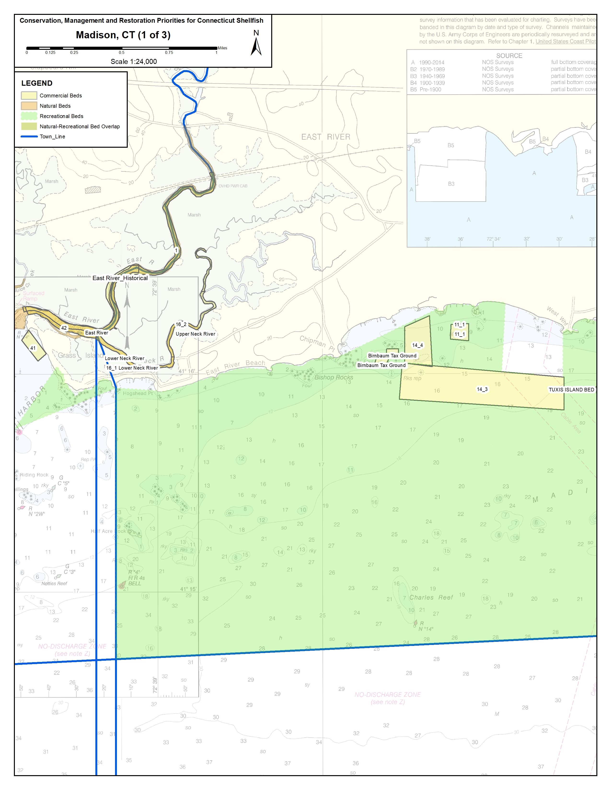
Example:
Area 1: HR, +++, 4 acres, eastern oyster
Context: This is a natural oyster bed that has been silted over. Natural recruitment occurs annually and while silting isn’t a problem any more there isn’t sufficient hard substrate to support a large population.
Area 1

Slide 11
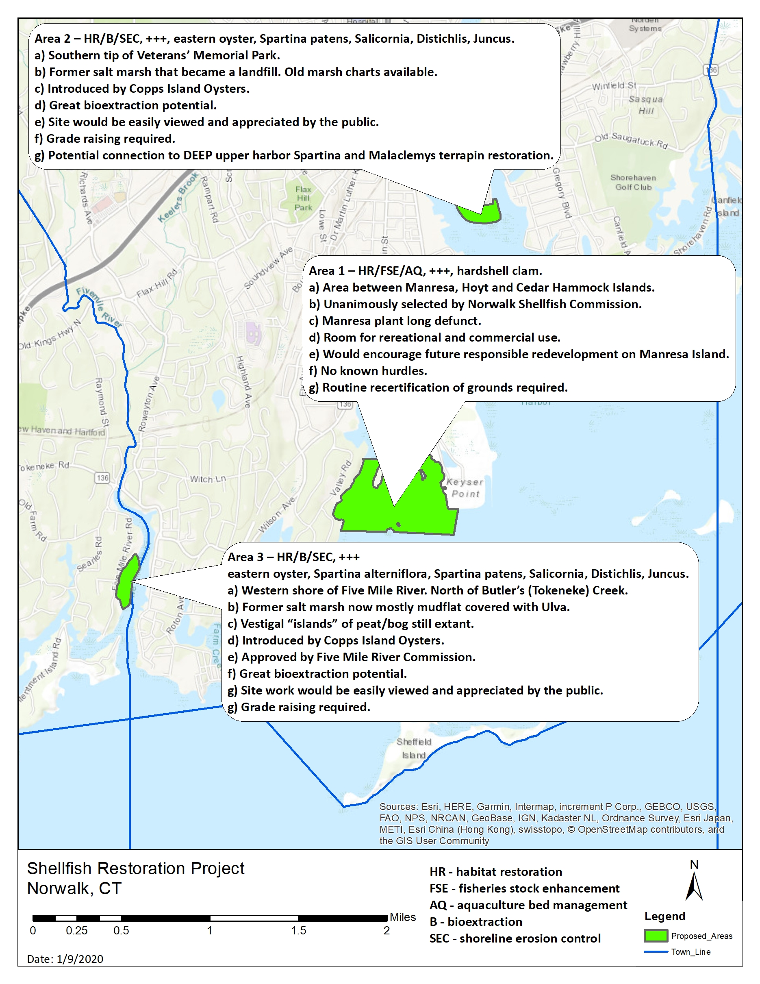

Slide 12
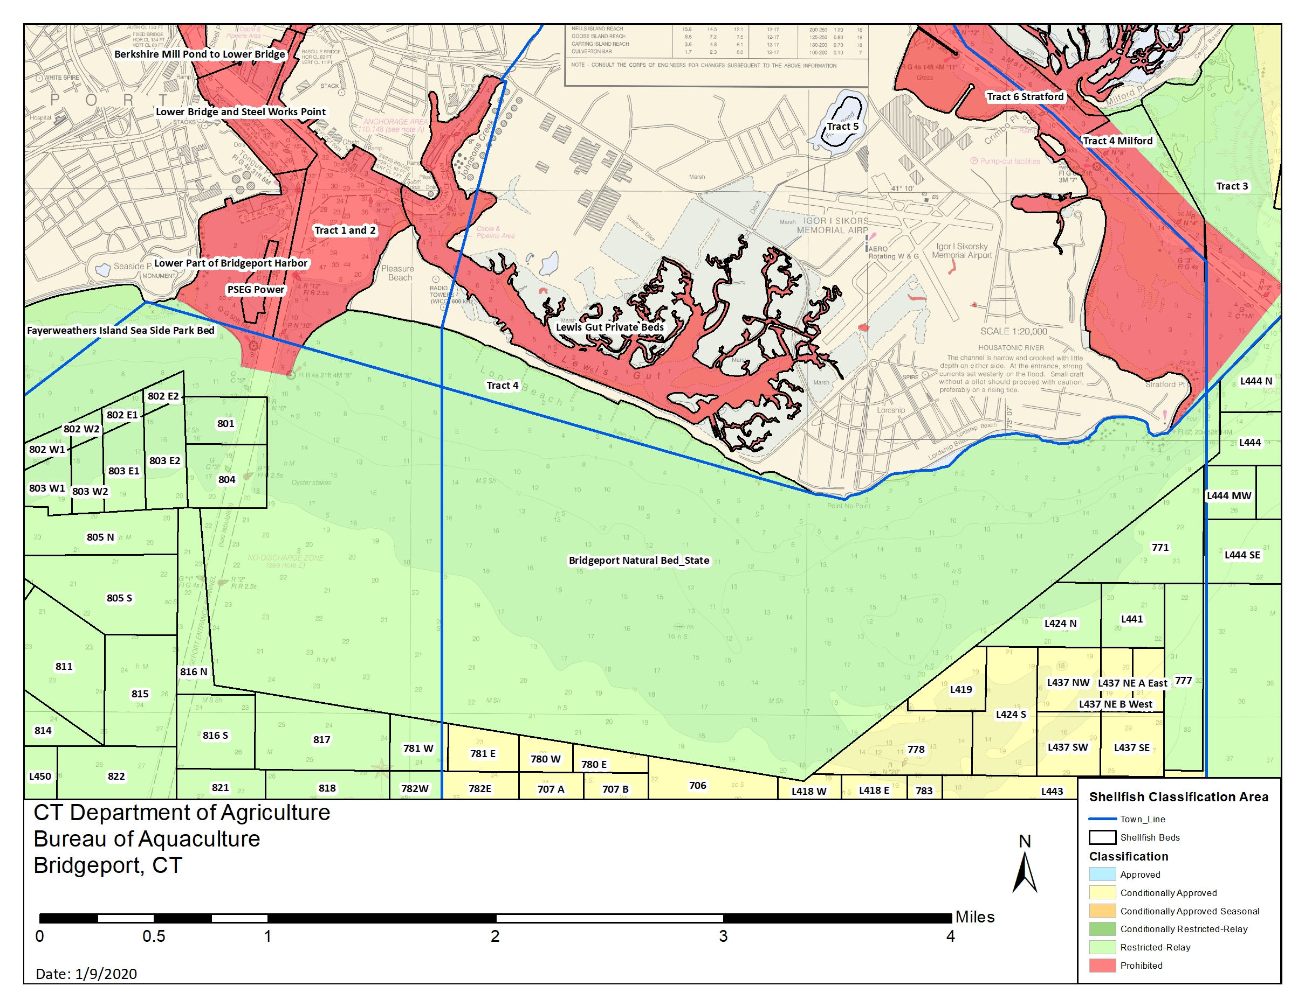

Slide 13
CONSERVATION, MANAGEMENT AND RESTORATION PRIORITIES AND PRACTICES FOR CONNECTICUT SHELLFISH
Purpose of Project:
The goal of this project is to develop, through a transparent, collaborative process, a comprehensive shellfish conservation, management and restoration plan that addresses barriers and recommendations for high priority projects and practices for Connecticut.
Purpose of Shellfish Restoration Steering Committee:
Partner organizations representing local, state and federal planning and regulatory agencies, environmental organizations, restoration practitioners, academia, and the aquaculture sector, will be engaged in the review and refining of the results of a GIS analysis* and will also provide input and feedback on a plan for shellfish restoration priorities and practices in Connecticut. Steering committee members will assist in the identification of priority sites, practices and municipal restoration resources and potential funding sources.
*GIS analysis will inform the process of identifying potential sites and practices for shellfish restoration in Connecticut.

Slide 14
Shellfish Restoration Steering Committee:
Bell’s Shellfish - David Hopp 203-515-2631 ​bells.coastal@gmail.com
CT Billion Oyster Project - Katie Mosher kmoshersmith@nyharbor.org
And Peter Malinowski pmalinowski@nyharbor.org
CT DA/BA - Kristin DeRosia-Banick Kristin.DeRosia-Banick@ct.gov
CT DA/BA - David Carey David.carey@ct.gov
CTSG – Tessa Getchis tessa.getchis@uconn.edu
CT DEEP - Harry Yamalis harry.yamalis@ct.gov
CT DEEP - Krista Romero krista.romero@ct.gov
CT DEEP – Christopher Bellucci christopher.bellucci@ct.gov (or designee)
(NEFSC holding interviews for new shellfish biologist; ask Lisa Milke in January)
NRCS CT - Debbie Surabian debbie.surabian@usda.gov
Save the Sound - Gwen MacDonald gmacdonald@savethesound.org
TNC – Nathan Frohling nfrohling@tnc.org
UConn Extension - Mike O’Neill mp.oneill@uconn.edu
USFWS – Suzanne Paton suzanne_paton@fws.gov
NOAA - Jim Turek James.Turek@noaa.gov
NOAA – Elizabeth Hayes Elizabeth.hayes@noaa.gov
ACOE – Cori Rose Cori.M.Rose@usace.army.mil
NMFS - Alison Verkade alison.verkade@noaa.gov
The Sound School - Peter Solomon peter.solomon@new-haven.k12.ct.us
Fairfield Shellfish Commission - John C. Short, Jr. shellfishcommission@fairfieldct.org
Cornell Cooperative Extension – Chris Pickerell cp26@cornell.edu (or designee)
??Pew Charitable Trust - Aaron Kornbluth akornbluth@pewtrusts.org
Stakeholder Group:
Long Island Soundkeeper - Bill Lucey blucey@savethesound.org
Harbor Watch – S. Crosby (or designee) s.crosby@earthplace.org

Slide 15
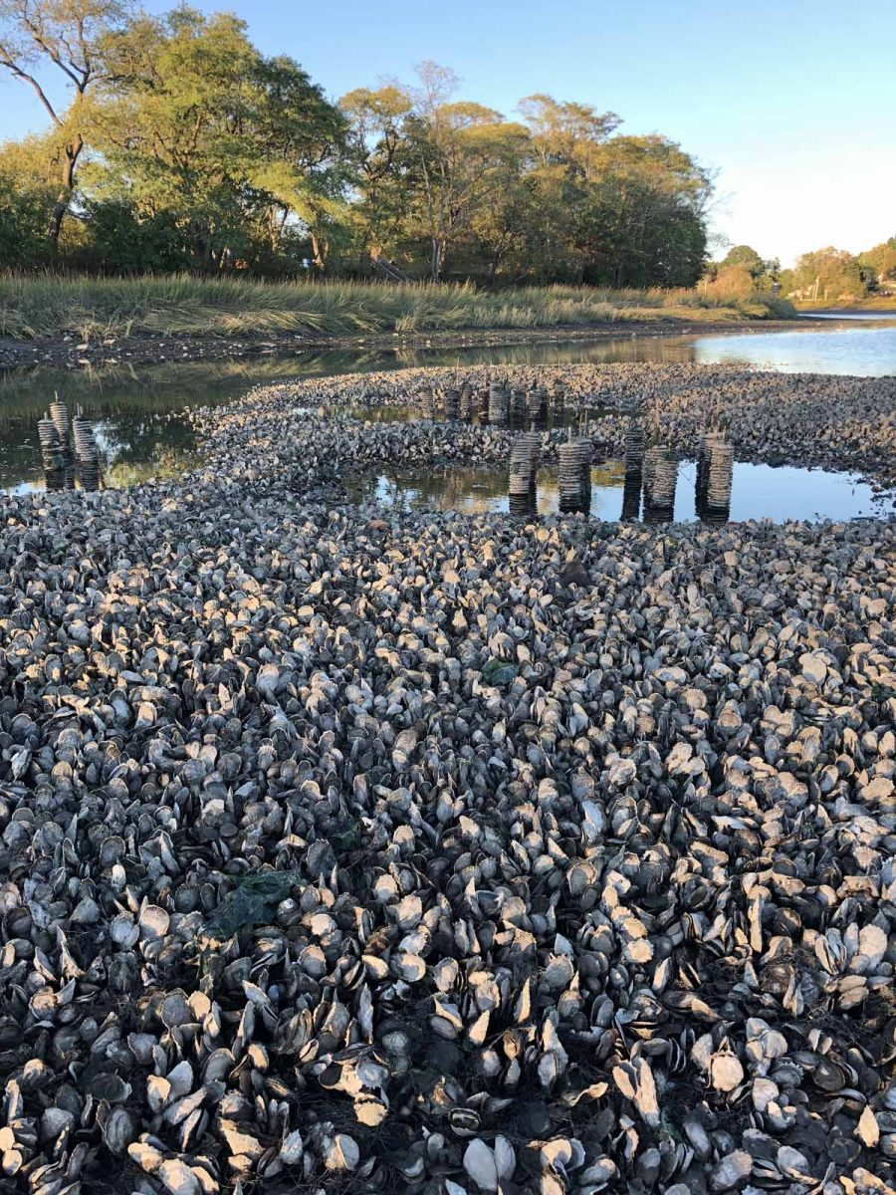

Slide 16
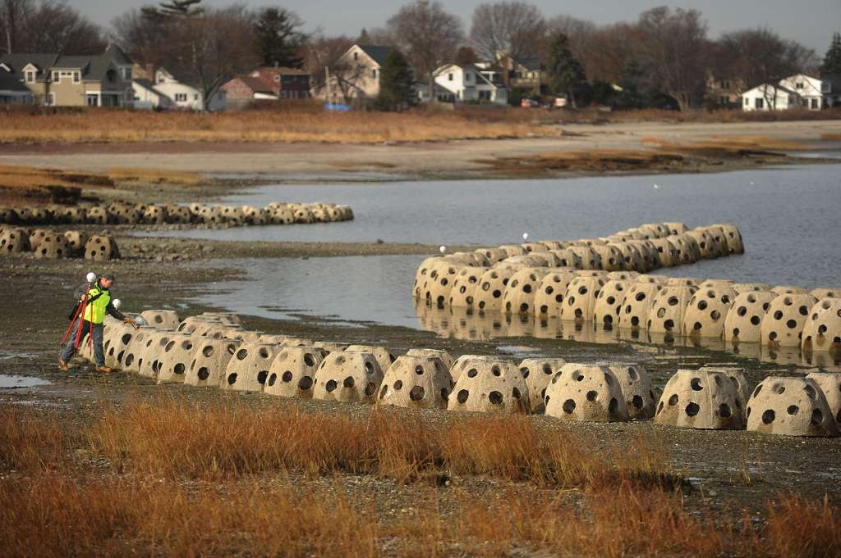

Slide 17
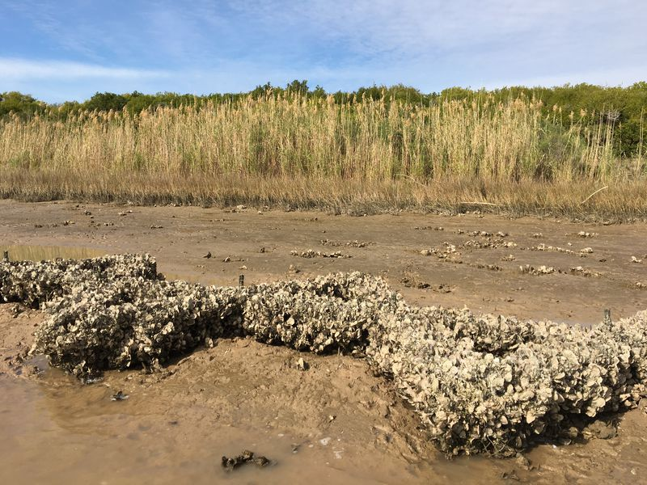

Slide 18
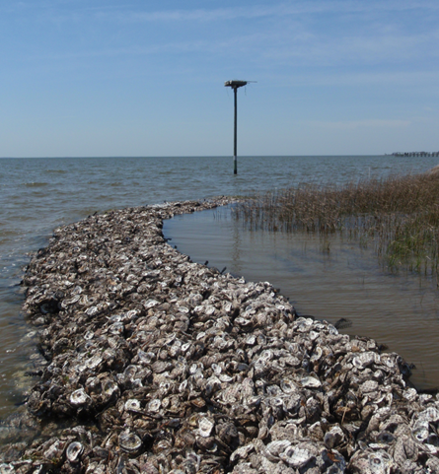

Slide 19
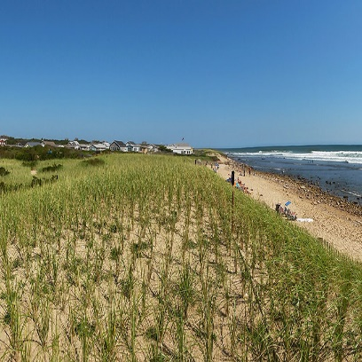
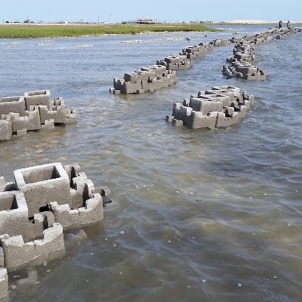
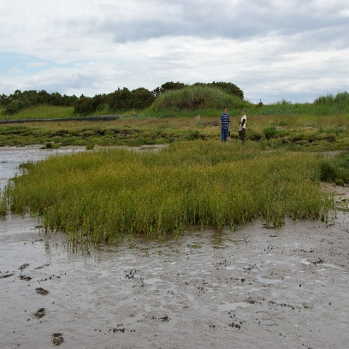
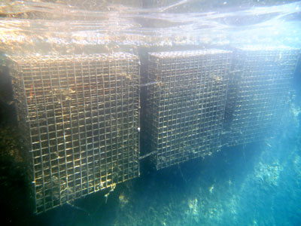
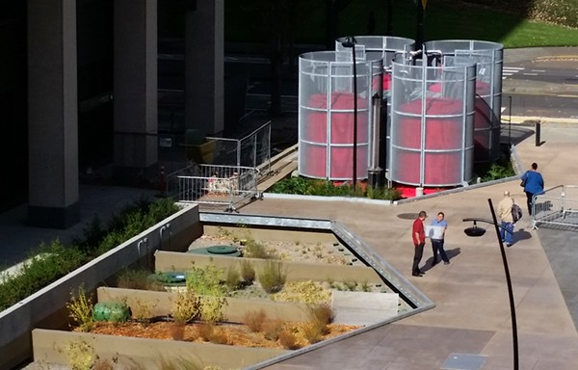
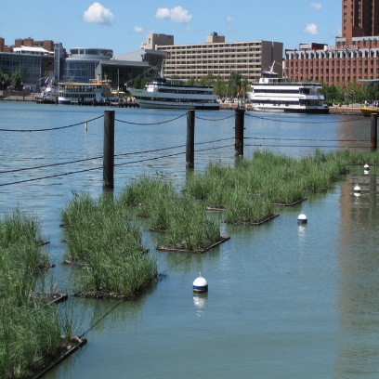
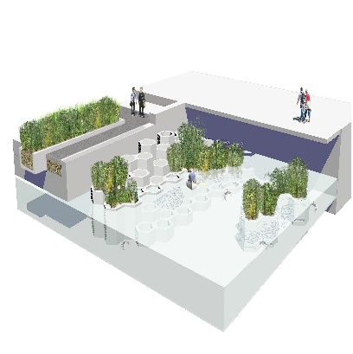
Long Wharf Concepts
Proposed Road + Wall
Dune Restoration
Oyster Castles
Marsh Restoration
Living Wall & Biohut
Trickle Filter
Floating Wetlands
Fish Hive Treatment

