Slide 1
Connecticut’s Shellfish growing area program
Recreational Shellfish Programs and The National Shellfish Sanitation Program Model Ordinance (NSSP-MO)
Alissa Dragan, Environmental Analyst 2
Department of Agriculture, Bureau of Aquaculture
Gathering of the Shellfish Commissions, January 11, 2020

Slide 2
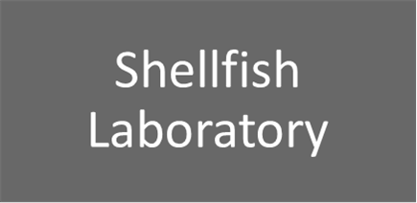
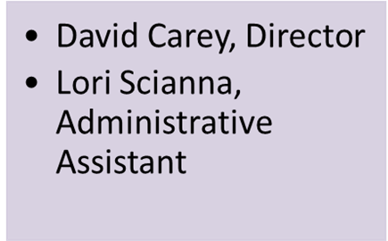
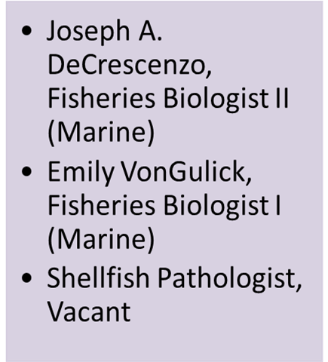
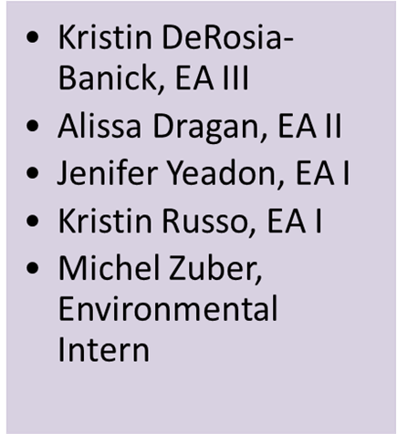
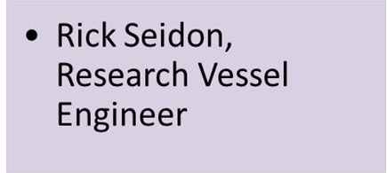
DOAG Staff

Slide 3
National Shellfish Sanitation Program
Model Ordinance
Oversight
FDA
Interstate Shellfish Sanitation Conference
Responsibilities
SSCA
Industry
Research
Notes:
ISSC formed 1982. Industry, State & Federal Regulators

Slide 4
The Bureau of Aquaculture Implements the NSSP-MO
NSSP_MO Chapter 1 @1 A-F and @2 A-H:
Growing Areas
Shellfish Sanitation
Vibrio
Enforcement

Slide 5
DOAG nssp-mo responsibilities
DOAG is the responsible Agency for ensuring the safety of molluscan shellfish for human consumption. DOAG Analysts oversee CT shellfish production from the growing areas through the distribution chain
Growing Area Classification
Growing Area Management (Closures & Openings)
Regulate Shellfish Harvest, Processing, Sale, & Shipment
Biannual Harvester, Processor, & Dealer Inspections
Aquaculture Permitting, Including Inland Fish Farming & Seaweed
Illness Investigations
Laboratory Evaluations for CT Dairy Industry

Slide 6
Why do we need a shellfish sanitation program?
Shellfish are effective filter feeders & can concentrate pathogens or other contaminants as they feed
Shellfish are consumed RAW with no cook step to kill any pathogens that may be present
Shellfish are often grown near shore
They are sessile & captive to their environment & cannot move away from contaminants
Contaminants may be pollution-related or naturally occurring

Slide 7
Water sample procedure
EQUIPMENT:
125 ml single-use sterilized plastic specimen bottles (supplied by DOAG) or 125 ml reusable plastic bottles (supplied by CT DPH lab) NOTE: You may not clean, boil or sanitize your own bottles
Sample stick
Cooler, ice, and frozen ice packs to cool & hold samples at 50⁰ F (10⁰ C), or less, until refrigerated or delivered to laboratory
Tide chart for your area
Nautical chart of area with DA/BA sample station locations & coordinates
Shellfish seawater laboratory collection forms & account number supplied by DOAG, DPH Laboratory or private laboratory, respectively
PROCEDURES:
Check Tides (1.5 hours +/- HT & LT)
Contact DOAG to schedule
Check each bottle for cracks prior to use
Properly label bottle & data sheet
Keep label out of sample cup
Sample depth 18”
Immediately place in cooler on ice
You MUST include a temperature control
Do NOT:
Touch inside of cap or bottle;
Re-submerge bottle;
Break ice;
Sample stirred up sediments
Freeze samples

Slide 8
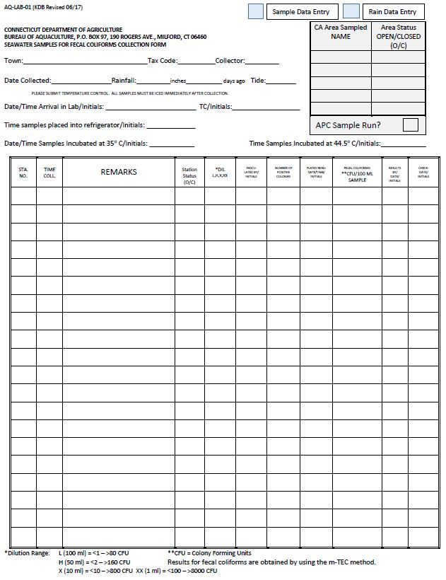
SAMPLE FORM
SAMPLE TRACKING
Sample Tracking -
Samplers Should Also Include the Following:
Station Status (O/C)
Note anything unusual, large flock of birds, odors, discolored water, etc.
Samplers Must Complete Form:
Town & Tax Code
Collector(s)
Date & Tide Stage (E, L)
Station ID
Time of Collection
Please Include:
Area Sampled
Area Status (O/C)
APC Sample Run?

Slide 9
Shellfish tissue sample procedure
EQUIPMENT:
Heavy-weight food grade plastic bags (supplied by DA/BA), or other clean, waterproof container
The Appropriate implement (clam rake, etc.) shall be used for collection of the species of harvest
Cooler, ice, & frozen ice packs to cool & hold samples at 50⁰ F (10⁰ C), or less, until refrigerated or delivered to laboratory
CT DA/BA Shellfish Meats Collection Form
PROCEDURES:
Contact DA/BA to schedule
The Town, growing area name, & date must be written on the bag with waterproof, permanent marker
Collect 15 individuals of the same species. Place in bag & close. Shellstock should be clean. (If shellfish are small, more animals are needed)
Place sample bag in cooler. Keep sample above freezing & below 50⁰F (10⁰C). Shellstock must not come into direct contact with ice, or melted ice water, use sealed plastic bag & keep sample upright.
You MUST include a temperature control
Complete Shellfish Meat Collection Form:
Town, date, area, time, collector
Sample Type (species)
Date harvested, harvester

Slide 10
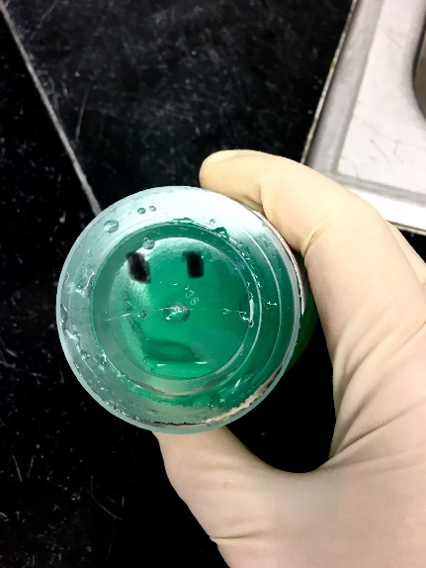
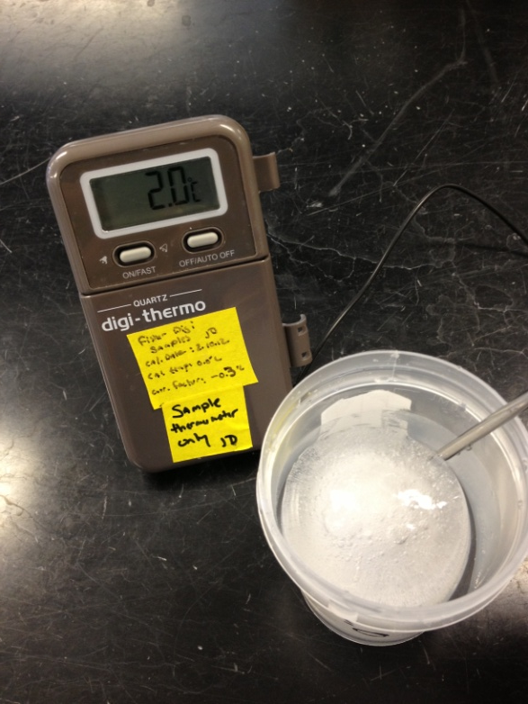
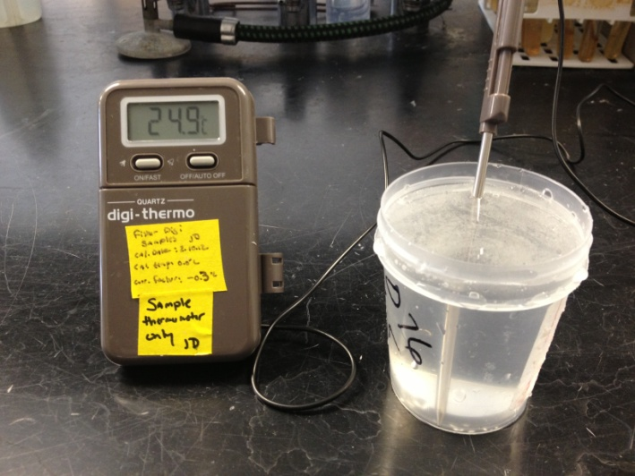
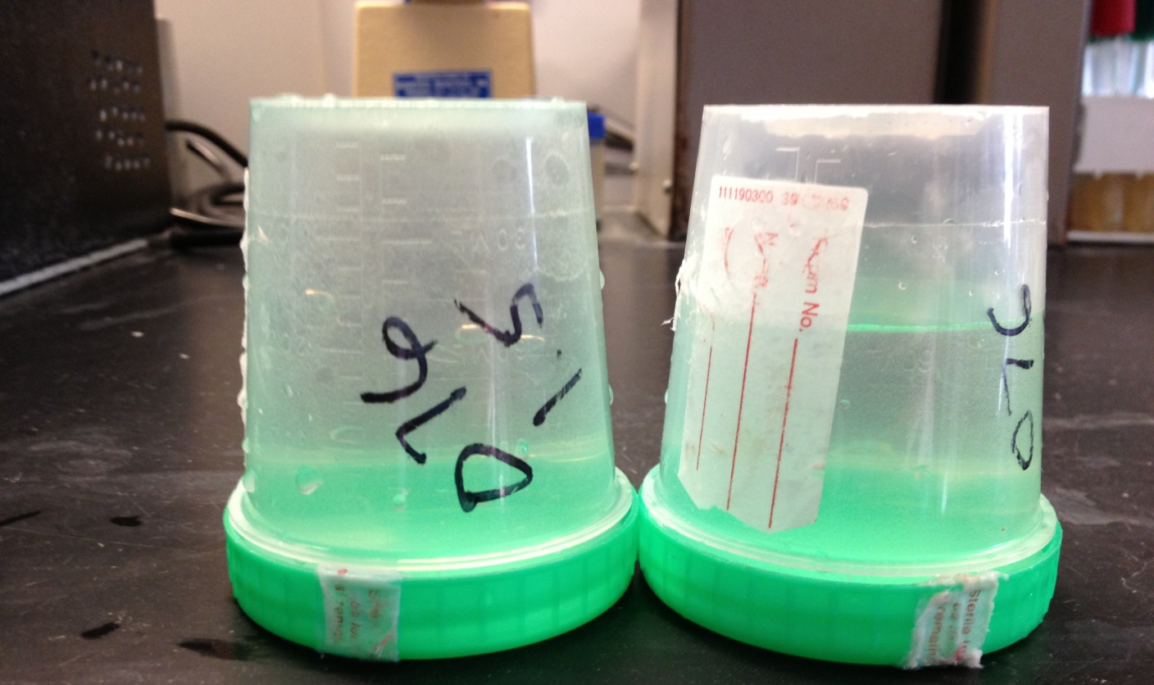
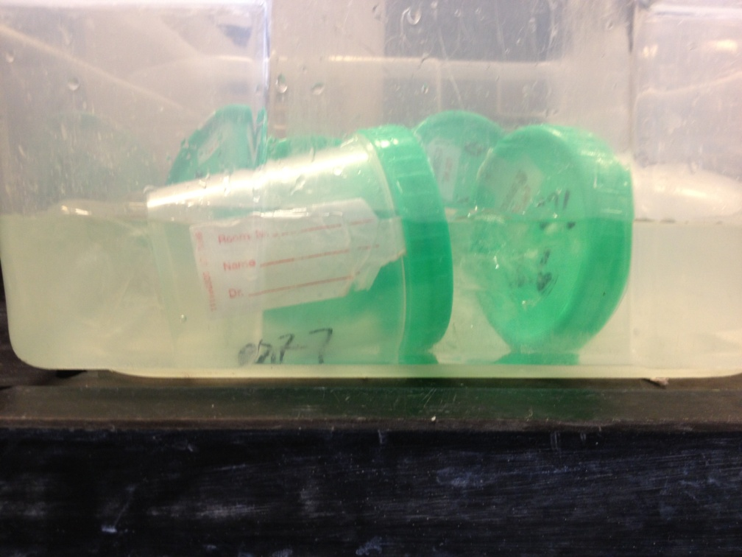
Common sampling mistakes
Frozen!
Notify DOAG if You Are (OR Are Not) Sampling
Please Deliver Samples Promptly
Don’t Forget to Include a TC
Check Bottles for Cracks
Cracked!
No airspace
Airspace too large
Too Hot!!
Sumberged

Slide 11
Sampling compliance
CA Monthly Samples
Once per month OPEN status (12 total) at each station
If sample can not be collected in a month, an additional OPEN sample must be collected the following month
APC Samples
Collected 0-4 days following ≥0.5” rainfalls
Re-Opening Samples
Required for re-opening prior to day 15
5 per Year required at each station. There must be 15 APC samples in a 3-year period
Shellfish tissue samples required to verify 7 day closure

Slide 12
Sampling compliance – nssp bacteriological standards
MEETS NSSP APPROVED CRITERIA
Geometric Mean of Membrane filtration (MF) colony forming units (CFU) shall not exceed 14 CFU/100 mL
AND not more than 10% of samples shall exceed 31 CFU/100mL
To meet the Approved Criteria, it takes 8 million cubic feet of water to dilute one person’s waste in one day
59,850,779 gallons
Volume equal to 12 football fields covered in 10 feet of water

Slide 13
Growing area classifications
Shoreline Survey
Water & Tissue Sample Results
Marina Survey
Data Analysis
Does area meet Approved criteria in open status?
Does tissue data support 7-day closure?
Maximum occupancy of marinas & mooring fields
50-50 Rule
Walk shoreline
Identify, map & classify pollution sources

Slide 14
Sanitary Survey Components
Written evaluation of all environmental factors, including actual & potential pollution sources impacting water quality in a shellfish growing area
Stormwater outfalls, pipes, streams mapped & sampled if flowing
properties inspected for signs of failing septic systems & cross connections to stormwater system
Water pollution control facilities, industrial discharges, storm sewers & pump stations are evaluated

Slide 15
2019 NSSP-MO Changes
Marinas & Mooring Areas have been separated:
“Mooring areas mean any boat that is used to provide temporary or permanent anchorage for more than 20 boats…”
After assessment determines that the mooring area is not a pollution source and it is documented in the Conditional Management Area Plan, the area can be placed in the open status.
Changes may allow for some Conditionally Approved Seasonal areas to remain open year round.
There may be opportunity to create new areas.
Documentation is key. Types of vessels, usage including holiday & weekend occupancy, etc.

Slide 16
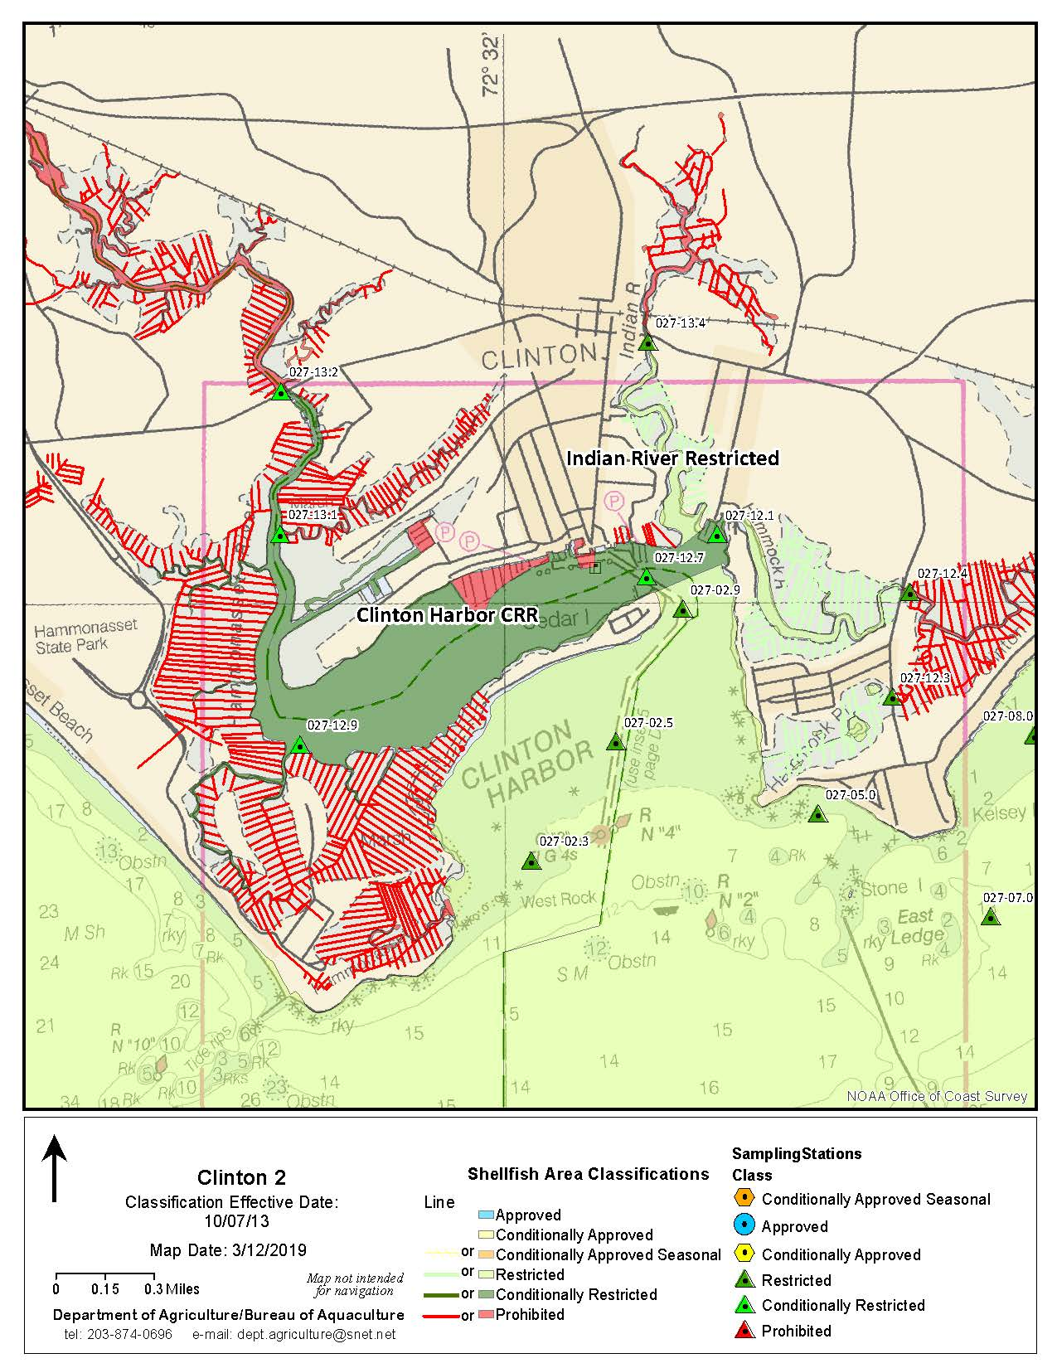
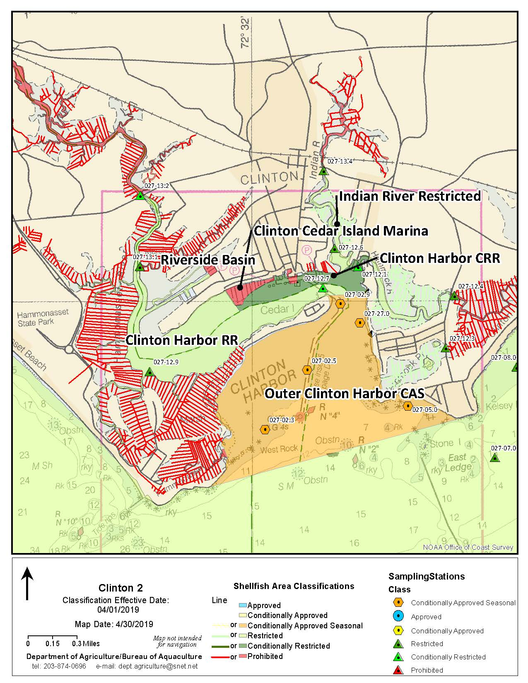
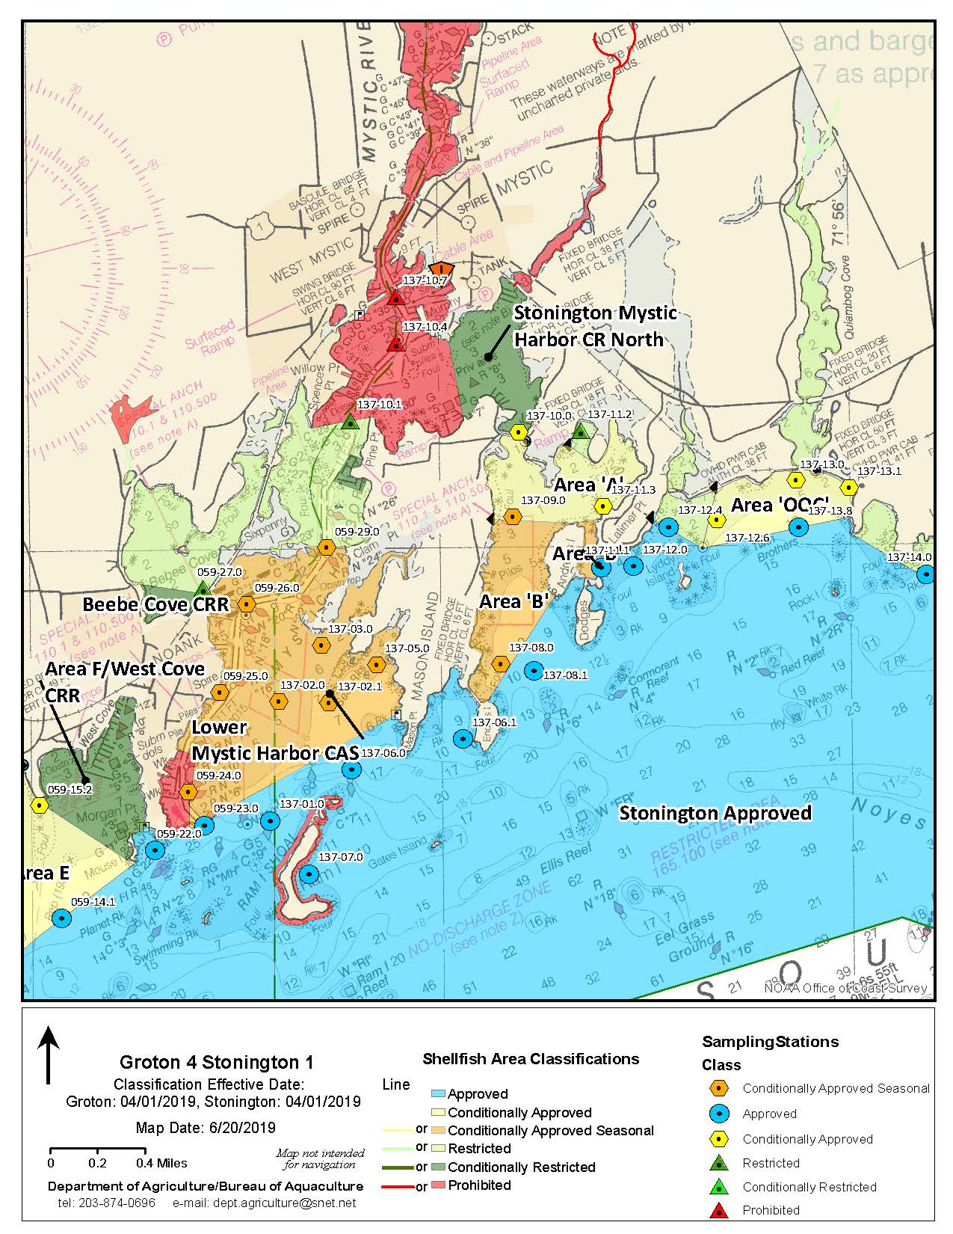

Slide 17
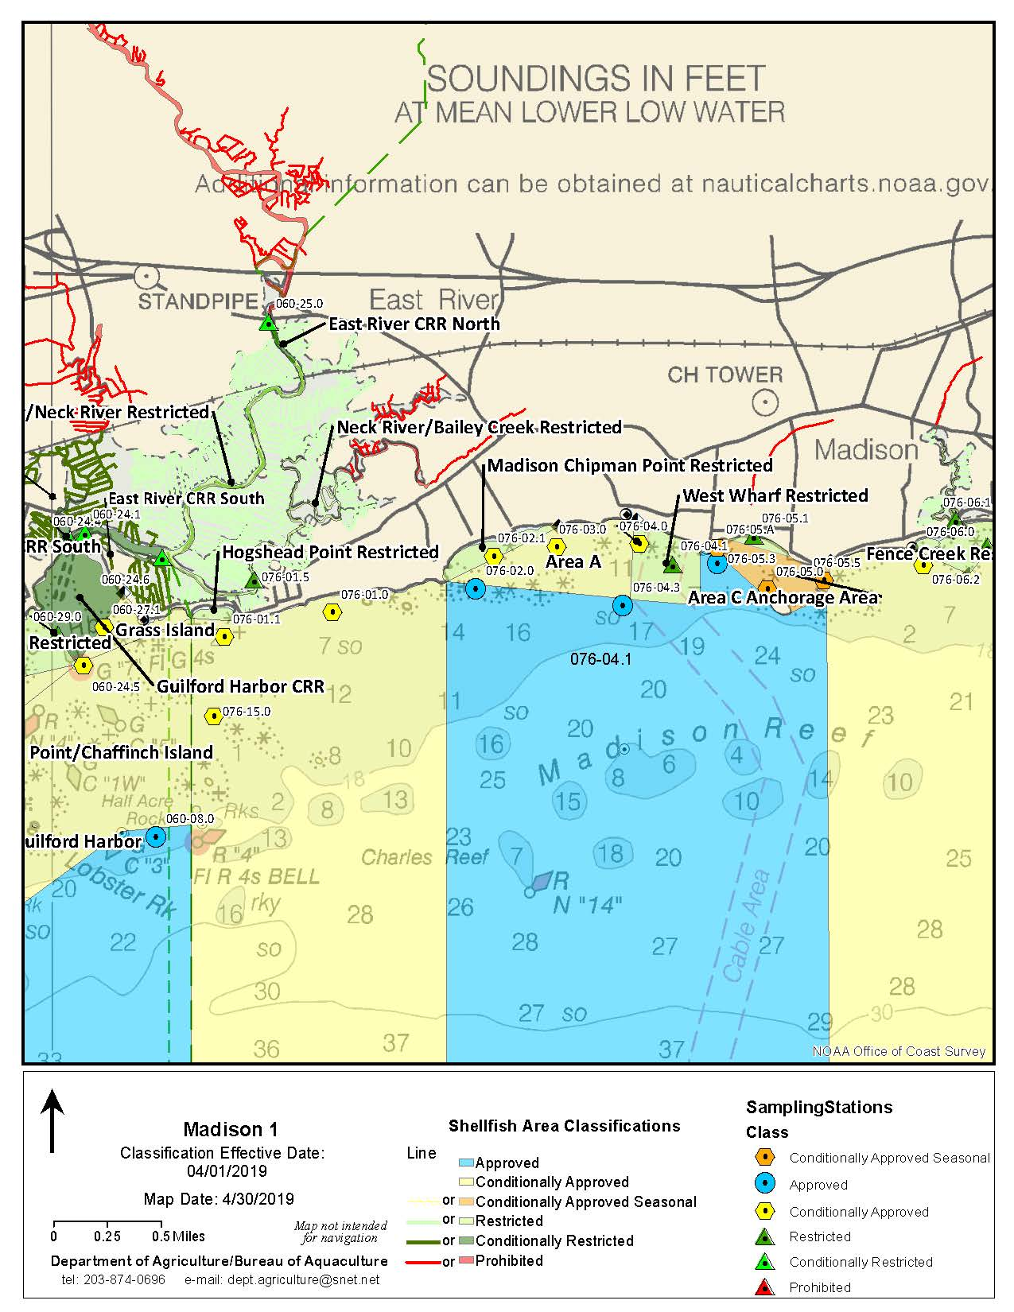
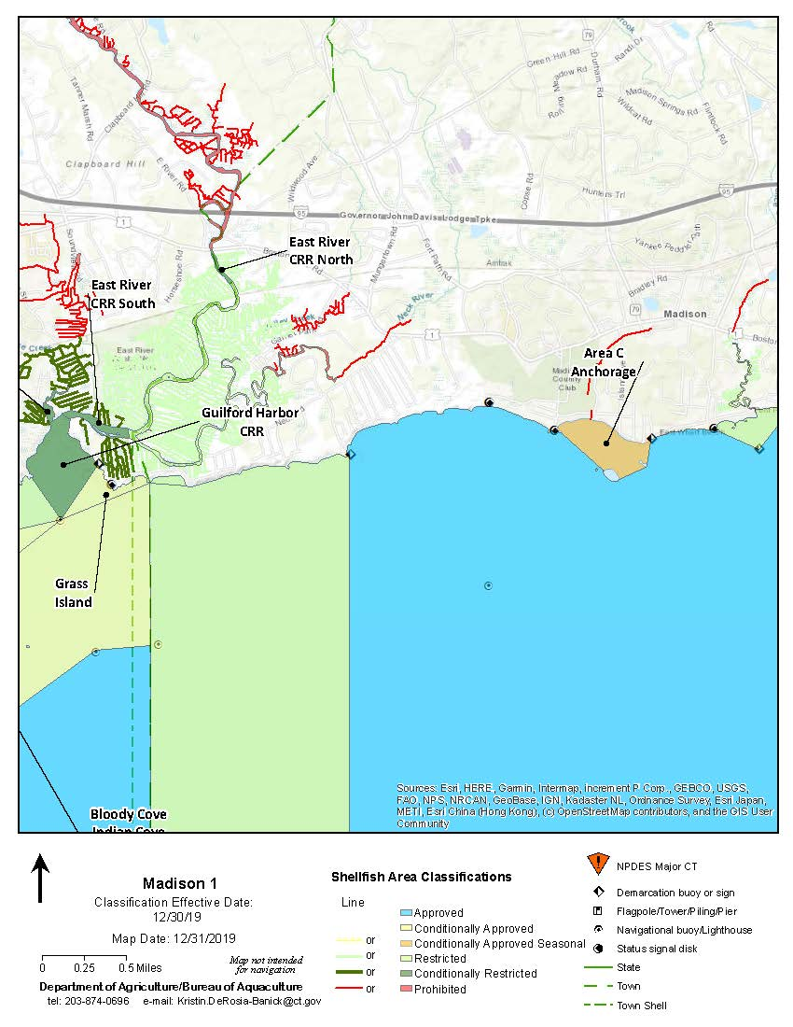
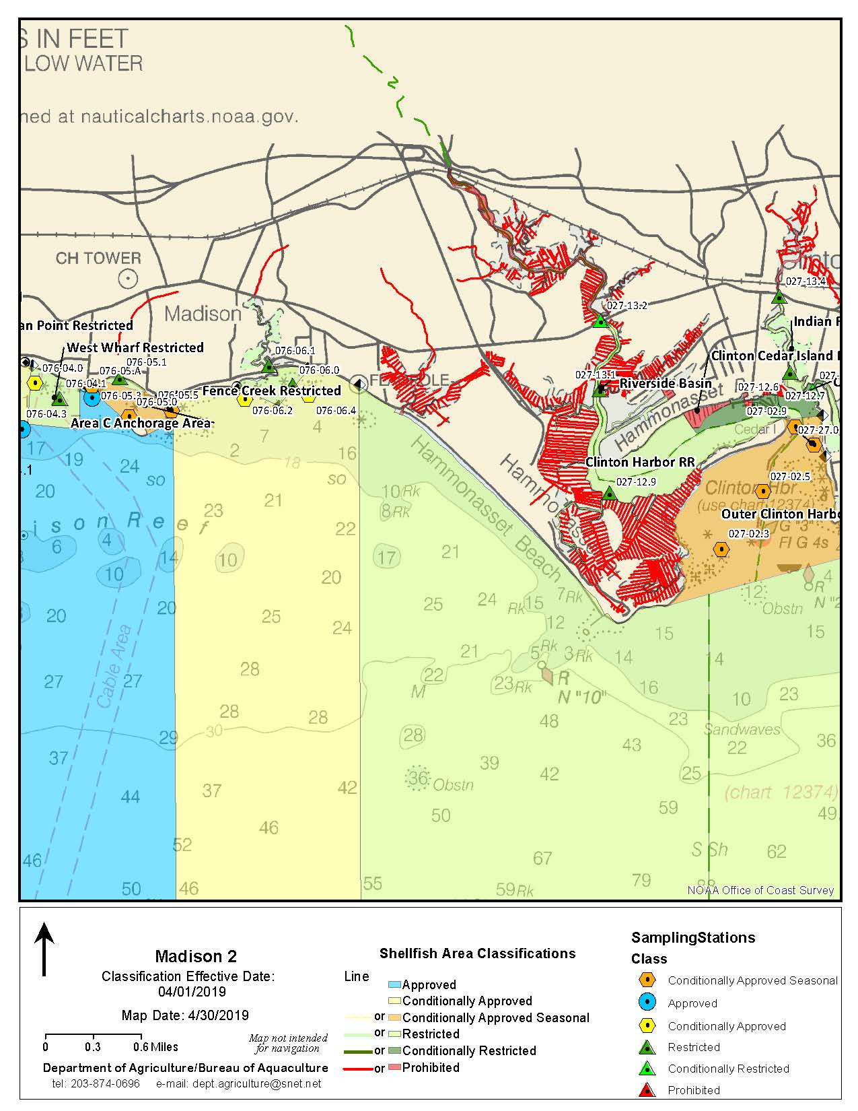
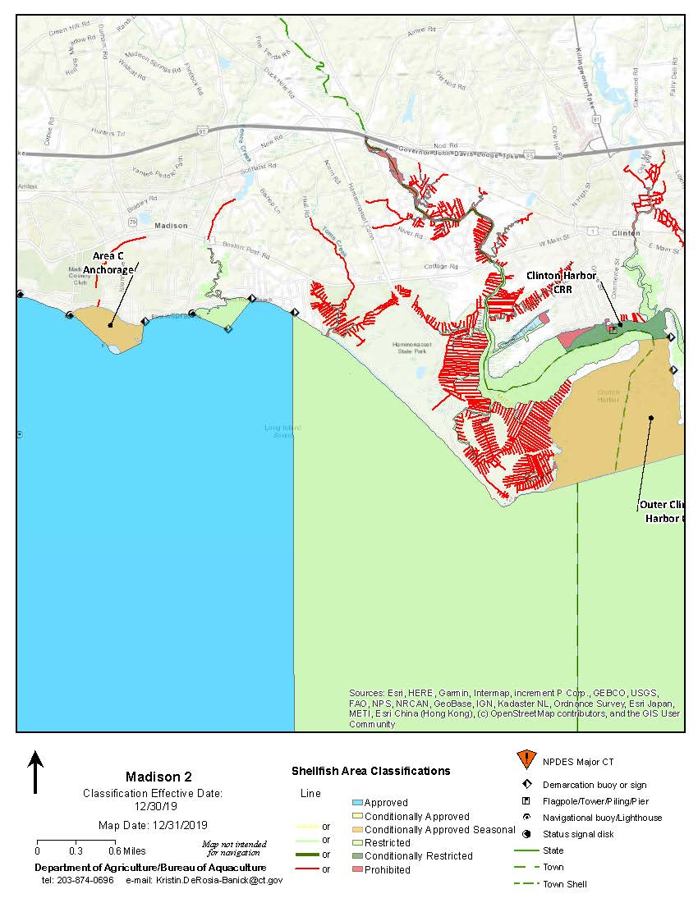

Slide 18
