Slide 1
Ingestion and Depuration of Microplastics by Marine Bivalves
Vena Haynes, J. Evan Ward, Kayla Mladinich, and Bridget Holohan
University of Connecticut Avery Point
Department of Marine Sciences
Groton, CT 06340

Slide 2
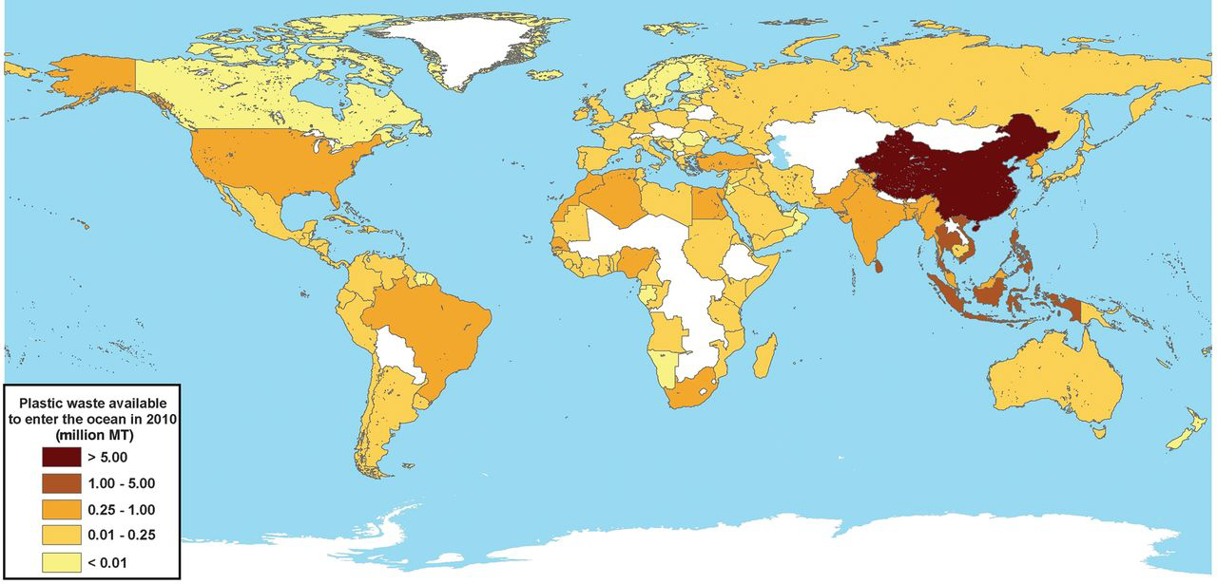
Plastic debris in the oceans
Current estimate of mismanaged plastic waste input to the oceans since 2010 = 100 million metric tons
populations living within 50 km of a coast in 192 countries
Jambeck et al. 2015 - Science

Slide 3
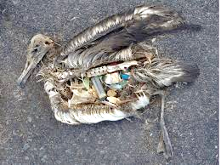
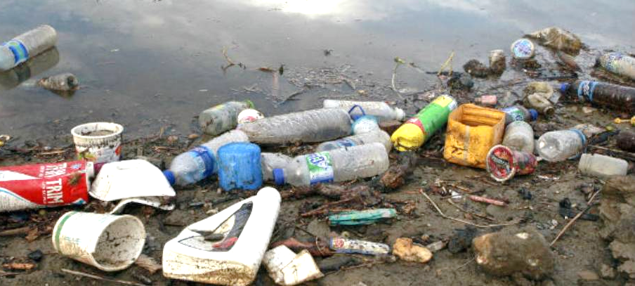
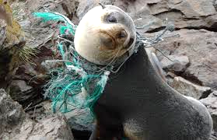
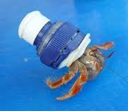
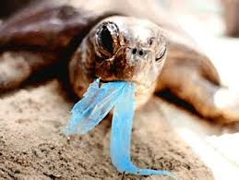
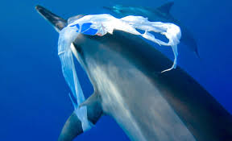
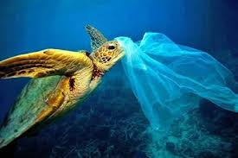
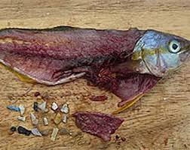
Impacts on marine animals
> 800 species contaminated by plastics entanglement, colonization, and ingestion
mammals, birds, aquatic invertebrates

Slide 4
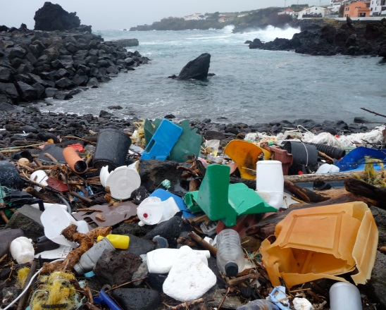
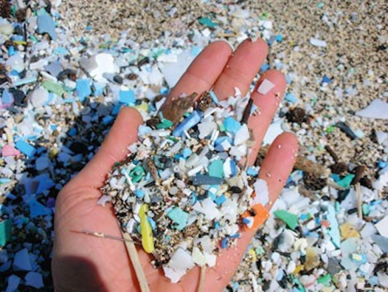
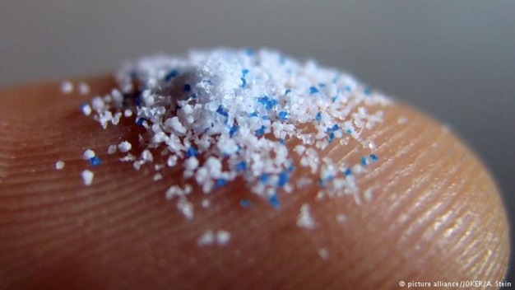
Microplastics
Plastics particles smaller than 5 mm
Primary microplastics from personal care products (microbeads)
Secondary microplastics from degradation of larger plastics debris
polyester & polypropylene microfibers
polystyrene angular & spherical particles

Slide 5
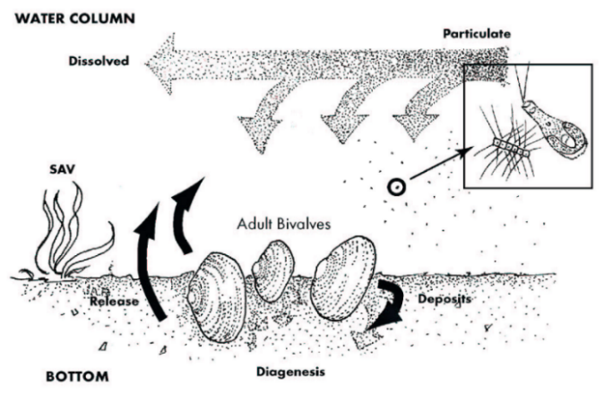
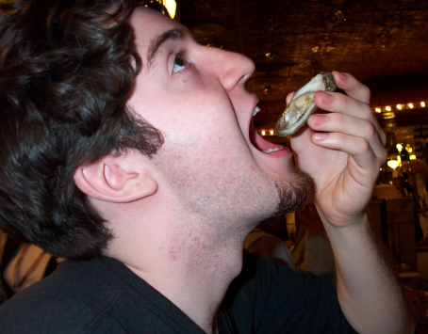
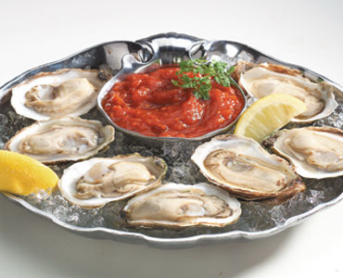
Shellfish contamination…?
Bivalves are ecologically important
Filter feeding: 1-2 gal/hr (e.g. adult oyster)
Potential to accumulate microplastics
Negative impacts
Bivalves are consumed by animals of higher trophic levels
Transfer of pollutants to humans possible
jonrowley.com

Slide 6
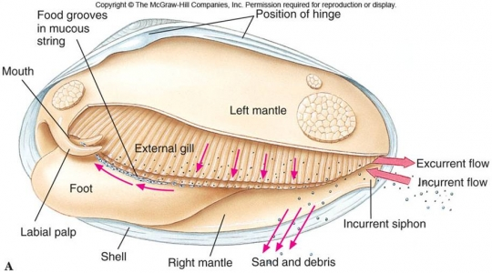
Background – relevance
Bivalves are discriminant filter feeders
Not retained – remain in water column
Selected against – “spit out” and sink to the bottom
Ingested – accumulation & effects possible
(LinkedIn Learning)

Slide 7
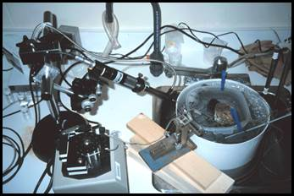
Background – aggregates & bivalves
Capture & handling of agglomerations & aggregations
in vivo observations using video endoscopy
No studies have examined accumulation and elimination of nano- and micropolystyrene after a longer term exposure
?
?
?
?
?
?
Notes:
Frontal ciliary tracts of ordinary filaments are divided into a central, ventrally directed coarse tract, flanked on either side by a dorsally directed fine ciliary tract.

Slide 8
Objective
Determine the ability of Mytilus edulis to ingest, accumulate, and depurate nano- and micro-polystyrene over a 3-week period
Polystyrene

Slide 9
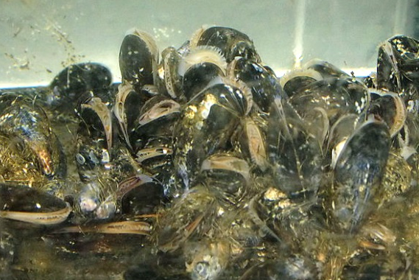
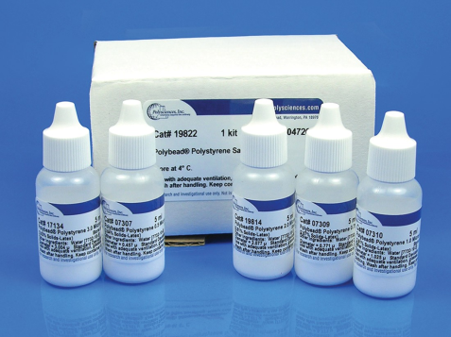
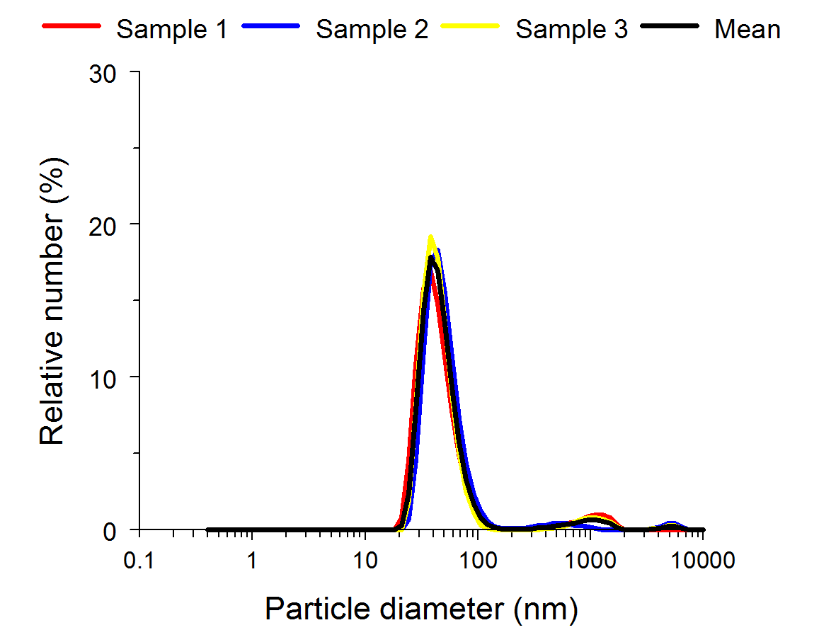
Approach
Mussels (ca. 3 cm) collected from local population
Acclimated in natural, flowing seawater 1 week
Fluorescent polystyrene spheres
Aged 3 days in seawater
No biocides or surfactants
Size of polystyrene spheres (DLS)
Micro = ca. 5 µm
Nano = ca. 40 nm
Concentration of polystyrene spheres
Ca. 0.1 mg/L/hr/day
(but ca. 2 µm agglomerates)

Slide 10
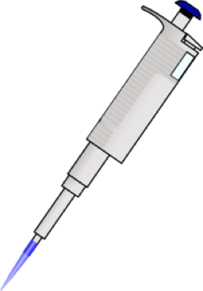
Design
Three treatments established
Food only - 50/50 mix Tetraselmis &
Shellfish Diet (20,000 cells/ml)
Micro-polystyrene & food
Nano-polystyrene & food
Exposure period
Mussels dosed 4x a day
Feces collected & pooled (1-7 day; 8-14 day)
Water changed every day
Animal samples collected after 7 & 14 days
Depuration period
Food only
Feces collected separately for each day
Animals collected after 7 days

Slide 11
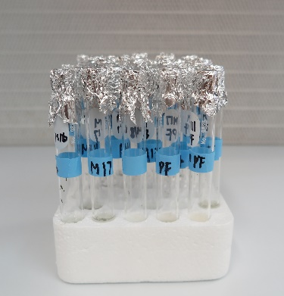
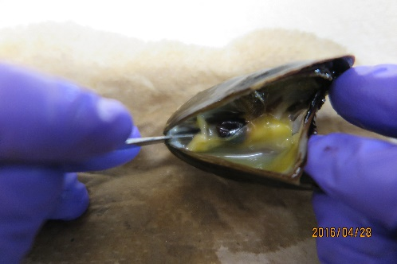
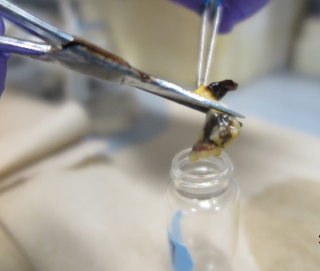
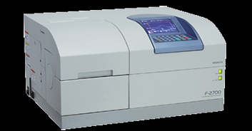
Analyses
Tissue and Feces samples
Digested in NaOH (7 days)
Fluorescence spectroscopy
Samples and blanks
Mass determined by standard curve
Notes:
Nano: Ex 593 nm; Em 612 nm
Micro: Ex 530 nm; Em 568 nm

Slide 12
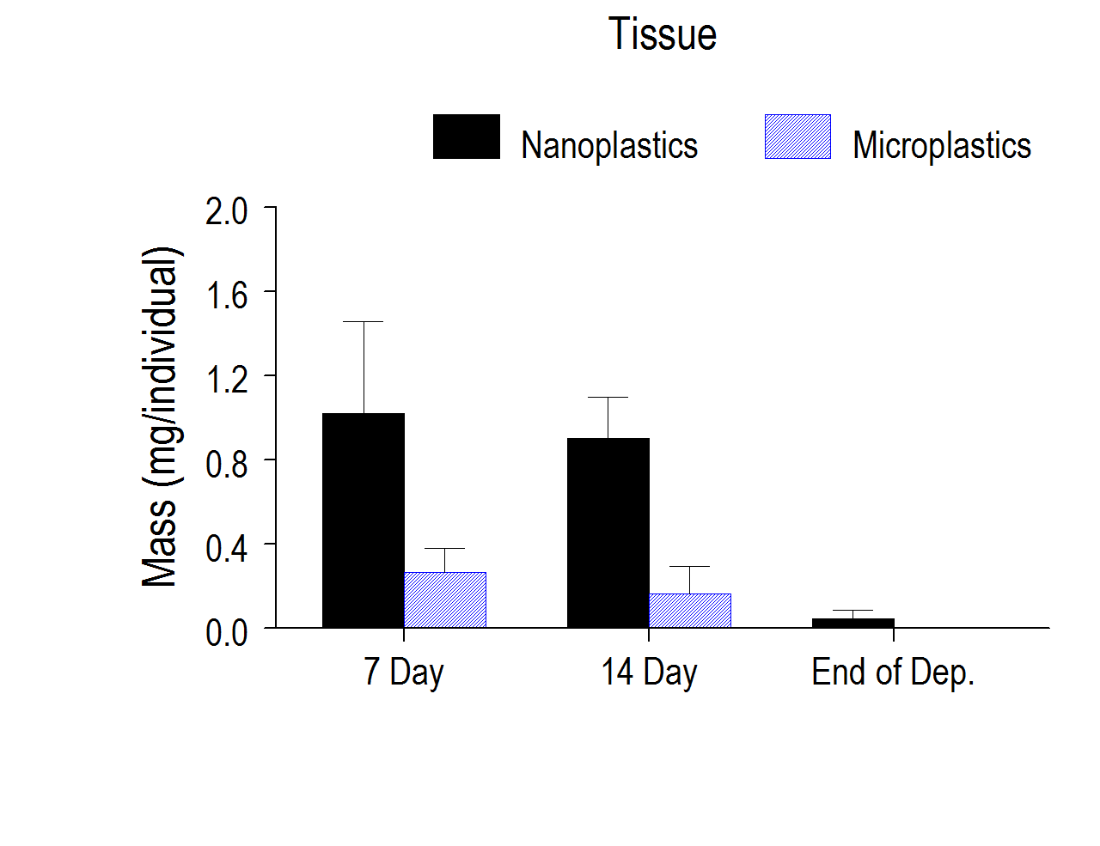
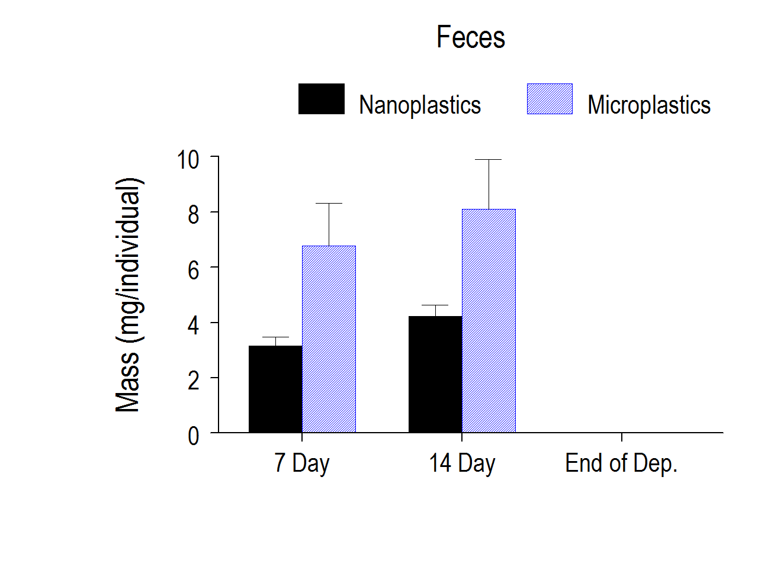
Outcome
Tissue
Retention of nano-polystyrene > micro (7 & 14 days)
No difference in retention between 7 and 14 days
Residual amounts of plastics at end of depuration
*
*
BDL
Feces
Egestion of micro > nano-polystyrene (7 & 14 days)
No difference in egestion between 7 and 14 days
Residual amounts of plastics at end of depuration
*
*
Data are means +/- SD (n=6-9)
Notes:
Measurement were terminated after oxygen fell below 70% of saturation. With the microcathode, low permeability polypropylene membranes there is no need to stir the water. Also, normal pumping of water by mussel is more than sufficient.

Slide 13
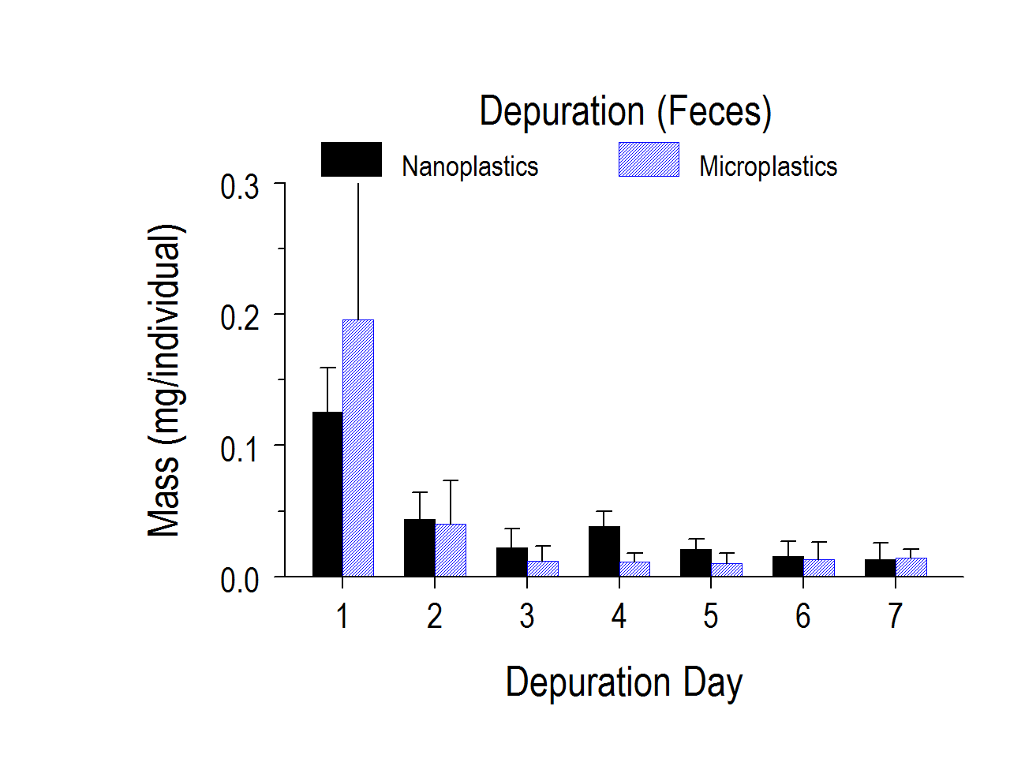
Outcome
Concentration in feces shows rapid depuration of nano- and micro-polystyrene
Nano-polystyrene depurate a bit slower
Overall: ingestion of micro-polystyrene > nano-polystyrene
Micro-polystyrene mean = 8.25 mg (14 days)
Nano-polystyrene mean = 5.12 mg (14 days)
Data are means +/- SD (n=6-9)
Notes:
Ammonium excretion rate was calculated taking into account blanks, volume of seawater and time.

Slide 14
Conclusions
Mussels capture and ingest plastic particles
Lower ingestion for nano-polystyrene
Higher ingestion for micro-polystyrene
Depuration of both nano- and micro-polystyrene is rapid
Nano: > 60% after 1 day
Micro: > 80 % after 1 day
No bioaccumulation of plastic detected after 14 days of exposure
Corroborates our short term (hrs) studies

Slide 15
Take-home points
Bivalves are poor bioindicator for plastics pollution
Not all microplastics are captured at same efficiency
depends on size
may depend on surface properties
Not all microplastics that are captured are ingested
large aspect ratio particles tend to be rejected
surface coating & charge affect ingestion
Bigger threat to bivalves may be additives and chemicals associated with microplastics

Slide 16
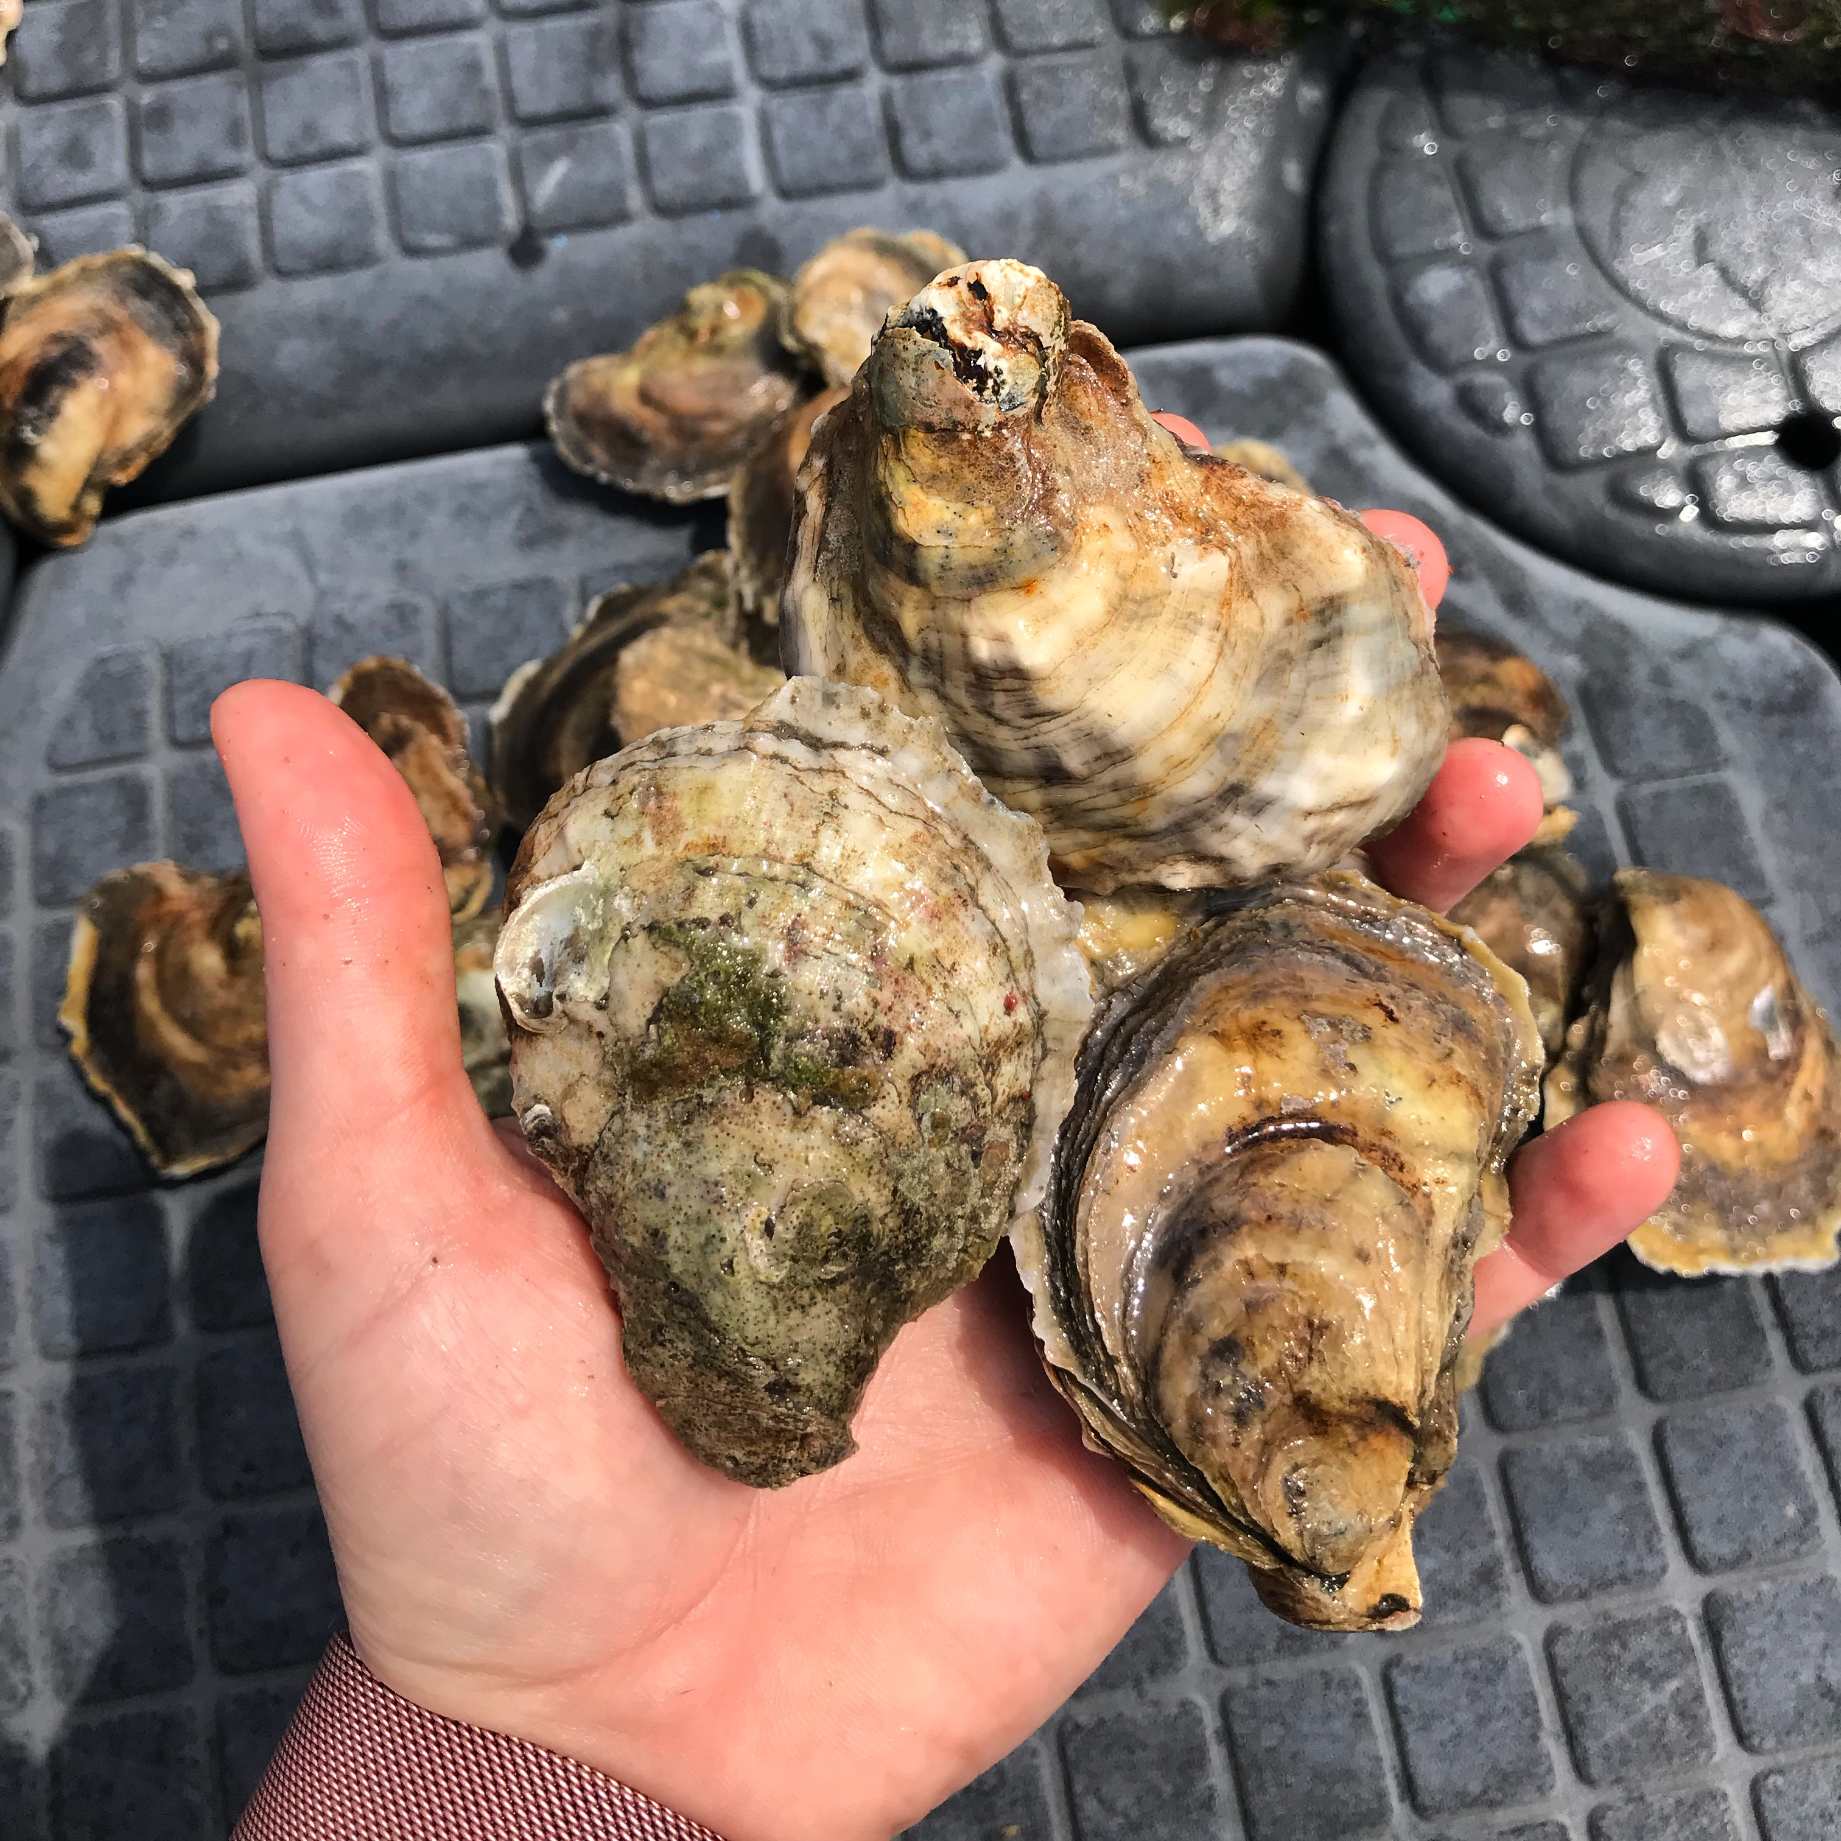
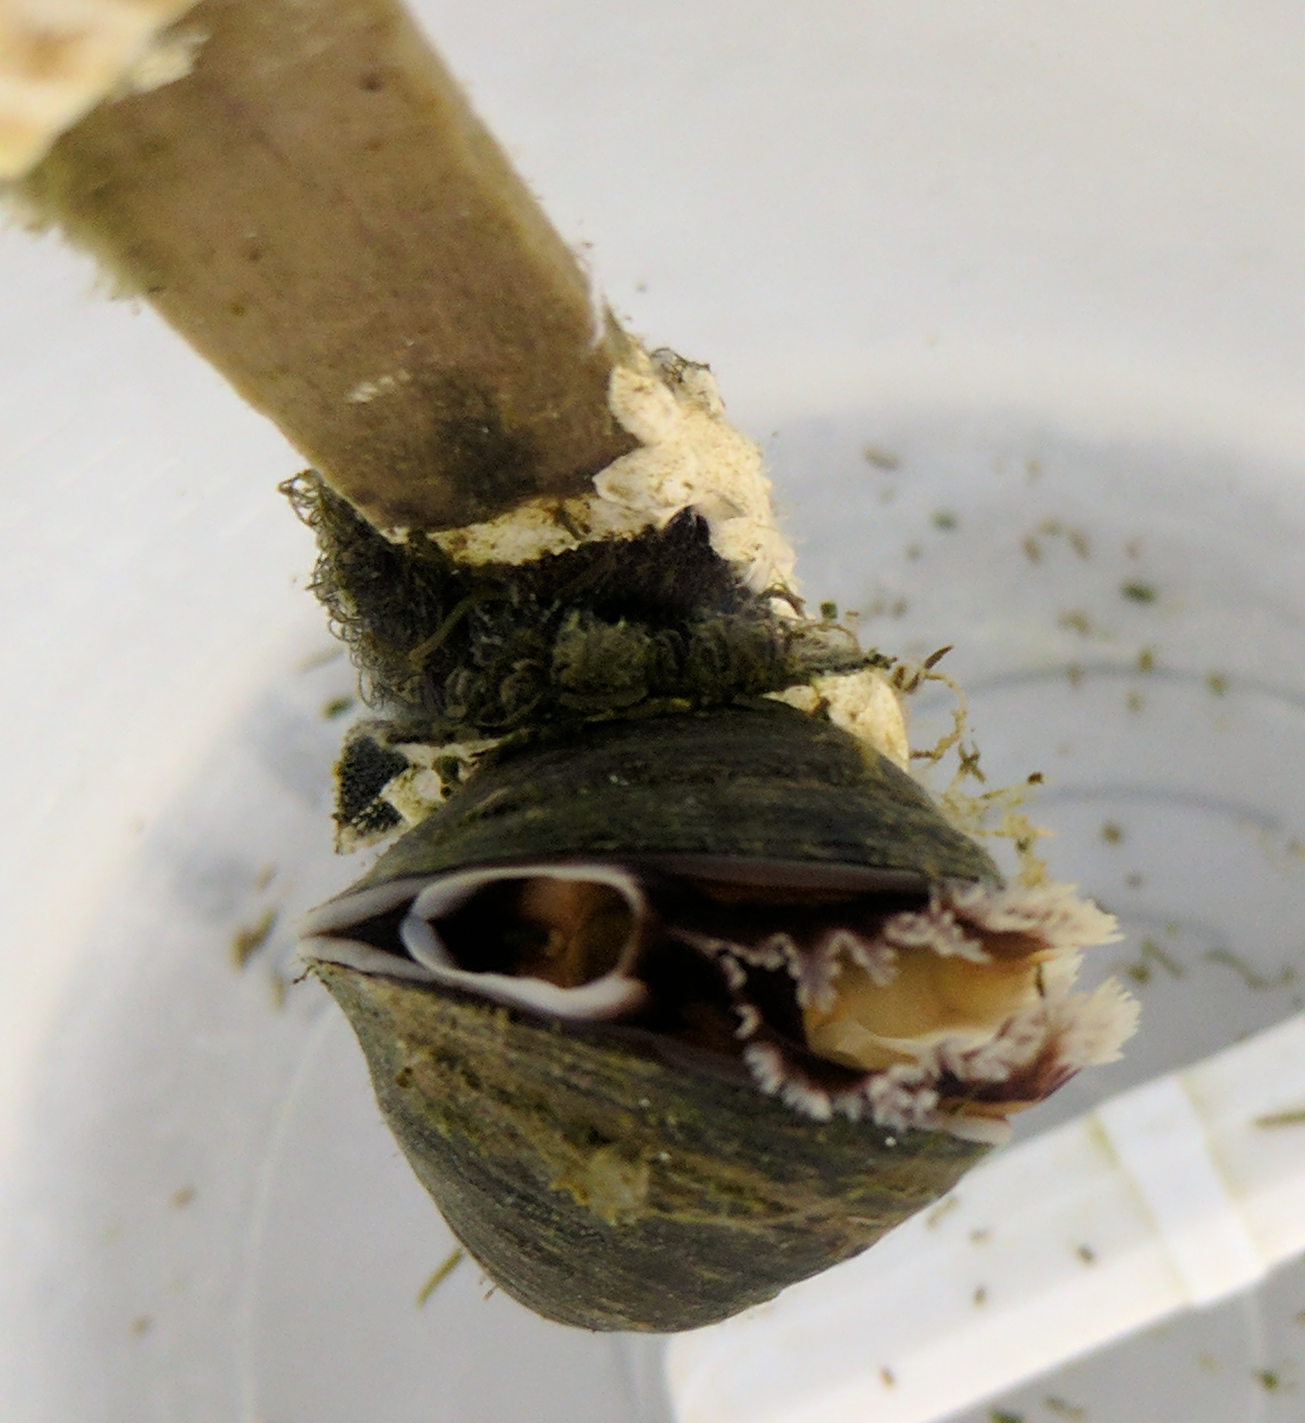
Current work
Oysters
3 week study with nano- and micro-polystyrene
Complete biokinetic models
Acknowledgements
We would like to thank Abigail Plugnis and Tyler Griffin for laboratory assistance.
Notes:
Lower ingestion of nano
Reject fibers (100-300 um)… Herrick and Ward unpublished
Agrees with acute exposure

