Slide 1
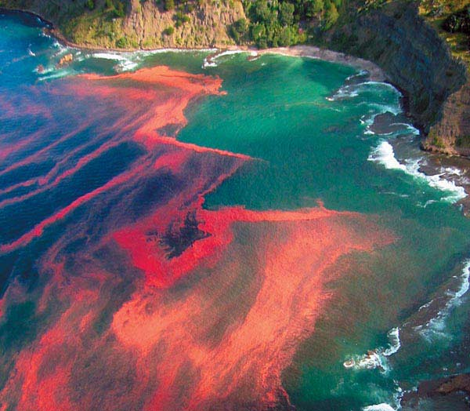
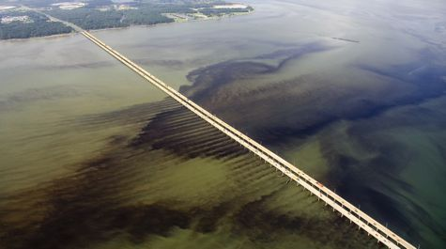
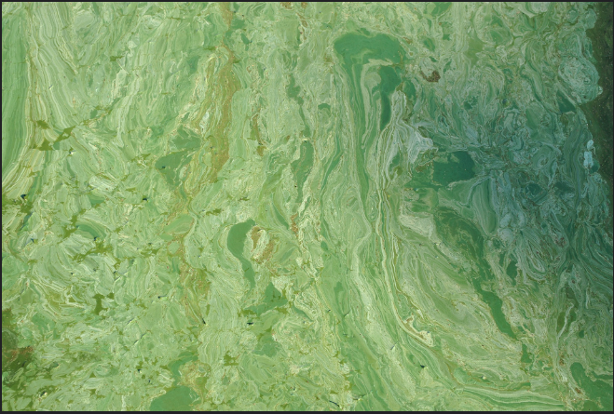
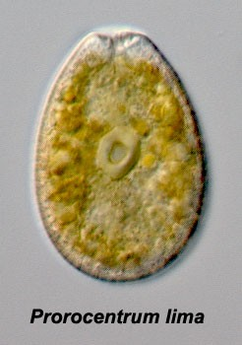
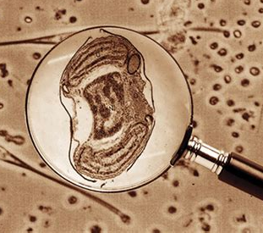
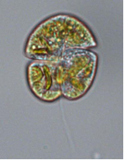
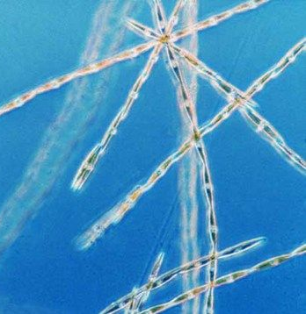
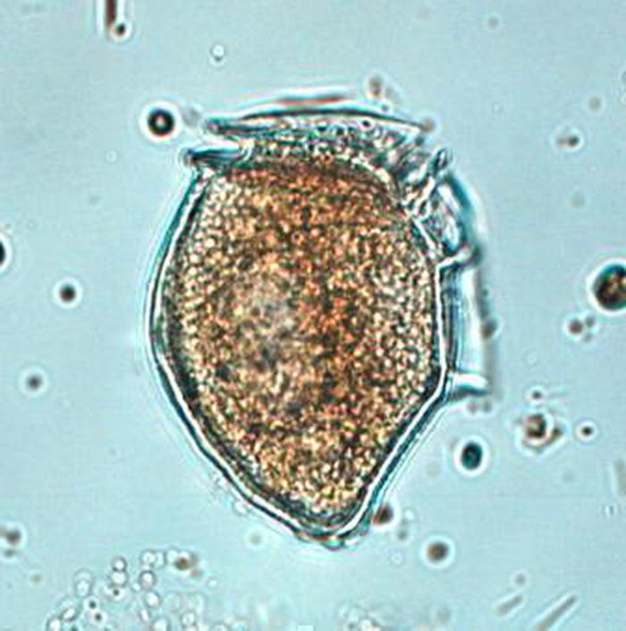
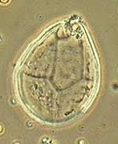
Harmful Algal Bloom Update
Connecticut Department of Agriculture
Bureau of Aquaculture
Emily Van Gulick, Fisheries Biologist I
Notes:
Top: HABs: (1) red tide in New Zealand, Noctiluca scintillans (non-toxic); (2) Alexandrium monilatum bloom in Virginia; (3) Emiliania huxleyi in Europe; (4) Aphanizomenon in Florida (cyanobacteria)
Bottom: HAB species: (1) Prorocentrum lima; (2) Aureococcus anophagefferens; (3) Karenia mikimotoi; (4) Pseudo-nitzschia; (5) Alexandrium fundyense; (6) Dinophysis norvegica; (7) Ostreopsis

Slide 2
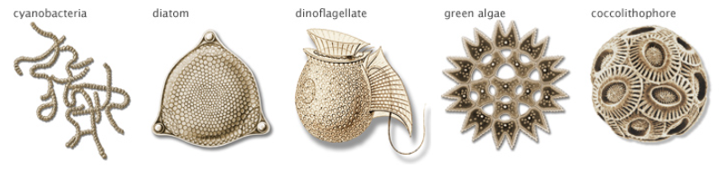
What are phytoplankton?
Act as base of marine food webs
Feed shellfish and other filter feeders
Produce 50% of oxygen on Earth
Critical for marine nutrient cycling

Slide 3
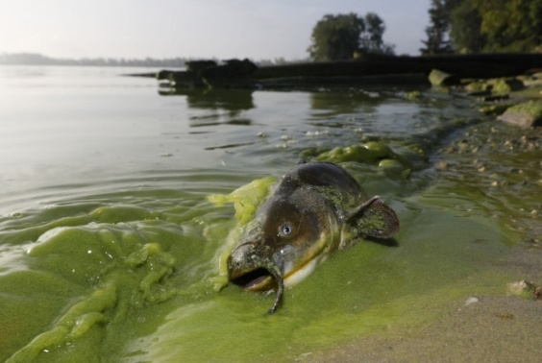
What is a harmful algal bloom (HAB)?
Are detrimental to human health, the environment and/or the economy
Can be associated with the production of toxins and/or other “harmful” substances
Can be associated with discolored water and/or marine animal kills
Usually not predictable
Traditional HAB patterns may be changing/ emerging HABs have appeared in new areas

Slide 4
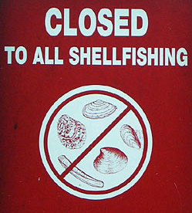
How do they impact the shellfish industry?
X
Harmful algal bloom

Slide 5
Marine Biotoxins
Toxins CANNOT be removed from shellfish with post-harvest processing (e.g. cooking, freezing, etc.)
Toxins do not alter the taste, smell, or appearance of shellfish
There are no antidotes available for patients that have consumed toxin-contaminated shellfish
Supportive care only
Many shellfish toxin illnesses in U.S. are associated with illegal recreational harvesting in closed beds

Slide 6
U.S. Harmful Algal Bloom (HAB) Trends
Notes:
HABs impact every single state in the US, and they are increasing in frequency and intensity around the world.

Slide 7
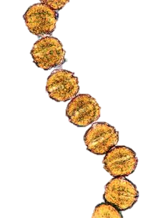
HAB genus | Toxin | Syndrome | Potential effects
Alexandrium “New England red tide” | Saxitoxin Potentially lethal | Paralytic Shellfish Poisoning (PSP) | Tingling, numbness, burning in extremities or mouth; lack of coordination/staggering; drowsiness; fever; rash; respiratory difficulty and/or arrest; death -Gastrointestinal: Nausea, vomiting, diarrhea

Slide 8
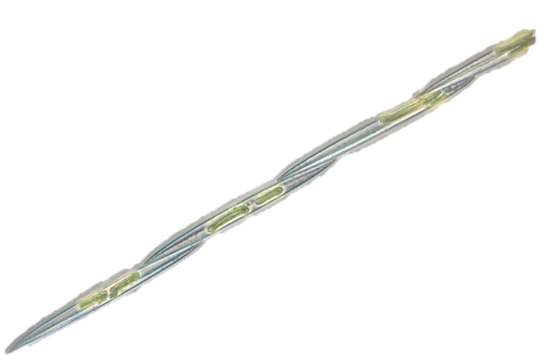
HAB genus | Toxin | Syndrome | Potential effects
Pseudo-nitzschia | Domoic acid Potentially lethal | Amnesic Shellfish Poisoning (ASP) | -Dizziness; headache; disorientation; short-term memory loss; seizures; respiratory difficulty; coma; long-term neurological damage, including memory defects and weakening/death muscles in extremities; death -Gastroenteritis usually develops within 24 hours of consumption – nausea, vomiting, abdominal cramps, diarrhea

Slide 9
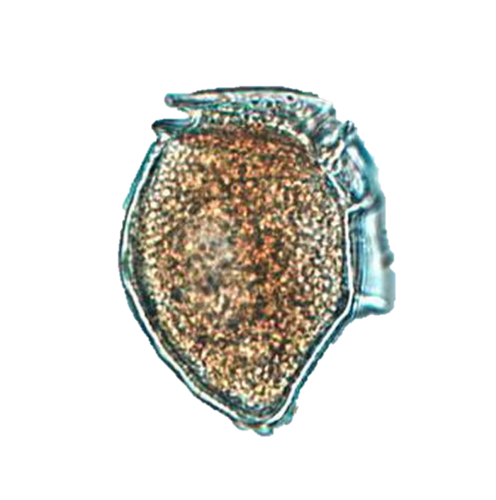
HAB genus | Toxin | Syndrome | Potential effects
Dinophysis | Okadaic acid | Diarrhetic Shellfish Poisoning (DSP) | -Gastrointestinal onset within 30 mins-few hours of consumption: Incapacitating diarrhea, nausea, vomiting, abdominal pain; recovery typically within 3 days -Potential association with cancer (long-term exposure)
Prorocentrum

Slide 10
Local Biotoxin Closures
PSP
May-July
1985, 1992, 2003
ASP -
October 2016
March 2017
PSP - 2006,
2008-2013, 2019
PSP 2012, 2015
PSP
2012, 2013
DSP - 2011
DSP – 2013
PSP 2015, 2019
PSP - 2011, 2012, 2015

Slide 11
Global Toxin Illness Cases (1970-2010) (Visciano et al. 2016)

Slide 12
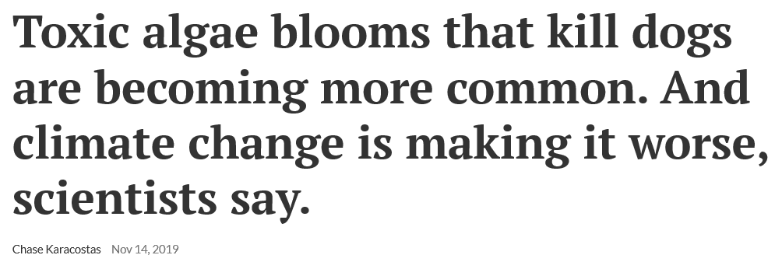
The cost of HABs
HABs are estimated to cost the U.S. $83 million annually (Hoagland et al. 2002)
Notes:
The cost of HABs extend beyond economic losses – they also have social, psychological, and political costs.

Slide 13
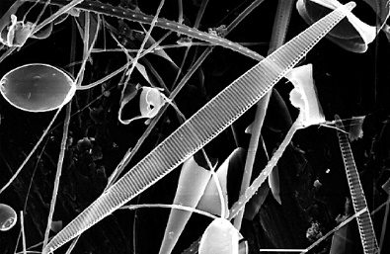
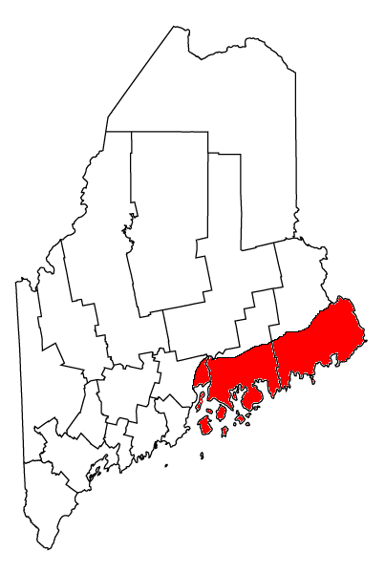
The appearance of ASP in New England
Pseudo-nitzschia australis was not reported in the Northeast until 2016 and has one of the highest recorded domoic acid concentrations
Sudden massive, toxic blooms appeared in 2016 from Maine to Rhode Island
Mussels, quahogs, clams, European oysters recalled after some areas >80ug DA/100g shellfish tissue
9/30/2016 - Maine recalls 5 tons mussels and clams
Closures persisted for months

Slide 14
Pseudo-nitzschia australis
October 2016 – Massachusetts and Rhode Island implement precautionary ASP closures
Highest concentrations reach 2,000,000 cells/L in lower Narragansett Bay, RI
Initial testing showed no signs of domoic acid, causing RI to re-open growing areas – 10 days later, domoic acid was detected, prompting another closure
Notes:
RIDEM 2016 P-n bloom in RI waters presentation
https://www.pressherald.com/2018/04/10/state-ready-to-close-shellfish-areas-at-first-sign-of-toxins/

Slide 15
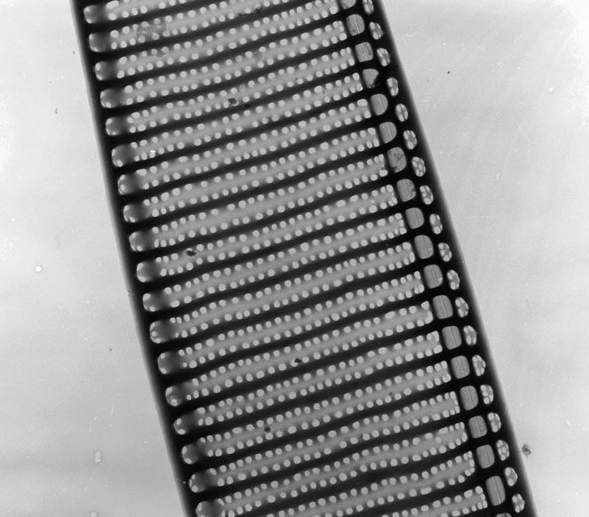
Pseudo-nitzschia australis
March 1, 2017 – Spring bloom and domoic acid closures in Rhode Island
DA levels reached 32 ug DA/g tissue
P. australis confirmed in RI (Hubbard et al. 2017)

Slide 16
Pseudo-nitzschia australis
September 2017 – Maine closure, recall of product (Down East)
58,480 lbs mussels impacted and recalled
December 2017 – Maine late-season closure (Casco Bay)
Some closures extended into early 2018
2018 – Maine takes a more conservative approach – movement away from closure after tests show levels above FDA limit
Initiated weekly domoic acid testing
Toxin levels can spike from single digits to twice the federal limit within 1 week (Kohl Kanwit, Head Maine Public Health Division)
September 2018 – Maine precautionary closure (Down East)
Notes:
RIDEM 2016 P-n bloom in RI waters presentation
https://www.pressherald.com/2018/04/10/state-ready-to-close-shellfish-areas-at-first-sign-of-toxins/

Slide 17
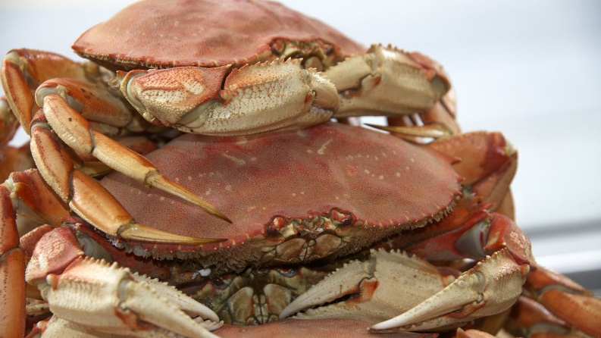
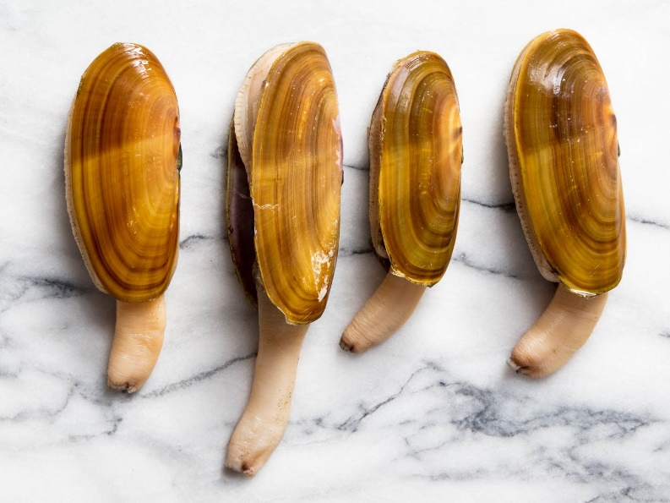
Pseudo-nitzschia on the U.S. West Coast

Slide 18
Pseudo-nitzschia in the U.S. West Coast
There are at least 123 fishing communities on the west coast
The spring/summer Pseudo-nitzschia bloom in 2015 was the largest spatially (extended from California to Alaska) and the longest duration of any toxic event that ever occurred in the region
The bloom was associated with an unusual “warm blob” that spread throughout the northwest
Closures extended from May 2015 to as late as spring 2016 in some regions

Slide 19
Pseudo-nitzschia in the U.S. West Coast
As many as 30,000 razor clam diggers will visit the Washington coast in a single day during the razor clam season (October-April)
As much as ~40% of the 2015-16 razor clam season was lost
Previous season-long closures have resulted in a loss of $24.4 million
Domoic acid concentrations were some of the highest ever reported in foraging fish and crabs
The Dungeness crab fishery opening was postponed for 1 month in Washington and Oregon + 6 months in California = loss of $97.5 million
Even after closures ended, some regions experienced reduced ex-vessel crab prices

Slide 20
Pseudo-nitzschia in the U.S. West Coast
HABs on the west coast are associated with eroded cultural identity, negative physical and mental health, decreased life expectancy, increased poverty, alcoholism, drug use, reduced confidence in seafood safety, and losses in the tourism and recreation sectors.
Should HABs be treated as natural disasters going forward?
May 2015 – closures start
February 2016 – Governor of California requested federal disaster assistance
January 2017 – Secretary of Commerce declared the disaster, enabling disaster relief funds to be appropriated
January 2018 – funds appropriated to individuals who purchased Dungeness crab licenses
Received $14.2 million years after the request for $48.3 million

Slide 21
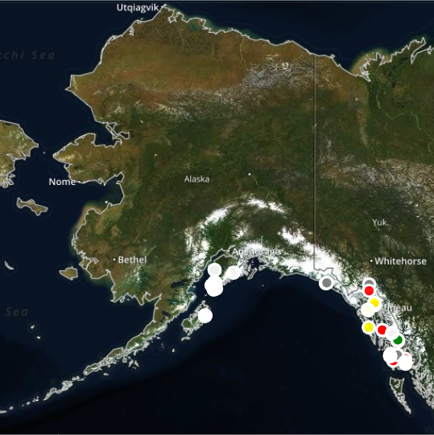
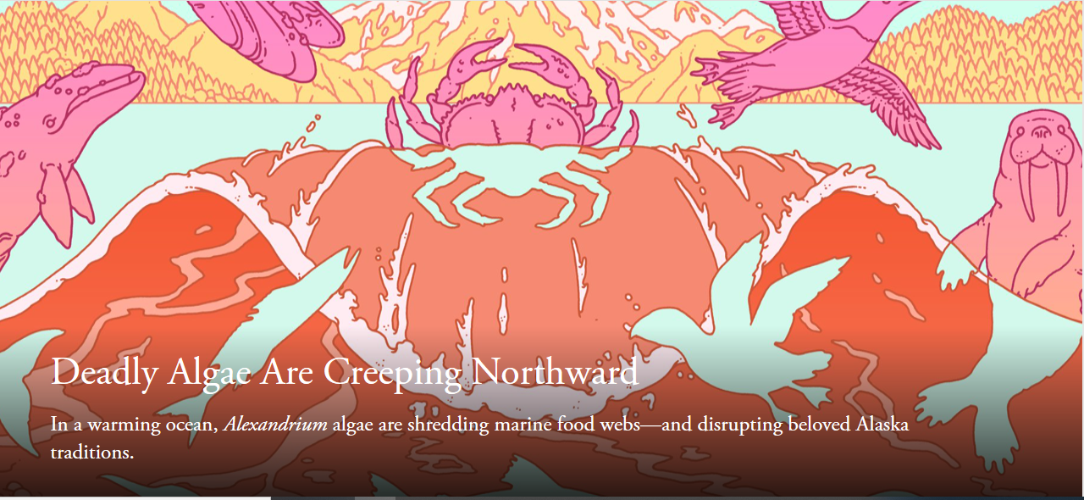
Emerging PSP issues in Alaska
d

Slide 22
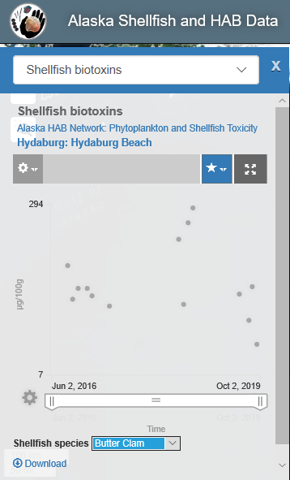
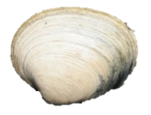
PSP in Alaska
Regulatory limit 80 ug saxitoxin/100g shellfish
120-180 ug saxitoxin produces moderate symptoms (ANZFA 2001)
Butter clams over the regulatory limit for multiple years
80
Notes:
https://www.foodstandards.gov.au/publications/documents/TR14.pdf

Slide 23
PSP in Alaska
Regulatory limit 80 ug saxitoxin/100g shellfish
120-180 ug saxitoxin produces moderate symptoms (ANZFA 2001)
400-1,060 ug saxitoxin can cause human death (ANZFA 2001)
From June 30, 2018 – April 23, 2019, paralytic shellfish toxins ranged from 116 – 1,119 ug STX/100g shellfish
Nov 12, 2019 – 116 ug STX/100g shellfish
80
Notes:
https://www.foodstandards.gov.au/publications/documents/TR14.pdf

Slide 24
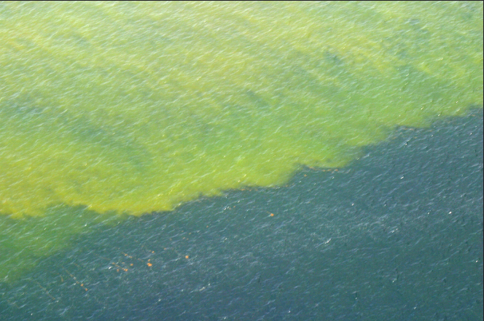
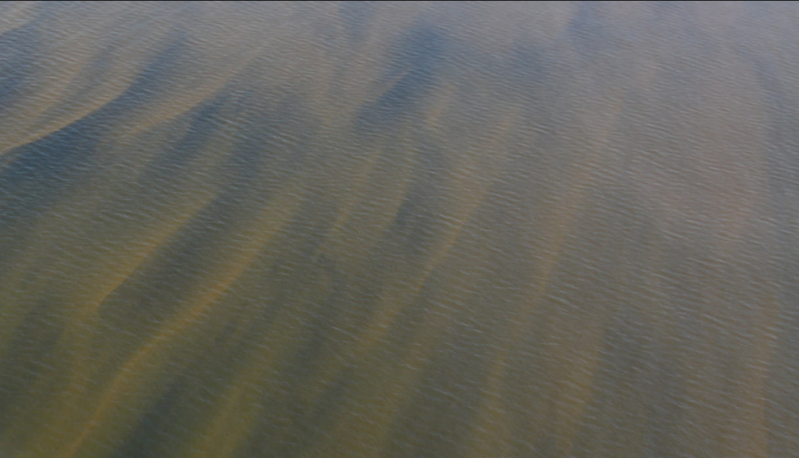
HAB genus | Toxin | Syndrome | Potential effects
Karenia “Florida Red Tide” | Brevetoxins | Neuro-toxic shellfish poisoning (NSP) | -Numbness, tingling and/or burning in extremities or face/mouth; lack of coordination; partial limb paralysis; hot/cold reversal; slurred speech; headache; pupil dilation; fatigue -Gastrointestinal symptoms: mild-moderate nausea, vomiting, abdominal cramps, diarrhea -Very rare symptoms: respiratory discomfort/ distress; in extreme cases, seizures, coma, convulsions, loss of consciousness, tachycardia
Can also be exposed to aerosolized brevetoxin on/near the beach

Slide 25
Florida 15 month Karenia bloom (2017-19)
Sept. 2018
Oct. 2018
Nov. 2018
October 2017 – Karenia bloom initiated offshore
By August 2018, the bloom stretched more than 150 miles
Spread to the east coast of Florida by October 2018 following Tropical Storm Gordon
Some shellfish harvesting areas closed starting in November 2017
Dec. 2018
Jan. 2019
Feb. 2019

Slide 26
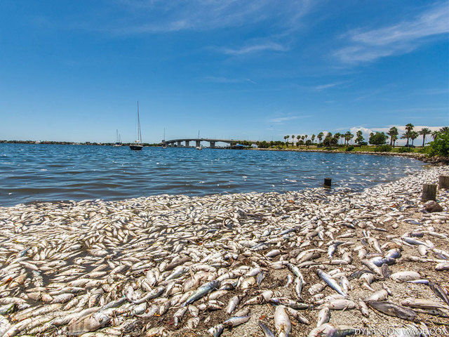
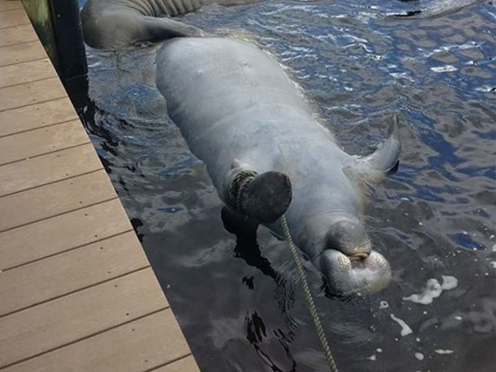
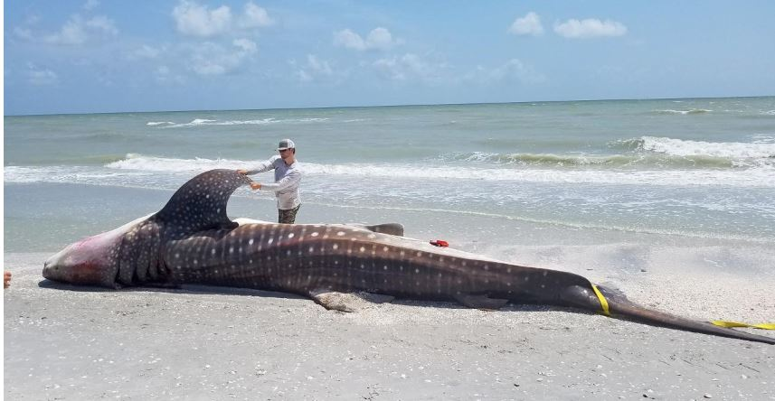
Impacts of Florida red tide
Florida Governor declared a state of emergency because the Karenia bloom lasted longer than any other in the past decade
The bloom killed hundreds of tons of marine life, including fish, marine mammals, sea turtles, and a whale shark
The bloom made national and world news
Negative local health and tourism impacts
Some shellfish growing areas were closed for more than 1 year

Slide 27
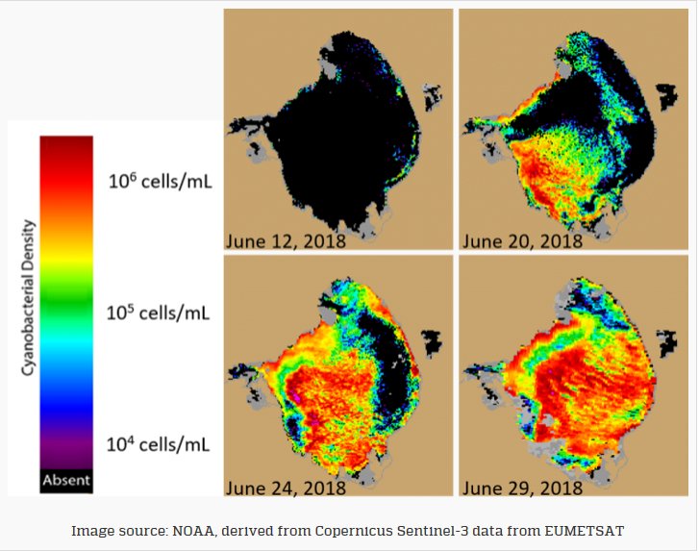
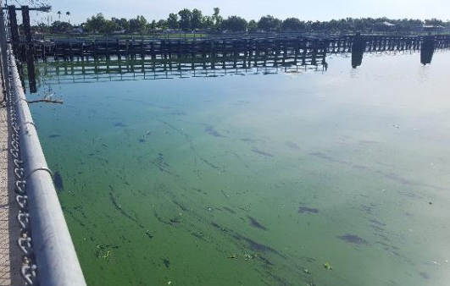
Management nightmare
Lake Okeechobee is Florida’s largest freshwater lake
Recurrent cyanobacteria (dominated by Microcystis aeruginosa) blooms occur in Lake Okeechobee and have been attributed to nutrient pollution from agriculture and urban influences
Microcystis aeruginosa produces microcystin (a hepatotoxin (liver toxin))
The World Health Organization considers microcystin levels below 10 μg/L to be safe for recreational contact – levels as high as 463.34μg/L were detected
Notes:
https://lakeokeechobeenews.com/lake-okeechobee/toxic-algal-bloom-found-in-caloosahatchee-river/

Slide 28
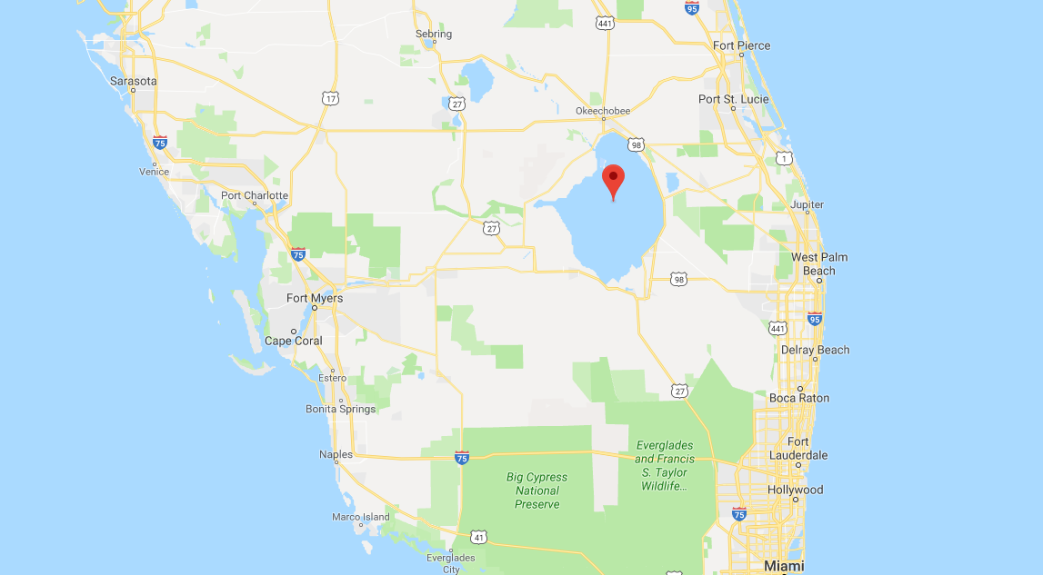
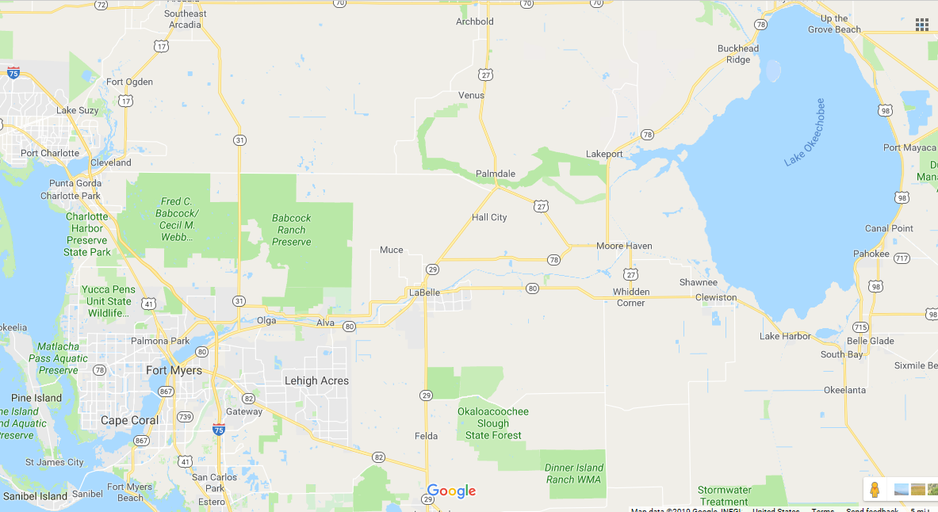
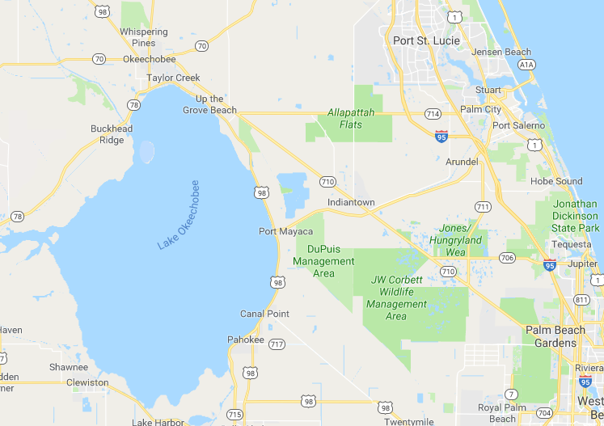
Management nightmare
2018 had high levels of rainfall – providing ideal conditions for cyanobacteria growth and requiring lake discharges to prevent the Herbert Hoover Dike from being compromised
Large-scale discharges from the canals connected to Lake Okeechobee on June 2nd, 2018
Combination and Karenia and Microcystis further confuses the public

Slide 29
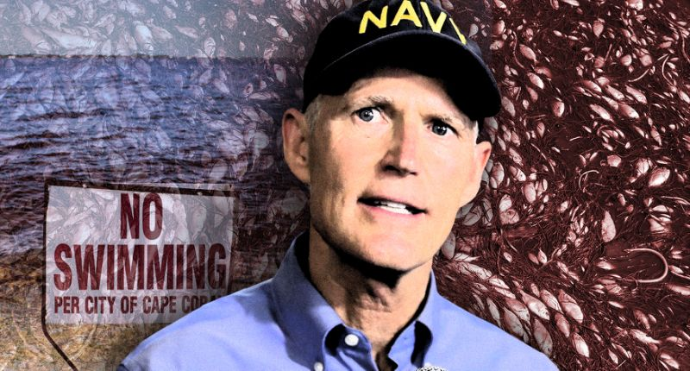
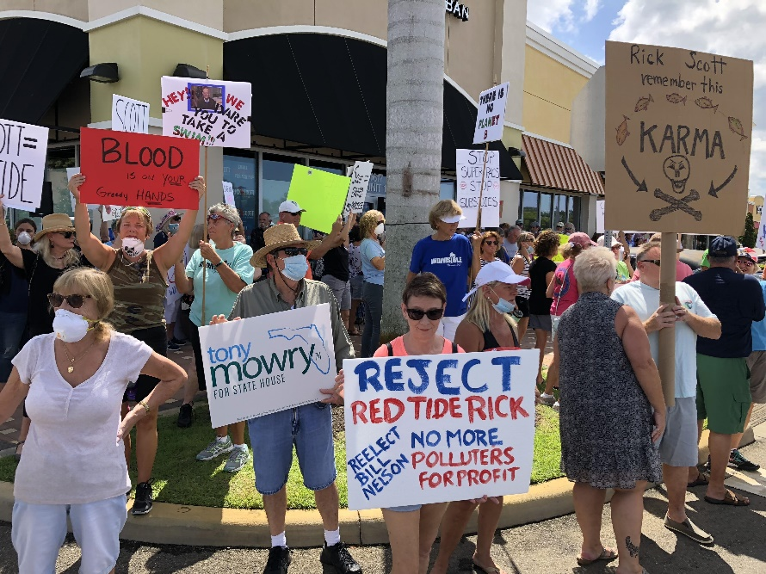
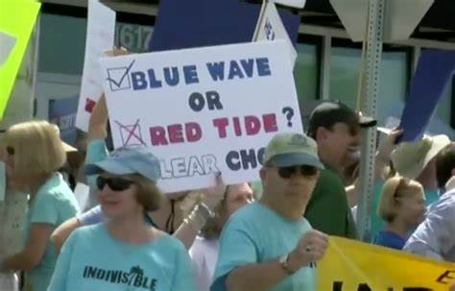
Notes:
Rick Scott cut $700 million from the state’s five water management boards. The agency that works on the Everglades restoration and advises the Army Corps of Engineers on Lake Okeechobee discharges had its budge slashed nearly in half, forcing it to lay off more than 100 people. Scott also supported repealing a 2010 law that required septic tanks to be inspected once every 5 years.
However, Scott did sign a $1.7 billion budget for the Department of Environmental Protection, an increase of $0.3 billion the previous year, and signed legislation for $50 million annually to protect springs and $200 million annually for Everglade restoration.
In August 2019, he declared a state of emergency and allocated more than $16 million to minimize the harmful effects of red tide.
https://www.sun-sentinel.com/news/politics/fl-ne-rick-scott-red-tide-20181005-story.html

Slide 30
Educational outreach
Critical tool
Share knowledge, reduce number and frequency of misconceptions
Promote safe practices, HAB reporting, etc. to increase shellfish safety
Promote local seafood industry

Slide 31
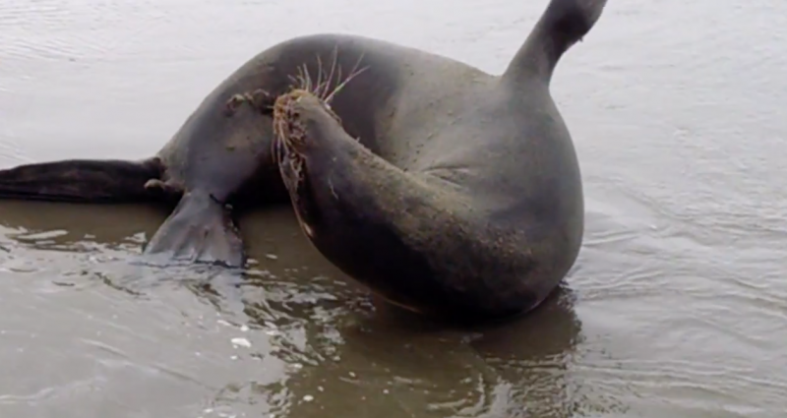
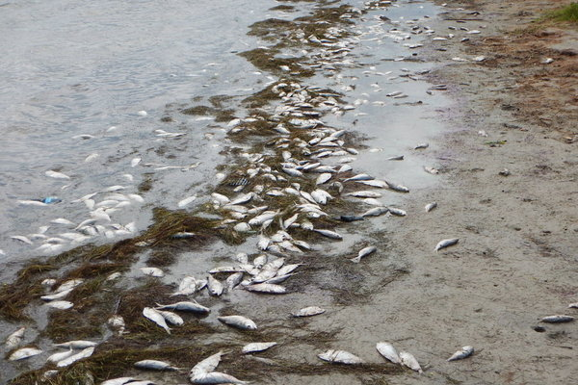
We need your help to cover CT’s coastline...
Please report discolored water, strange marine animal behavior and/or animal kills!!!
1) Take a sample; 2) take a photo; 3) call DA/BA

Slide 32
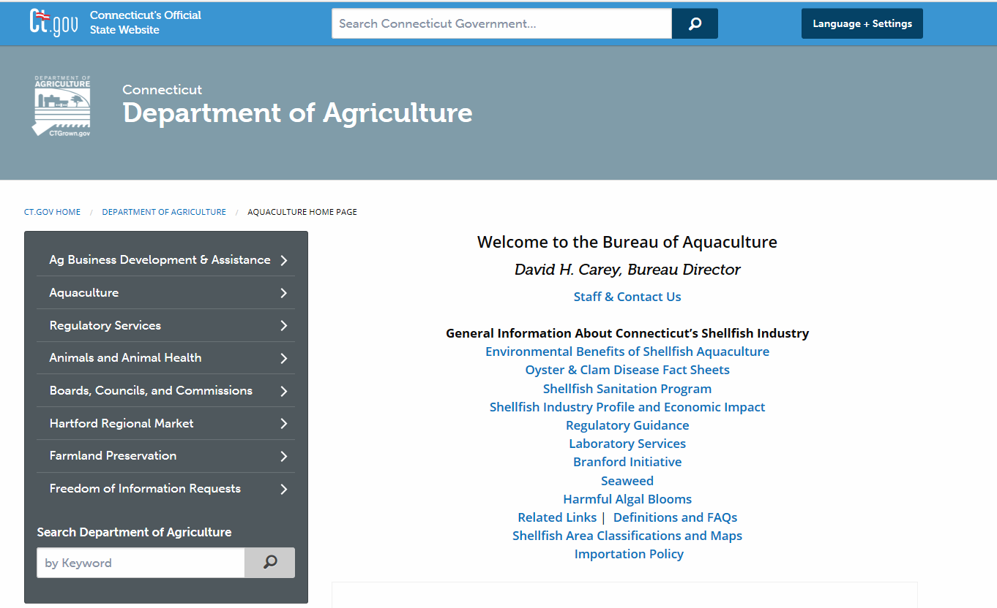
Please check out our new website...
https://portal.ct.gov/DOAG/Aquaculture1/Aquaculture/Harmful-Algal-Blooms

Slide 33
Questions?

