Slide 1
Connecticut shellfish disease update 2020
Connecticut department of agriculture bureau of aquaculture
Kristin derosia-banick
Supervising environmental analyst

Slide 2
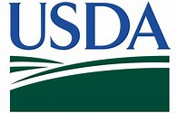
Disease surveillance of Eastern oyster (Crassostrea virginica) populations in Connecticut was conducted during 2019 and 2020 Roxanna Smolowitz and staff of the Aquatic Diagnostic Laboratory at Roger Williams University. Surveillance was conducted as part of a regional disease surveillance project funded by United States Department of Agriculture (USDA) Animal and Plant Health Inspection Service (APHIS).

Slide 3
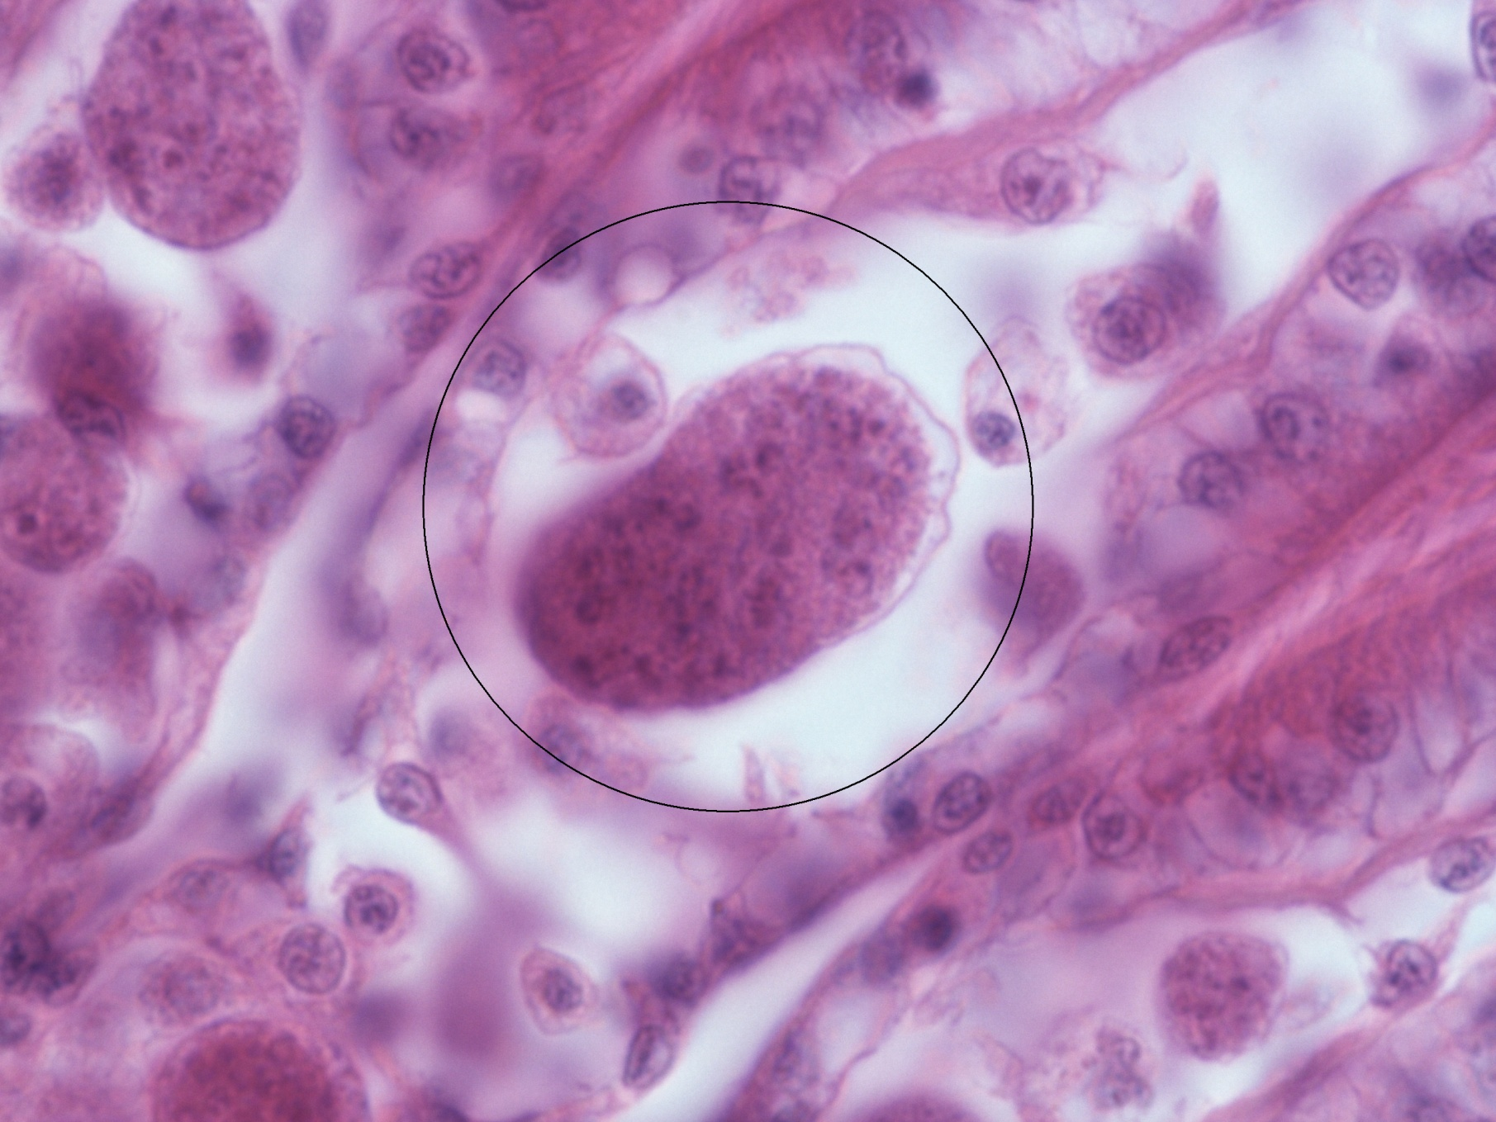
CT oyster disease history: MSX
The 1997 outbreak of MSX infection in market size oysters caused serious economic damage to the oyster industry. The following year, infection spread to seed oyster beds and caused devastating mortality. Populations began to recover after 2004.
MSX‐prevalence in Connecticut oysters has been in steady decline since the 1998 outbreak.
During recent years, the activity of MSX has declined in Long Island Sound, as well as in other large east coast estuaries. MSX occurs in CT as a co‐infection with another haplosporidian parasite, SSO.

Slide 4
CT oyster disease history: dermo
Infection with Dermo does not necessarily cause death of the oyster. Dermo can be characterized as a slow‐ killing disease.
It takes up to three years in Connecticut after initial infection for parasite intensities to approach levels high enough to cause death of the oyster.
Oysters are marketed when they are three to four years old. Consequently, Dermo has not caused significant mortalities in Connecticut’s commercial oyster stocks.
Dermo‐associated mortalities have been detected in areas of unusually slow oyster growth or during restoration efforts when oysters are grown indefinitely.
.

Slide 5
Dermo: Perkinsus marinus

Slide 6
Prevalence % of Perkinsus marinus (Dermo) in CT 1997 to 2020*

Slide 7
2020 Dermo Weighed Prevalence (weighed intensity)
West to East

Slide 8
2020 Dermo Weighed Prevalence (weighed intensity)
Hatchery versus wild West to East

Slide 9
Haplosporidium nelsoni (MSX)

Slide 10
Prevalence % of Haplosporidium nelsoni (MSX) in Connecticut 1997 to 2020*

Slide 11
2020 MSX Weighed Intensity (weighed Prevalence) West to east

Slide 12
2020 MSX Weighed Intensity (weighed Prevalence) hatchery versus wild West to east

Slide 13
What does it mean?
Dermo Status
MSX Status
Prevalence is high at 78%
Weighed prevalence indicates moderate to heavy Dermo infection in the majority of samples analyzed
Wild populations trending higher than hatchery
In Connecticut this level of infection has not historically caused significant mortalities in our commercial oyster stocks.
Individual grower reports have not indicated a high level of mortality despite this moderate to high prevalence of disease.
Prevalence is low at 26.8%, although higher than historical level (2011)
Weighed prevalence MSX results indicate an overall light level of infection of MSX, with 100% of samples having a weighed prevalence of less than 2.0
28% of the samples testing negative for the parasite
Hatchery populations trending slighter higher than wild
Populations having a weighed prevalence of MSX greater than 2.0 are likely to be showing noticeable mortality.
The current prevalence of MSX may be causing low levels of background mortalities in CT populations.
Commissions who are experiencing noticeable or significant mortality on their farm should report this finding to the Bureau and seek additional guidance from the state or consulting pathologist.

Slide 14
Disease management: dermo
Dermo
Infected oyster grounds should be kept in operation as an active part of the transplantation programs.
Since both seed and adult oysters can be infected without significant mortalities in market oysters, transplantation can occur from seedbed to grow‐out areas.
When relying on hatchery‐raised seed, use Dermo‐resistant strains.

Slide 15
Disease management: MSX
MSX
Transplanting of oysters from restricted relay areas to MSX infected conditionally approved or approved areas for purification can proceed as before; maintaining oysters in infected areas between mid‐June to the end of November should not exceed a period of three weeks.
Oysters should not be transplanted from infected areas to uninfected areas, and infected areas should not be used as intermediate growing areas in transplantation programs.

Slide 16
Importation Policy
Northern quahog:The Bureau of Aquaculture will not allow the importation of clams from south of NJ.
Eastern oyster: The Bureau of Aquaculture does not allow the importation of oysters with the exception of hatchery stock from RI and MA, or stock from NY and Long Island Sound.
Bay scallops: The Bureau of Aquaculture does not allow the importation of scallops from outside of Long Island Sound.
Prior to all importation:
Prior to any shellfish importation, the source must be approved by the state shellfish pathologist at the Bureau of Aquaculture.
The applicant must arrange with Bureau of Aquaculture for a sample of live animals to be tested
The source of product is not guaranteed to be approved and should be a consideration in any project plans.

Slide 17
Risks associated with importing shellfish
Larvae, seed, and adult shellfish can harbor pathogenic, toxic, or non-native organisms.
Shellfish diseases can spread to native populations or can be transferred by reproduction.
Imported shellfish can contain the phytoplankton that cause harmful algal blooms (HABs) which can impact fish, shellfish, and human health.
Larvae of non-native species (ex: crabs, tunicates) can be transported with shellfish and lead to predation and biofouling.

Slide 18
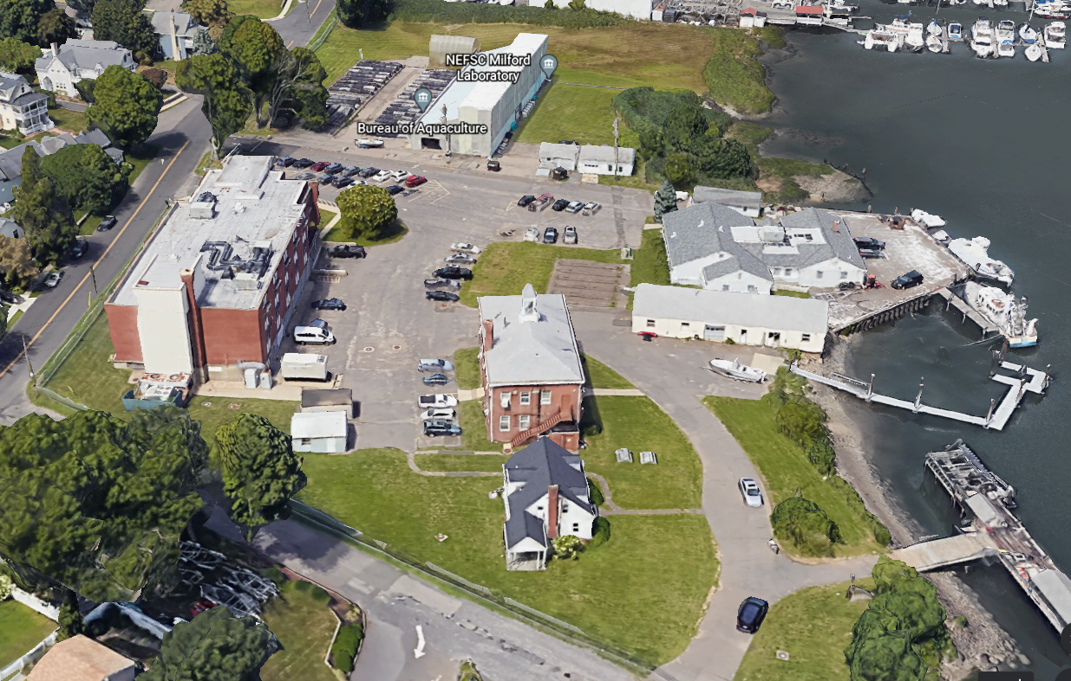
Milford Center of Expertise in Shellfish Health

Slide 19
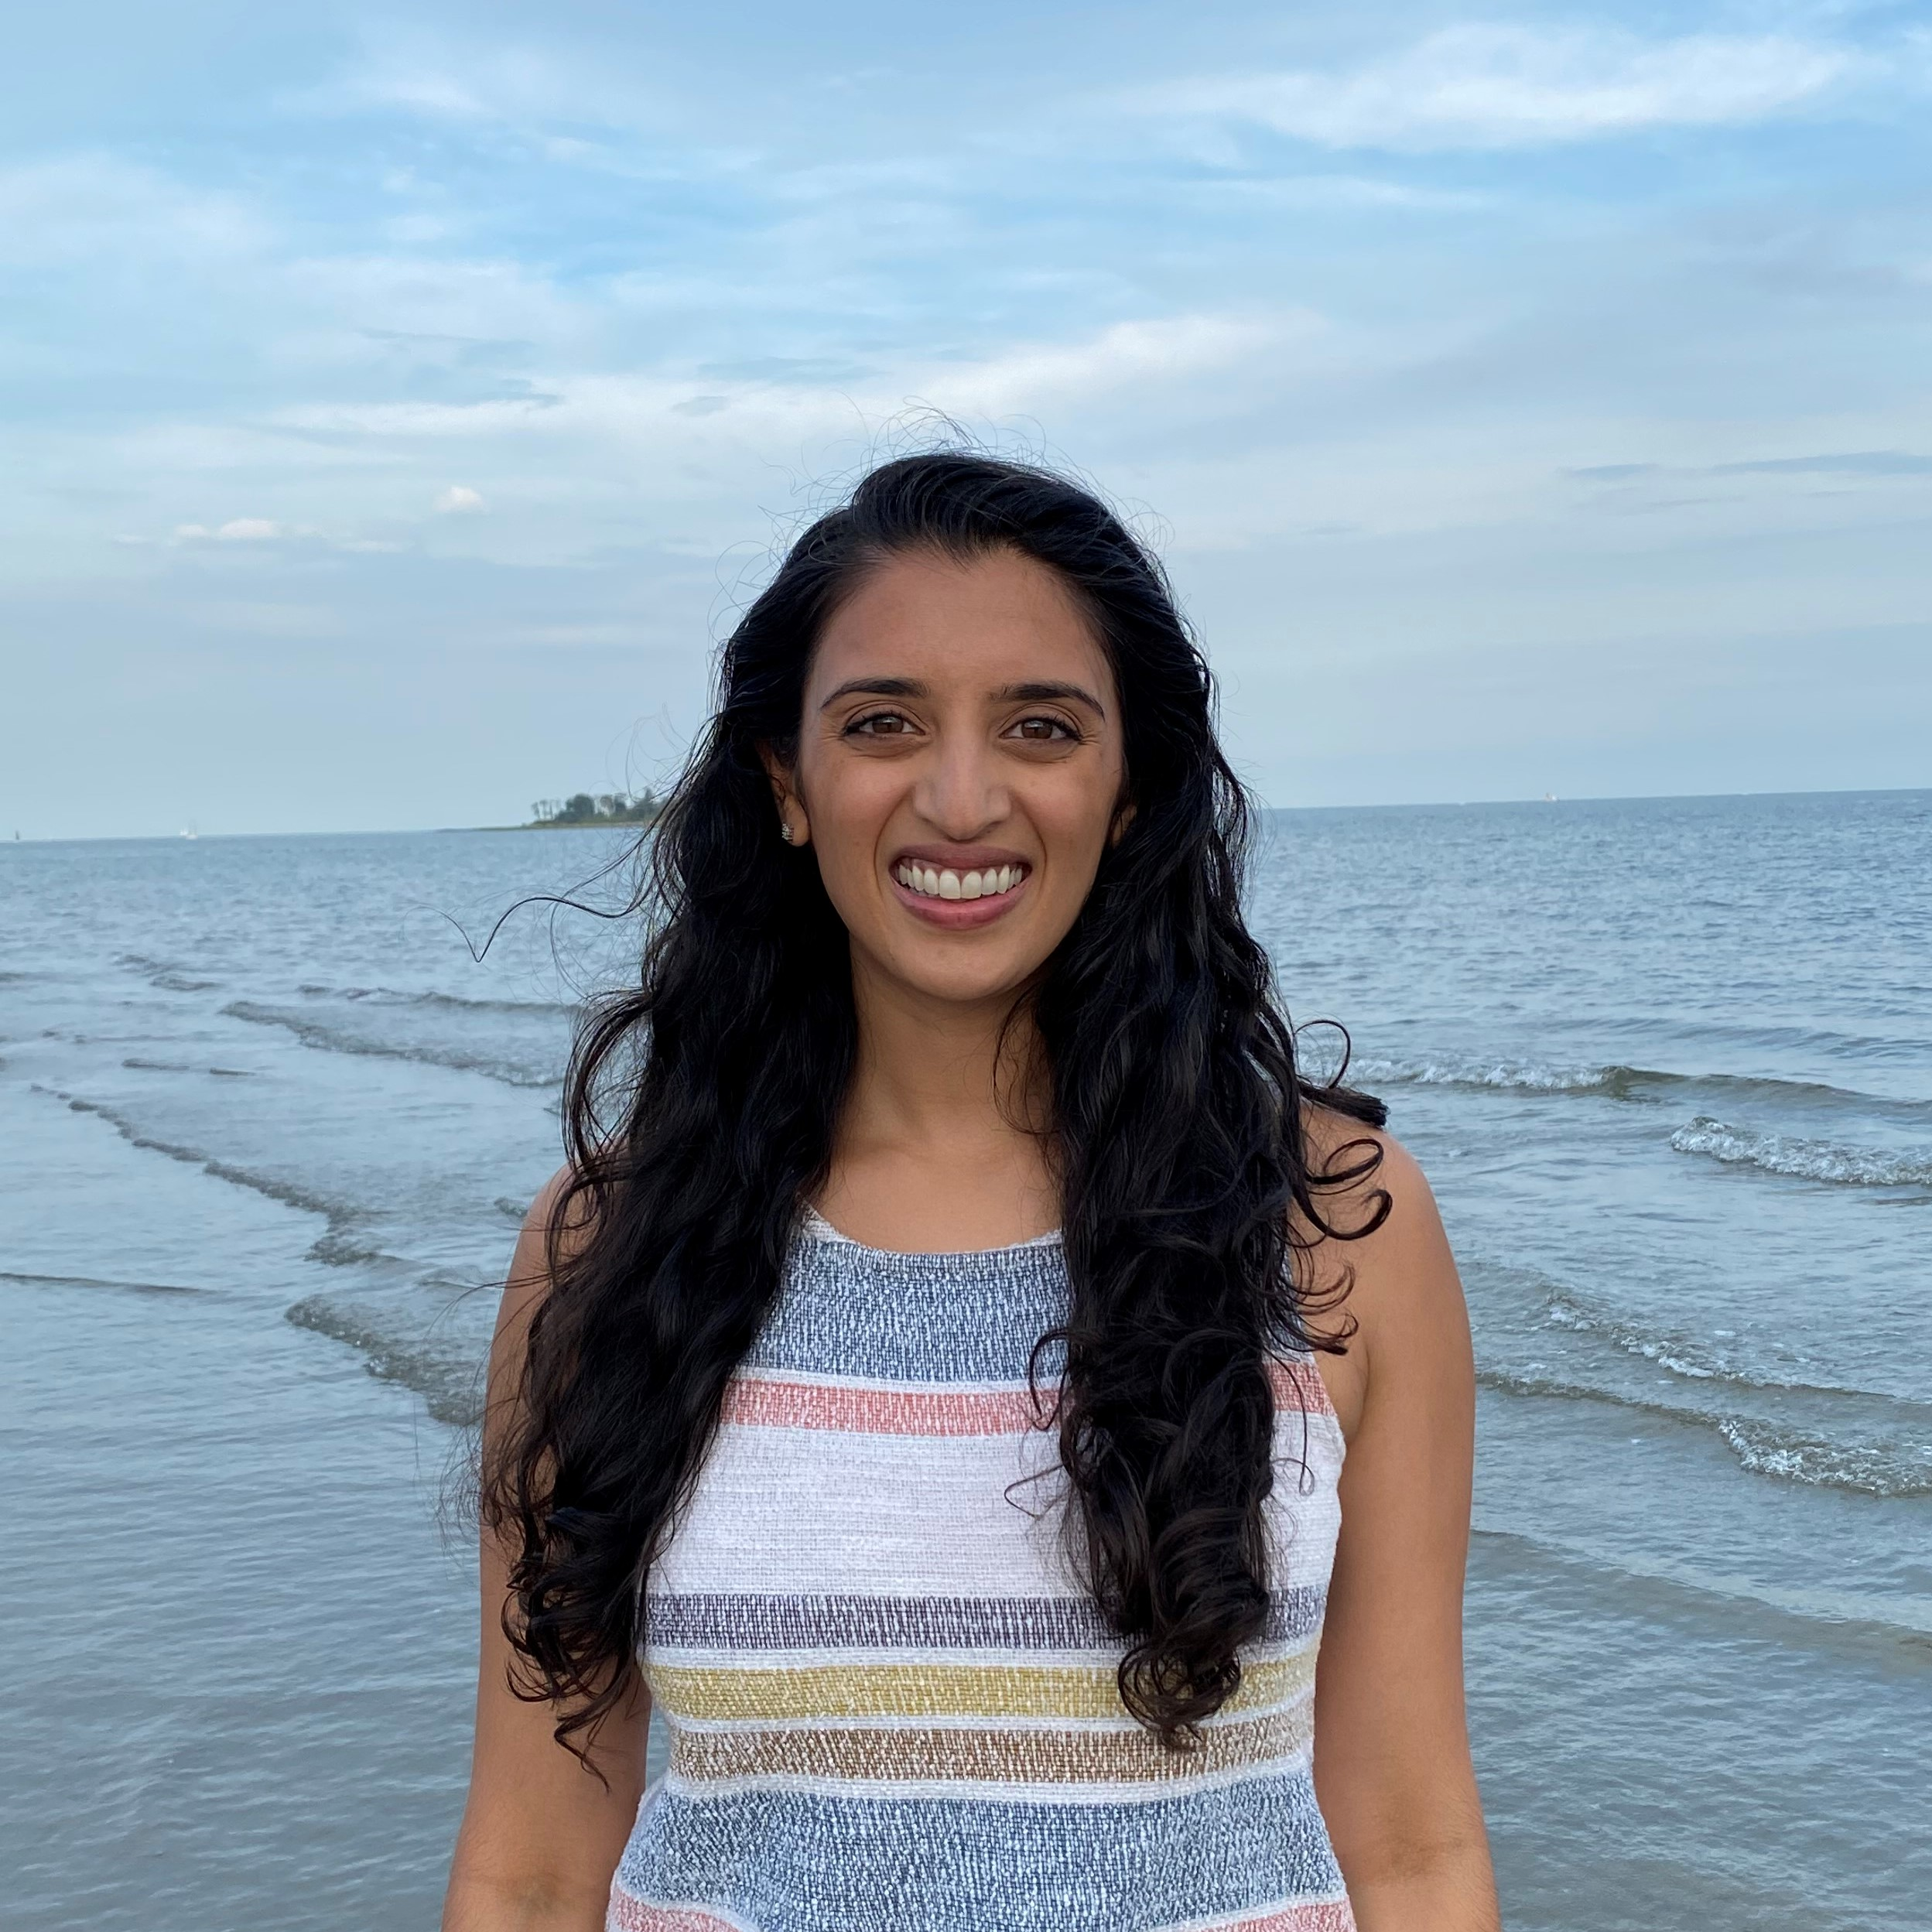
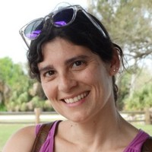
Milford Center of Expertise in Shellfish Health
Meghana P. Parikh, VMD, MPH
Research Veterinary Medical Officer
NOAA Milford Lab
Dr. Eve Galimany
Shellfish Pathologist
CT Department of Agriculture Bureau of Aquaculture
Notes:
Recent staffing additions at both the Bureau and NOAA’s milford lab will provide unparalleled expertise to our region.
Our Milford campus will be home to the newly established “Milford Center of Molluscan Health”
Eve Galimany is employed by the Bureau as a Shellfish Pathologist, and will work closely with NOAA Staff Veterinarian Meghana Parikh, Microbiologist Diane Kapareiko, and Gary Wikfors
Will allow us to Provide rapid and coordinated response in case of a shellfish disease outbreak, to assist us in protecting our state’s critical natural resource

Slide 20
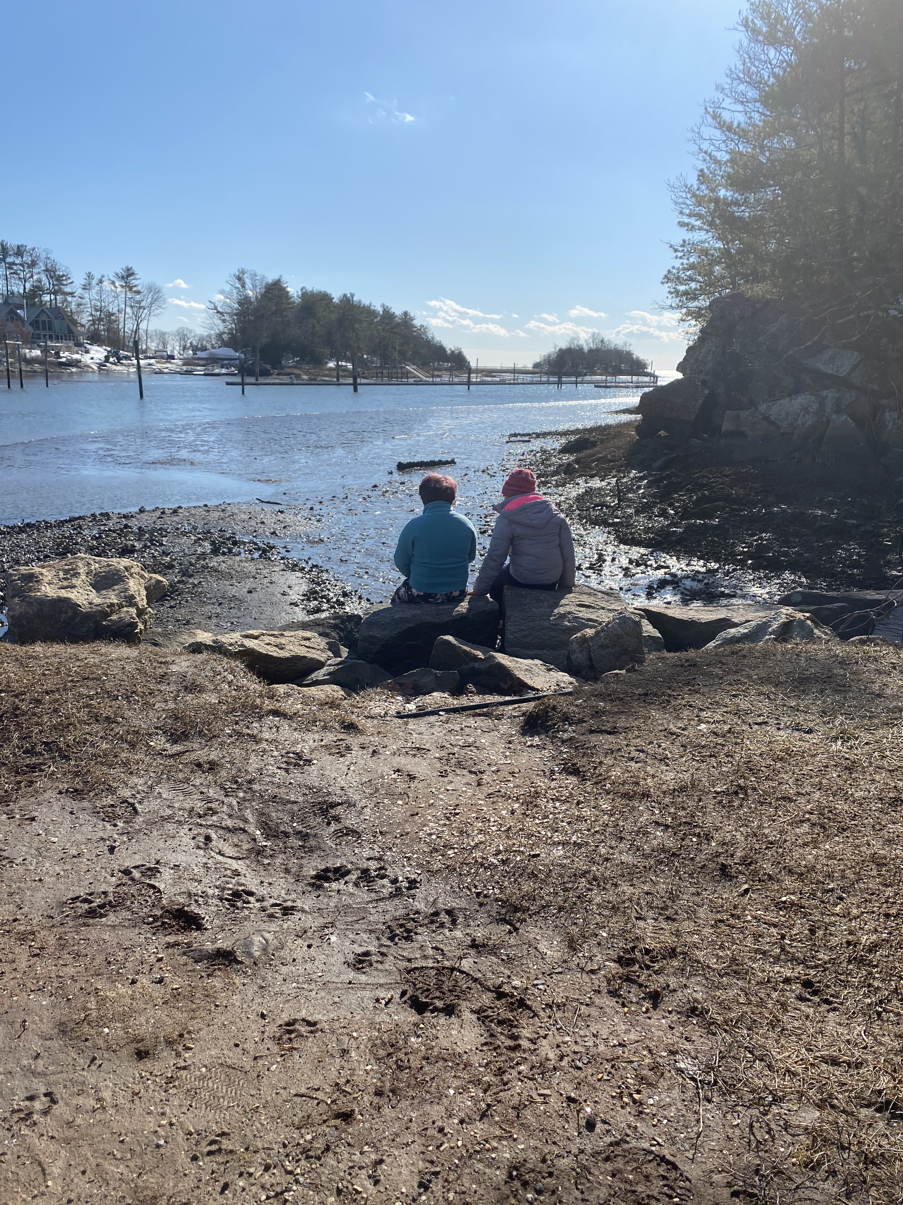
Thank You

