Slide 1
Connecticut’s Shellfish Growing Area Program
Recreational Shellfish Programs and The National Shellfish Sanitation Program Model Ordinance
(NSSP-MO)
Alissa Dragan, Environmental Analyst III
Gathering of Shellfish Commissions
February 13, 2021

Slide 2
DoAG Staff:
Administration
David Carey, Director
Lori Scianna, Administrative Assistant
Shellfish Laboratory
Shellfish Sanitation Program
Boat Operations
Joe DeCrescenzo, Fisheries Biologist II (Marine)
Emily VanGulick, Fisheries Biologist I (Marine)
Shellfish Pathologist, Vacant
Kristin DeRosia-Banick, Supervisory EA
Alissa Dragan, EA III
Shannon Kelly, EAII
Jenifer Yeadon, EA II
Kristin Russo, EA I
Michal Zuber, EA I
Rick Seidon, Research Vessel Engineer

Slide 3
National Shellfish Sanitation Program NSSP
Model Ordinance
Interstate Shellfish Sanitation Conference
FDA
Responsibilities
Oversight
SSCA
Research
Industry
Notes:
ISSC formed 1982. Industry, State & Federal Regulators

Slide 4
The Bureau of Aquaculture Implements the NSSP-MO
NSSP_MO Chapter 1 @1 A-F and @2 A-H:
Growing Areas
Shellfish Sanitation
Vibrio
Enforcement

Slide 5
DoAG NSSP-MO Responsibilities:
Growing Area Classification
Growing Area Management (Closures & Openings)
Regulate Shellfish Harvest, Processing, Sale, & Shipment
Biannual Harvester, Processor, & Dealer Inspections
Aquaculture Permitting, Including Inland Fish Farming & Seaweed
Illness Investigations
Laboratory Evaluations for CT Dairy Industry
DoAG is the Agency responsible for ensuring the safety of molluscan shellfish for human consumption. DoAG Analysts oversee CT shellfish production from the growing areas through the distribution chain

Slide 6
Shellfish are effective filter feeders & can concentrate pathogens or other contaminants as they feed
Shellfish are consumed RAW with no cook step to kill any pathogens that may be present
Shellfish are often grown near shore
They are sessile & captive to their environment & cannot move away from contaminants
Contaminants may be pollution-related or naturally occurring
Notes:
Molluscan shellfish filter large quantities of seawater each day and can accumulate pathogenic bacteria, viruses and contaminants, like heavy metals, as they feed.

Slide 7
Growing Area Classifications
Shoreline Survey
Marina Survey
Walk shoreline
Identify, map & classify pollution sources
Maximum occupancy of marinas & mooring fields*
50-50 Rule
Water & Tissue Sample Results
Data analysis
Does area meet Approved Criteria in open status?
Does tissue data support 7-day closure?
Notes:
>10 boats 50 – 50 Rule = assumption that 50% boats occupied, 50% of those boats are discharging.

Slide 8
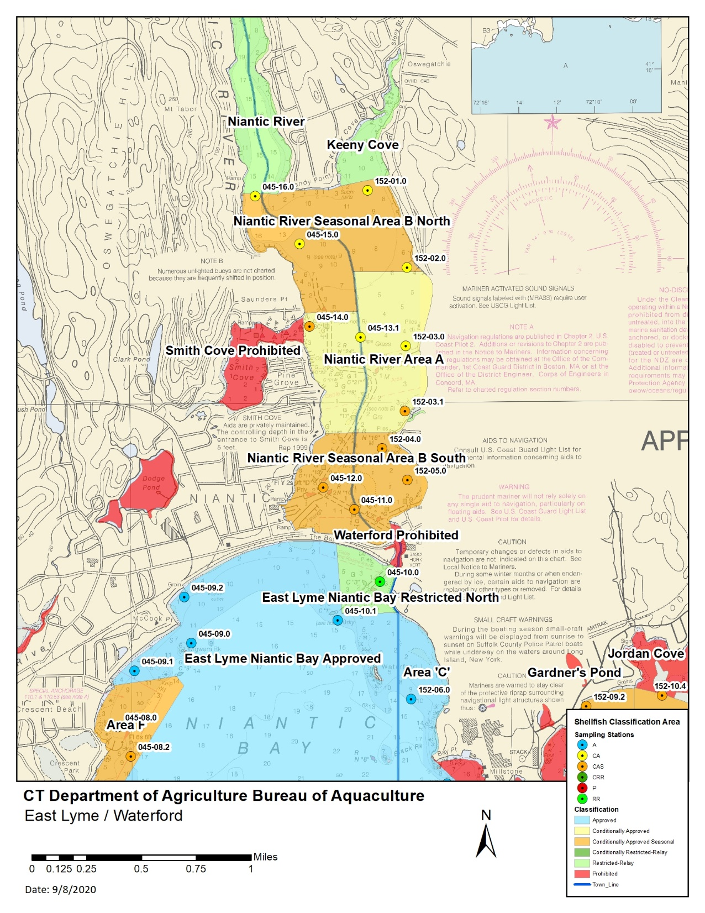
Sanitary Survey
Written evaluation of all environmental factors, including actual & potential pollution sources impacting water quality in a shellfish growing area
Stormwater outfalls, pipes, streams mapped & sampled, if flowing
Properties inspected for signs of failing septic systems & cross connections to stormwater system
Water pollution control facilities, industrial discharges, storm sewers & pump stations are evaluated
Notes:
Basis for all classifications
Need a current survey to enact any class changers
Due to COVID & staff limitations we are currently behind in this work.
FDA
Once every 12 years
NSSP-MO Ch IV Growing Areas @01.C.
When a written sanitary survey report is not completed, the area shall be placed in the closed status.
WE HAVE TO PRIORITIZE BACKLOG

Slide 9
NSSP-MO Sampling Compliance
Monthly OPEN Samples:
Once per month OPEN status (12 total) at each station
If sample can not be collected in a month, an additional OPEN sample must be collected the following month
2. APC Samples:
Collected 0-4 days following ≥0.5” rainfalls
5 per year required at each station. There must be 15 APC samples in a 3-year period
Re-Opening Samples:
Required for re-opening prior to day 15
Shellfish tissue samples required to verify 7 day closure
CA Monthly Open
APC Samples
Re-Opening
Notes:
Make sure you are using the “official” rain gauge for your town
If you do not know ASK

Slide 10
NSSP-MO Bacteriological Compliance
Geometric Mean of membrane filtration (MF) colony forming units (CFU) shall not exceed 14 CFU/100 mL
AND not more than 10% of samples shall exceed 31 CFU/100mL
MEETS NSSP APPROVED CRITERIA
To meet the Approved Criteria, it takes 8 million cubic feet of water to dilute one person’s waste in one day
59,850,779 gallons
Volume equal to 12 football fields covered in 10 feet of water
Notes:
Approved Criteria= no more than 10% of samples can exceed 31 CFU/!00 mL, Geometric mean can not exceed 14
<12 Open Samples/year can skew results to FAILURE
APC Samples – Determinations on trigger upgrades.
No wet weather data no upgrade.
Growing areas should meet NSSP criteria following rainfall events < trigger

Slide 11
Common Sampling Mistakes
Notify DoAG if You Are (OR Are Not) Sampling
Please Deliver Samples Promptly & within the Appropriate Lab Time-Frames:
Water Samples: 30 hours from time of first collection to incubation (includes processing time)
Meat Samples: 24 hours from time of first collection to incubation (includes processing time)
Don’t forget to include a TC
Check bottles for cracks

Slide 12
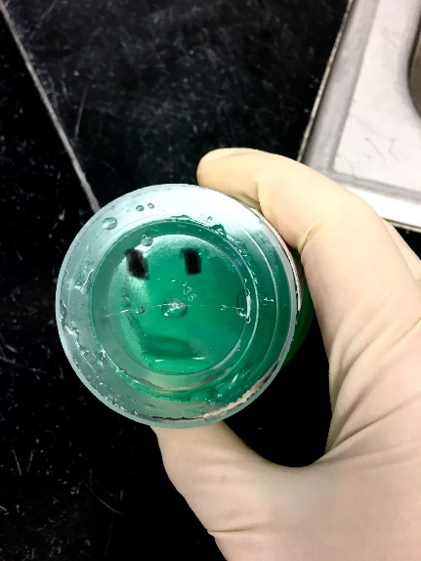
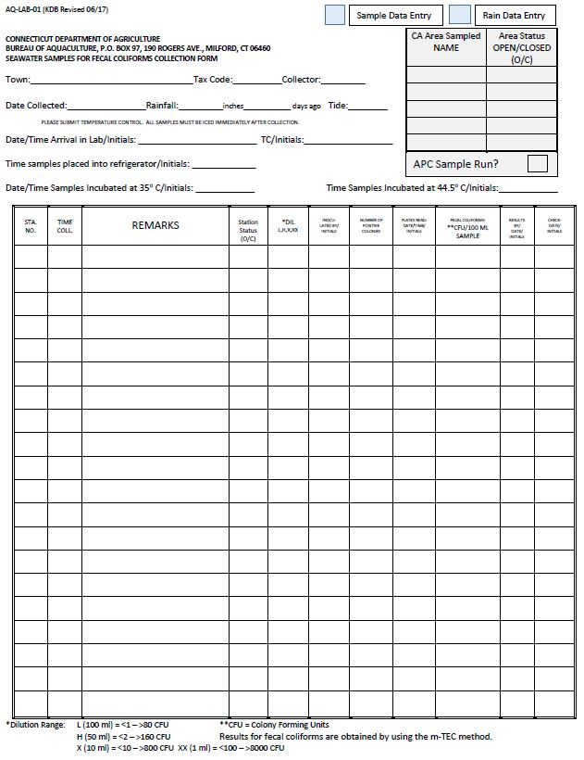
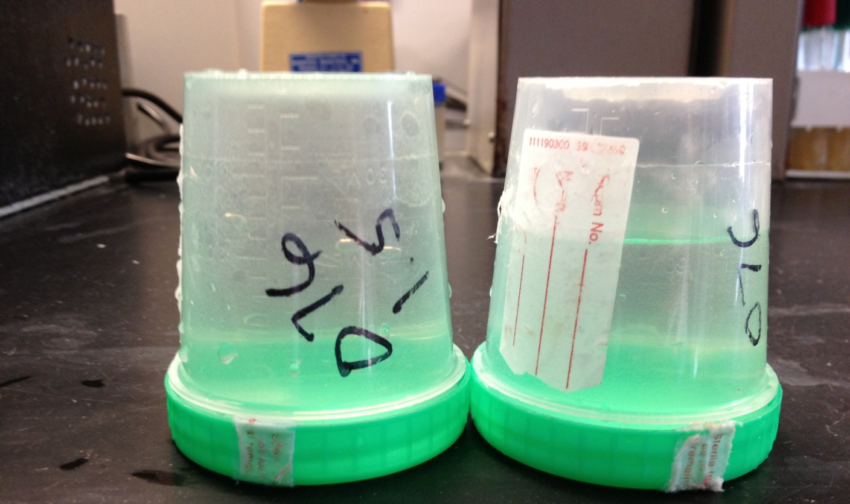
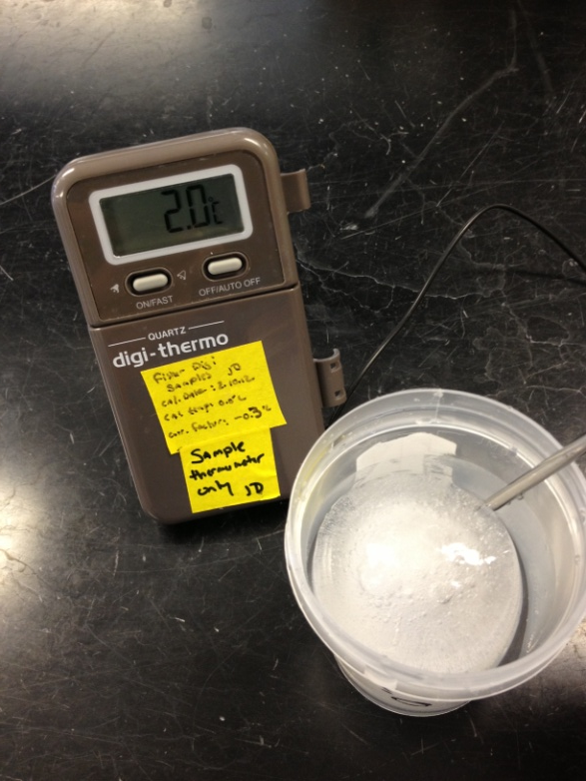
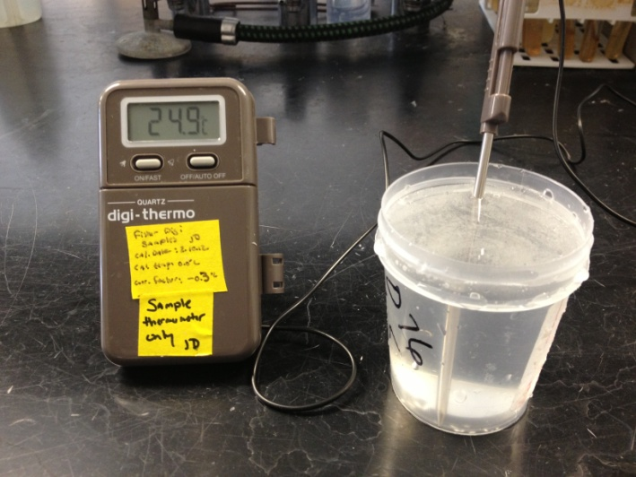
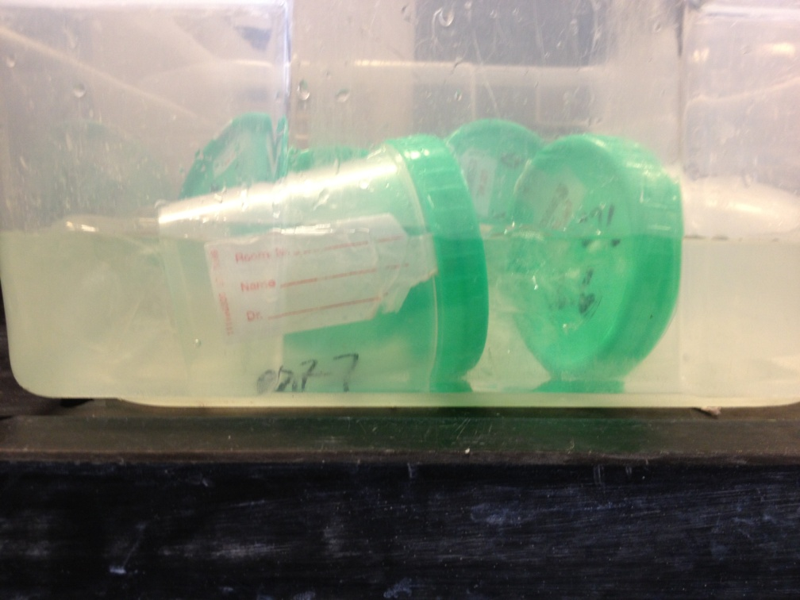
No Airspace
Too Much
Incomplete Form
Cracked
Delivered Outside of Laboratory Time-Frame
Frozen!
Too Hot!!
Sumberged
Notes:
Any samples that are collected without a temperature control will not be accepted. If temperature control is above 50⁰F (10⁰C) when the sample arrives in the lab, the sample will not be examined.

Slide 13
Please Note:
ALL samplers must be trained by DoAG staff
Any samples collected by untrained personnel will be discarded
Samples should be collected by the same individual for consistency
Please contact us if you need training

Slide 14
Rain Amount | Days Prior | Date | 035-02.4 | 035-03.1 |  | Rain Amount | Days Prior | Date | 035-02.4 | 035-03.1
0.55 | 3 | 8/21/2018 | 1 | 0.9 |  | 1.57 | 1 | 1/2/2019 | 2 | 0.9
0.56 | 1 | 2/26/2018 | 1 | 5 |  | 1.63 | 1 | 5/16/2017 | 1 | 2
 | 2 | 5/21/2018 | 0.9 | 0.9 |  | 1.64 | 4 | 5/1/2019 | 0.9
0.59 | 1 | 9/7/2017 | 8 | 2 |  | 1.69 | 4 | 10/15/2018 | 4 | 7
0.61 | 1 | 6/12/2019 | 0.9 | 0.9 |  | 1.73 | 4 | 8/15/2018 | 16 | 6
0.63 | 1 | 11/20/2019 |  | 6 |  | 1.78 | 4 | 1/17/2018 | 0.9 | 0.9
0.68 | 3 | 8/26/2019 | 3 | 6 |  | 1.96 | 4 | 1/28/2019 | 0.9 | 0.9
0.75 | 2 | 7/17/2017 | 0.9 | 1 |  | 2.21 | 4 | 7/12/2017 | 31 | 1
0.76 | 1 | 10/31/2019 | 1.9 | 1.9 |  | 2.28 | 4 | 10/21/2019 | 0.9 | 3
0.78 | 1 | 6/5/2018 | 1 | 6 |  | 2.42 | 3 | 5/9/2017 | 0.9 | 0.9
0.83 | 4 | 8/6/2018 | 1.9 | 4 |  | 2.64 | 4 | 12/18/2019 | 10 | 9
0.90 | 4 | 11/20/2018 | 1 | 1
0.94 | 2 | 10/30/2018 | 1 | 6 |  |  |  | Station | 035-02.4 | 035-03.1
1.20 | 2 | 12/4/2018 | 1 | 1 |  |  |  | # Spls | 25 | 25
1.52 | 3 | 5/15/2019 | 4 | 3 |  |  |  | GeoMean | 1.87 | 2.19
 |  |  |  |  |  |  |  | % > 31 | 0.00 | 0.00
 |  |  |  |  |  |  |  | Pass/ Fail | P | P
 |  |  |  |  |  |  |  | # > 31 | 0 | 0
 |  |  |  |  |  |  |  | 2019 Spls | 0 | 0
Rain Amount | Days Prior | Status | Date | 035-04.1 | 035-04.2
0.56 | 1 | O | 2/26/2018 | 4 | 1
 | 2 | O | 5/21/2018 | 4 | 4
0.61 | 1 | O | 6/12/2019 | 1.9 | 0.9
0.68 | 4 | M | 8/27/2019 | 0.9
 |  | O | 8/27/2019 |  | 0.9
0.78 | 1 | O | 6/5/2018 | 5 | 5
0.83 | 4 | O | 8/6/2018 | 1 | 0.9
0.94 | 2 | O | 10/30/2018 | 9 | 14
0.97 | 3 | C | 10/1/2018 | 7 | 10
1.1 | 1 | C | 7/26/2018 | 51 | 81
1.4 | 1 | O | 7/18/2018 | 66 | 68
 | 2 | O | 9/5/2017 | 1 | 1
1.52 | 3 | O | 5/15/2019 | 1 | 2
1.57 | 1 | O | 1/2/2019 | 0.9 | 0.9
1.64 | 4 | O | 5/1/2019 | 1 | 2
1.73 | 4 | O | 8/15/2018 | 7 | 10
2.28 | 4 | O | 10/21/2019 | 4 | 2
2.66 | 3 | C | 7/26/2019 |  | 2
3.69 | 2 | C | 11/1/2017 | 12 | 21
3.97 | 4 | C | 7/2/2018 | 48 | 9
 |  |  | Station | 035-04.1 | 035-04.2
 |  |  | Class | A | A
 |  |  | # Spls | 18 | 19
 |  |  | GeoMean | 4.42 | 4.02
 |  |  | % > 31 | 16.67 | 10.53
 |  |  | Pass/ Fail | F | F
 |  |  | # > 31 | 3 | 2
 |  |  | 2019 Spls | 6 | 7
Notes:
Analysis of Approved area samples that no longer meet criteria
Analysis of 1.5” CA for Approved upgrade

Slide 15
2019 NSSP-MO Changes
Marinas & Mooring Areas have been separated:
“Mooring Areas are any water area used to provide temporary or permanent anchorage for more than 20 boats…”
If assessment determines that the Mooring Area is not a pollution source and it is documented in the Conditional Area Management Plan, the area can be placed in the open status.
Changes may allow for some Conditionally Approved Seasonal areas to remain open year-round.
There may be opportunity to create new areas.
Documentation is key. Types of vessels, usage including holiday & weekend occupancy, etc.

Slide 16
Monitoring Required
Parking Lot
Party Anchorage

Slide 17
Partnership with DEEP Boating Division
location | vessel name | week 1 | week 2 | week 3 | week 4 | week 5
Gwen | s 24 |  | 25 | 25 | 25 | 25
 | Sea Turtle |  | 10 | 10 | 10 | 10
 | Seaquel |  | 35 | 35 | 35 | 35
 | Wild Slpurge |  | 45 | 45 | 45 | 45
 | Stay Thirsty |  | 45 | 45 | 45 | 45
 | Mi Lady III |  | 50 | 50 | 50 | 50
 | Run Away |  | 25 | 25 | 25 | 25
 | Camp David |  | 60 | 60 | 60 | 60
 | Enchantress |  | 35
 | Kataluma |  | 60 |  | 55 | 40
 | Pipe Dream | 40
 | Fintimadator
DEEP Maintains Federal Clean Vessel Act pump out data, performs outreach, and produces educational materials
DoAG will use this information as part of Mooring Area assessments

Slide 18
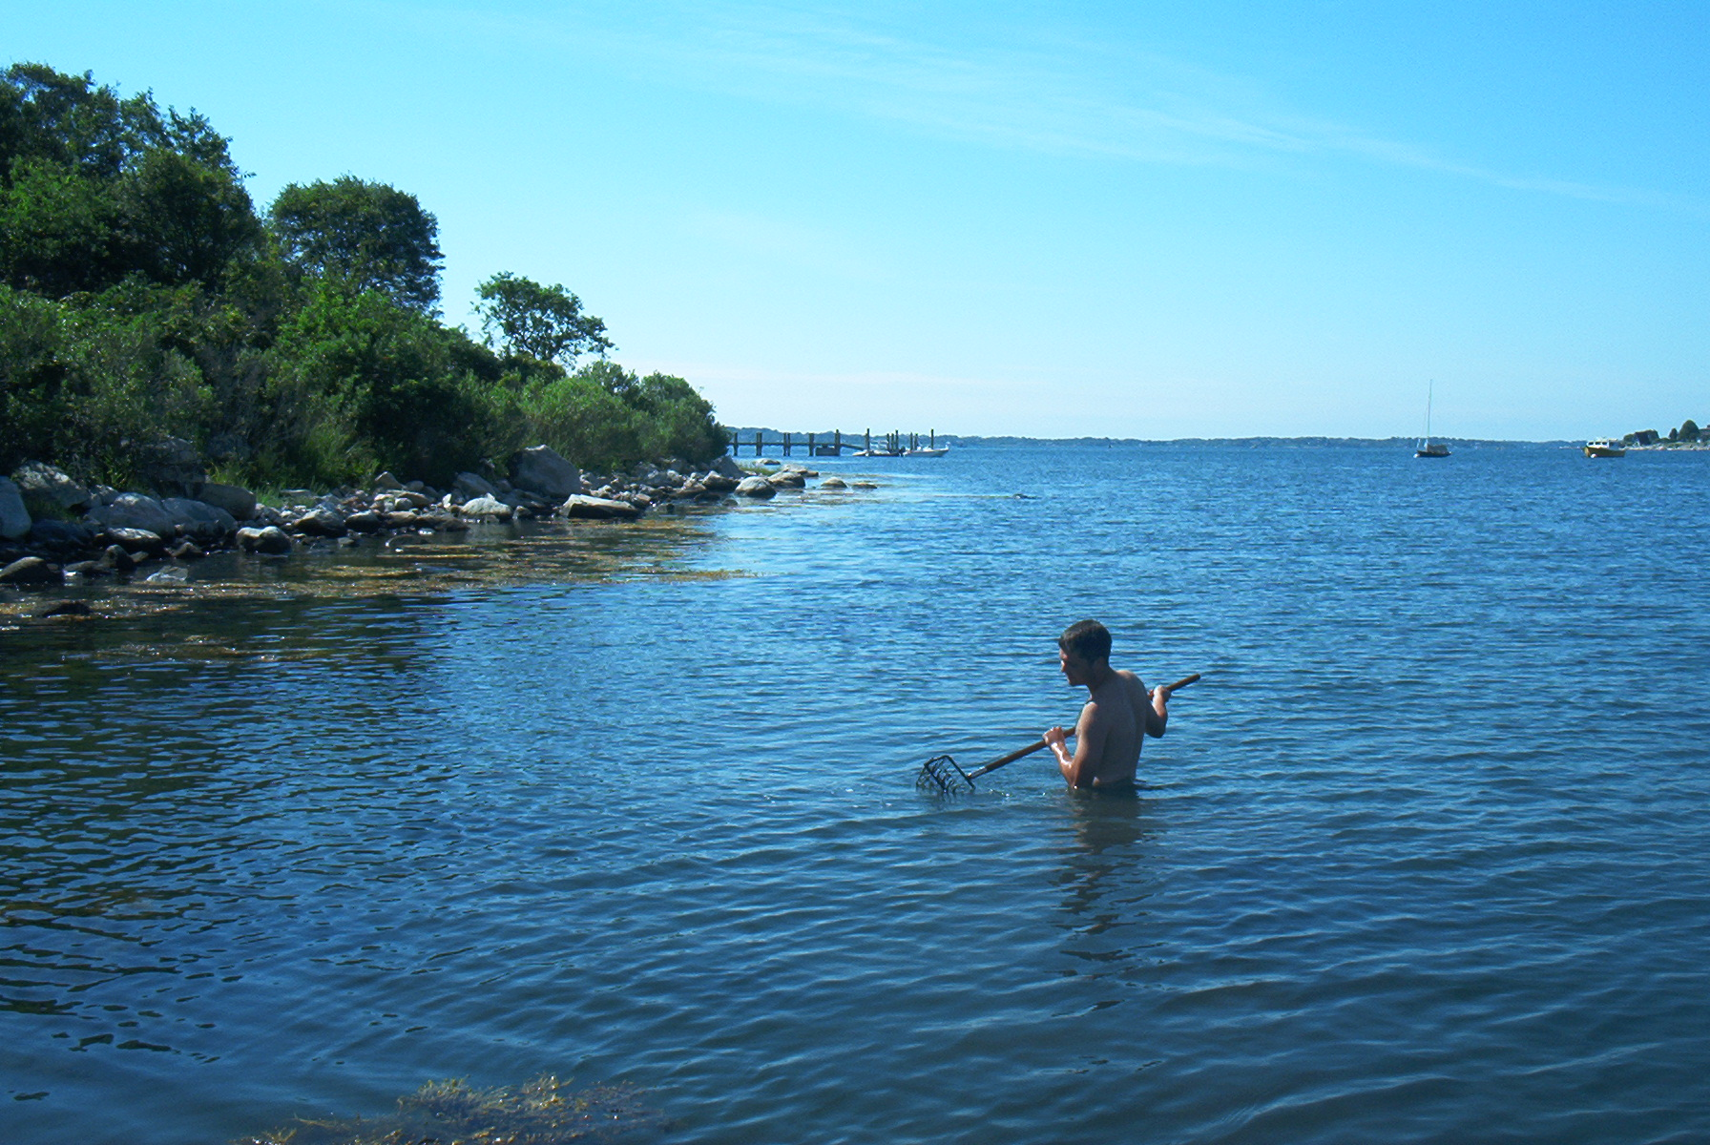

Slide 19
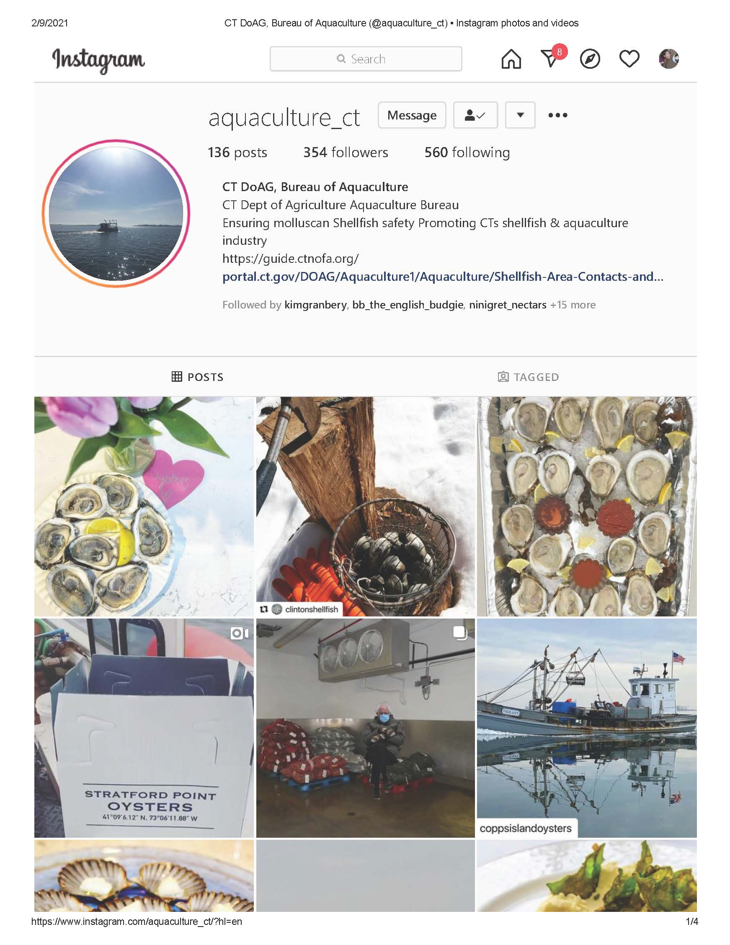
@ct_grown
@aquaculture_ct

Slide 20
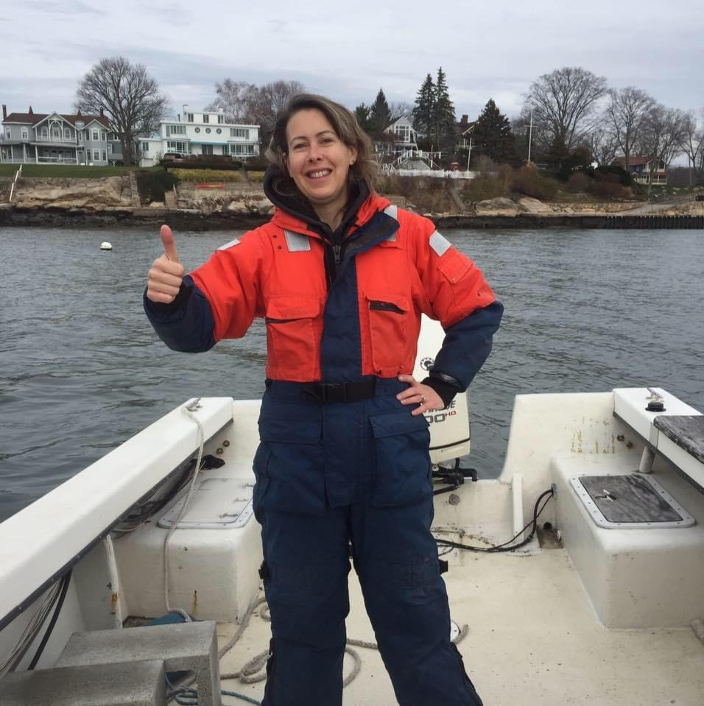
Questions?
alissa.dragan@ct.gov

