Slide 1
The Basics of Climate and
Shellfish Aquaculture in Long Island Sound
Tessa L. Getchis and Kristin DeRosia-Banick
Gathering of Shellfish Commissions, February 13, 2021
Reference: Getchis. T.L. & Carey, D.H. 2019. Climate Change and Aquaculture in Connecticut’s Long Island Sound. USDA. Northeast Climate Hub. 5pp. https://seagrant.uconn.edu/wp-content/uploads/sites/1985/2020/07/CTAquacuture_ResearchBrief_July2020.pdf
Notes:
Today I’m going to review about the basics about climate and shellfish aquaculture in Long Island Sound. But the more appropriate title should probably be “What we know is far less than what we don’t know”. If you’d like to read the technical report, the link is on your screen. Then I’m going to turn it over to Kristin who is going to talk about some very important research and policy initiatives that she and state leaders are involved in.

Slide 2
Overview
Climate change is a global challenge
Impacts to environmental, human and animal health
Food production sector is very vulnerable
Aquaculture farms exposed to atmospheric, oceanic effects
Greater impacts to shellfish than finfish production
Notes:
Climate change is a global challenge. It has the potential to impact the environmental, animal, and human health, as well as the economy. The food production sector is particularly susceptible to changes in the climate. Aquaculture farms are especially vulnerable to climate change as organisms and operations are continually exposed to temperature and chemical fluctuations in the ocean and air. Scientists believe there may be greater impacts to shellfish aquaculture compared with finfish production. Shellfish are dependent on natural food, habitat, and any environmental changes that cause shifts in the food web can have cascading effects.

Slide 3
Climate and Shellfish Aquaculture
Key threats include:
Temperature
Precipitation
Ocean Acidification
Severe weather
Sea level rise
Notes:
There are five key ways that climate change can pose a threat to shellfish aquaculture including: temperature extremes, changing precipitation patterns, ocean acidification, severe weather, and sea level rise. These factors have the potential to affect production, infrastructure, and sales (De Silva and Soto 2009, Barange et al. 2018). However, while many of the consequences of climate change on aquaculture remain unclear, some negative impacts have already been observed (Weatherdon et al. 2016).

Slide 4
Temperature | Rising and extreme air and water temperatures
Northeast US warming at a rate of nearly 0.5 degrees F per decade since 1970*
Stress
Disease
Industry Practices
Presence of pathogens that thrive in higher temperatures
*Northeast Climate Impacts Assessment
Notes:
Rising average air and water temperatures, as well as more extreme heat waves and cold spells, are likely to affect aquaculture. Farmed shellfish may be stressed or die as a result of extreme temperatures and exposure. It is likely that shellfish farmers will also have to deal with new pests and pathogens. Extreme temperatures may also expose workers to challenging and potentially unsafe working conditions. In Connecticut, farmers have already been dealing with the impacts of a pathogenic bacteria of concern. Vibrio parahaemolyticus is a naturally occurring bacteria that can sicken consumers when shellfish are eaten raw. This bacteria proliferates at higher temperatures. To minimize product exposure to extreme heat, regulators have recently required actions such as reduced trip lengths and rapid cooling of shellfish on the boat using ice (Connecticut Department of Agriculture, Bureau of Aquaculture). These modifications of storage and shipping practices are helping the shellfish industry adapt to and mitigate the effects of foodborne pathogens in a changing climate, and it’s likely that they will have to continue to modify their practices adapt to climate change.

Slide 5
Precipitation | More rainfall, more extreme events
The observed change in very heavy rain during the last century was +55% in the Northeast US
Rainfall carries land-based pollution
Drought can increase salinity
Flooding can lower salinity to lethal levels
Some pathogens thrive in higher salinities
Extended closures
Economic impacts
Easterling et al. 2017. Precipitation change in the United States. In Climate Science Special Report: Fourth National Climate Assessment, Volume I.
Notes:
Precipitation patterns are changing in the Northeast, and these changes can impact aquaculture. For instance, the frequency of heavy rain events in the U.S. has increased in the last two decades (NOAA 2018). Models predict that this trend will continue (Ren et al. 2013). In the Northeast, the observed change in very heavy rain during the last century was +55% (Easterling et al. 2017).
According to Huang et al. (2017), Coastal areas received more total and extreme precipitation on average than inland areas. Heavy rainfall washes over land rather than permeating through and can introduce pollution such as bacteria and viruses, nutrients, and other contaminants from surface runoff and stormwater. Filter-feeding shellfish capture these particles in the water. To protect human health, local and state regulators monitor water quality in shellfish harvest areas. As you all know, harvesting areas are closed following heavy rainfall events and reopened when favorable water quality results are obtained.
Frequent and intense rainfall events have already increased the frequency and duration of temporary harvest area closures in some Connecticut towns (Connecticut Department of Agriculture, Bureau of Aquaculture). Most businesses can adjust operations to deal with short-term closures and associated delays of income. However, more frequent and longer duration closures or permanent closures would put shellfish aquaculture at significant risk for loss of market share, income loss, loss of jobs, and business closure and consolidation.
Episodes of heavy rainfall and drought can also dramatically affect the salinity of seawater. Runoff from heavy rains may temporarily reduce salinity (due to freshwater inputs from land), while droughts may increase salinity (due to reduced freshwater input). Shellfish can tolerate a wide salinity range, though early life stages can be more vulnerable to extreme environmental conditions including low salinity. Also, certain shellfish parasites such as Perkinsus marinus (Dermo disease) thrive in higher salinities caused by drought conditions. These parasites pose a threat to both wild and farmed shellfish populations (Sunila 2010).

Slide 6
Ocean Acidification
Key recommendation is to determine impact of multiple stressors on species as well as the magnitude of acidification
Seawater pH decreases (becomes more acidic)
Early life stage shellfish especially vulnerable
Shell formation may be affected
Animals ultimately starve because all of their resources are devoted to shell formation
Saba et al. 2019. Recommended priorities for research on ecological impacts of ocean and coastal acidification in the U.S. Mid-Atlantic Estuarine, Coastal and Shelf Science
Notes:
Ocean acidification happens when the pH of seawater drops (becomes more acidic) over a period of time. In essence, the removal of atmospheric carbon dioxide by oceans results in the production of carbonic acid, which lowers pH and acidifies ocean waters (NOAA 2019). Ocean acidification poses a serious risk to shellfish aquaculture, and especially to early-life-stage shellfish. A reduction in pH can change the elements available for shell formation.
Scientists have demonstrated that ocean acidification can affect the ability of shellfish to survive, build shells, and grow (Green 2009). Local scientists are just beginning to measure environmental conditions to better understand how pH fluctuates in estuarine environments (Wallace et al 2014). Daily and seasonal fluctuations in pH are characteristic of coastal habitats. But we know little about the effects of pH fluctuations on shellfish in the environment, although there have been lab experiments showing negative impacts. Some shellfish hatcheries are mitigating the effects of ocean acidification by adding soda ash to seawater. This artificially raises the pH of the seawater, making it less acidic than the seawater they draw into their facilities from the ocean.

Slide 7
Severe Weather
Bottom line is that businesses will need to adapt
Rough seas
Coastal flooding and erosion
Damage to property and shoreline infrastructure
Loss of days at sea
Lost gear and mortality due to storm surges (Sandy)
Harvest area closures
Notes:
Frequent nor’easters and subtropical storms have heavily impacted coastal Connecticut, causing catastrophic loss of life, property damage, and coastal erosion. While the NOAA National Hurricane Center website provides data showing an increasing trend in the named storms in the Atlantic Basin including subtropical storms, there is a great deal of variability from season to season.
Storm trend projections are very difficult to predict and there are no definitive projections for Connecticut as yet (Seth et al. 2019). Seaside operations can be particularly vulnerable to wind, waves, and surging seas. Protecting aquaculture facilities, vessels and gear from these forces can be a considerable challenge given the uncertainty in storm predictions. Aside from impacts to shoreside infrastructure, aquaculture businesses have been impacted by damage or loss of gear and vessels, lost days at sea, and harvest area closures. When possible, farmers move vessels and cultivation gear to more sheltered locations, but not all have such options.

Slide 8
Sea Level Rise
Shellfish production one of top five most imperiled agricultural sectors in Connecticut
SLR is accelerating faster than average
+ 20 inches (0.5m) by 2050 in LIS
Impacts to property, infrastructure, transportation
2010. Adaptation Subcommittee to the Governor’s Steering Committee on Climate Change
Notes:
Across the globe, communities are dealing with the threat of rising sea levels. Sea level rise is accelerating more rapidly in some locations than others. The Connecticut Institute for Resilience & Climate Adaptation (CIRCA) recommends planning for a sea level rise of about 0.5m (20 inches) above the present national tidal datum in Long Island Sound by 2050.
In its 2010 report, the Adaptation Subcommittee to the Governor’s Steering Committee on Climate Change identified shellfish production as one of the top five most imperiled agricultural planning areas in the state. Most aquaculture operations rely on shore-side infrastructure and facilities that, due to their proximity to the sea, are inherently vulnerable to sea level rise. This infrastructure can include man-made docks, building structures, mechanized refrigerated units, outdoor ice machines, tanks, processing equipment, hatcheries and any structure
identified for use by a seafood operation, as well as roads leading to and from these facilities. Shoreline resilience is based on geology and topography so resilience of any particular aquaculture operation will be site dependent. Elevating structures may be one useful mitigation strategy, but relocating is unlikely to be a feasible approach especially for hatcheries that draw seawater directly from Long Island Sound. Even if operations had the flexibility to elevate or relocate such infrastructure, these measures may be cost prohibitive.

Slide 9
Which Species, Which Affects?
Shellfish have wide range of tolerance to environmental conditions
Intertidal species are more adapted to temperature extremes
Larval shellfish more vulnerable to changes in pH
Notes:
Shellfish tolerate wider ranges of environmental factors such as salinity, temperature and oxygen than than finfish.
Intertidal species are more adapted to temperature extremes but every species has a tipping point between suitable, optimal and unsuitable
Larval shellfish are much more vulnerable to changes in pH, although we don’t yet fully understand how shellfish will fare as they are already somewhat tolerate to diel changes in pH in shallow coastal systems with marine plants and algae.

Slide 10
What’s Being Done?
Industry Advocacy
Research Studies
Government Initiatives:
Notes:
The shellfish aquaculture industry is acutely aware of changes in the coastal ocean environment that affects their operations. If aquaculture operations or the associated infrastructure are impacted by climate change, there may be cascading effects to the economic development of the municipality or region. Identifying these threats now will enable the aquaculture industry to develop adaptation strategies that not only build resilience, but also ensure that future shellfish production is sustainable. (Kristin to add more detail)

Slide 11
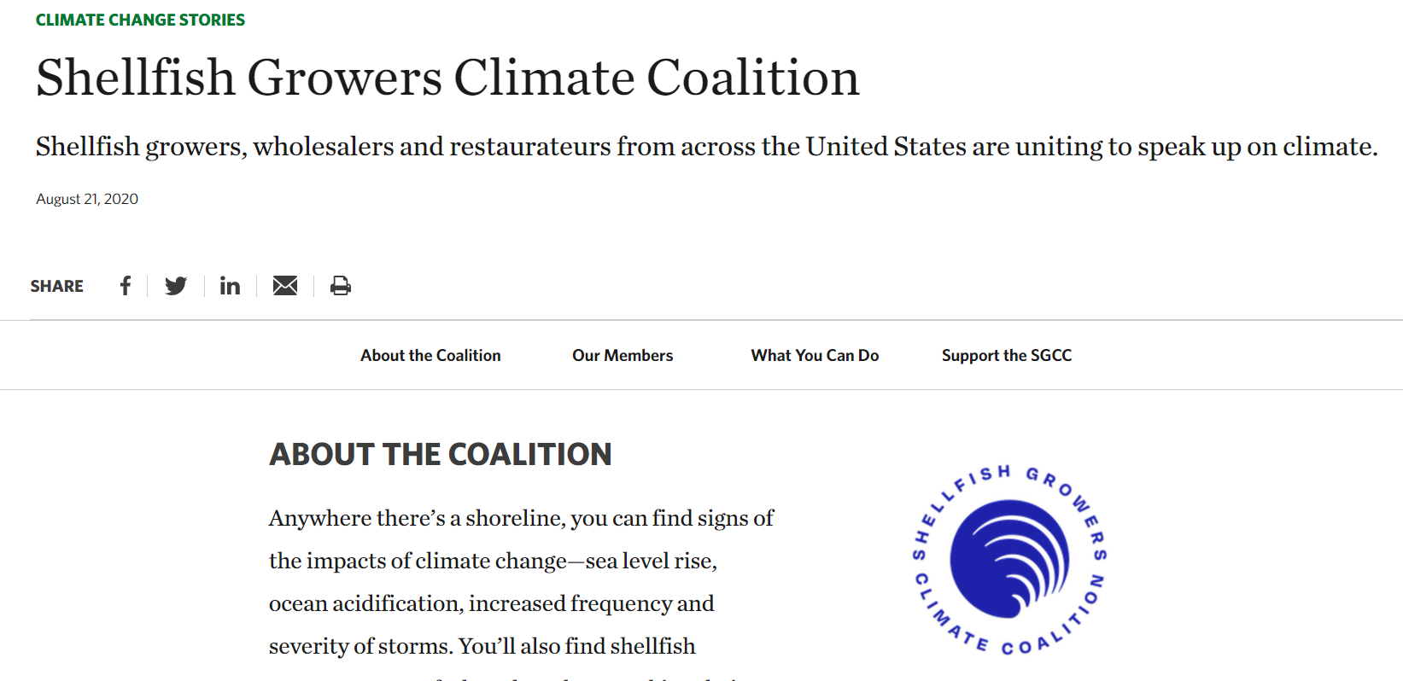
Shellfish Growers Climate Coalition | The Nature Conservancy
Notes:
In fact, concerned farmers recently formed a national climate change coalition to share stories of impact and work with governmental agencies to address climate change issues (The Nature Conservancy 2018). (Kristin to add detail here)

Slide 12
The Governor’s Council on Climate Change: GC3
Science and Technology Working Group
Advance Connecticut’s Capacity for Water Quality Observations in Long Island Sound: Relevance to Food Safety and Security
Join the International Association to Combat Ocean Acidification (OA Alliance) and commit to furthering the five goals identified in the Alliance’s Call to Action.
Public Health and Safety Working Group
PHS 25: Develop a monitoring system for water quality parameters critical to the shellfishing industry in real-time to forecast potentially high-risk events.
PHS - 27 Assess the vulnerability of public recreational freshwater and marine beaches to impacts from climate change and prioritize adaptation options to reduce vulnerability
Notes:
And the Governor has his own Council to address climate change on a broad scale. (Kristin add more detail)

Slide 13
(oaalliance.org)

Slide 14
Research Initiatives
Long Island Sound - Shellfish Aquaculture Research-Industry Partnership (LIS-SARIP) Quantifying and predicting effects of ocean acidification, salinity, and diseases on oyster production (pre-proposal submitted)
Safe Waters Forecasting Pilot Program: Using hydrodynamic and forecasting to predict water quality impacts to shellfish growing areas (Pilot project under development)
Cyanotoxins in Shellfish: 2020 Greenwich Event
PFAS: PFAS Task Force 2019; Several shellfish projects in planning stage
Notes:
Scientists, regulators and the industry are continually making observations and measurements to better understand how the climate is changing on local and global scales. They are seeking to assess threats to both water-based aquaculture operations and shoreline infrastructure in the state of Connecticut. (Kristin to add detail here)

Slide 15
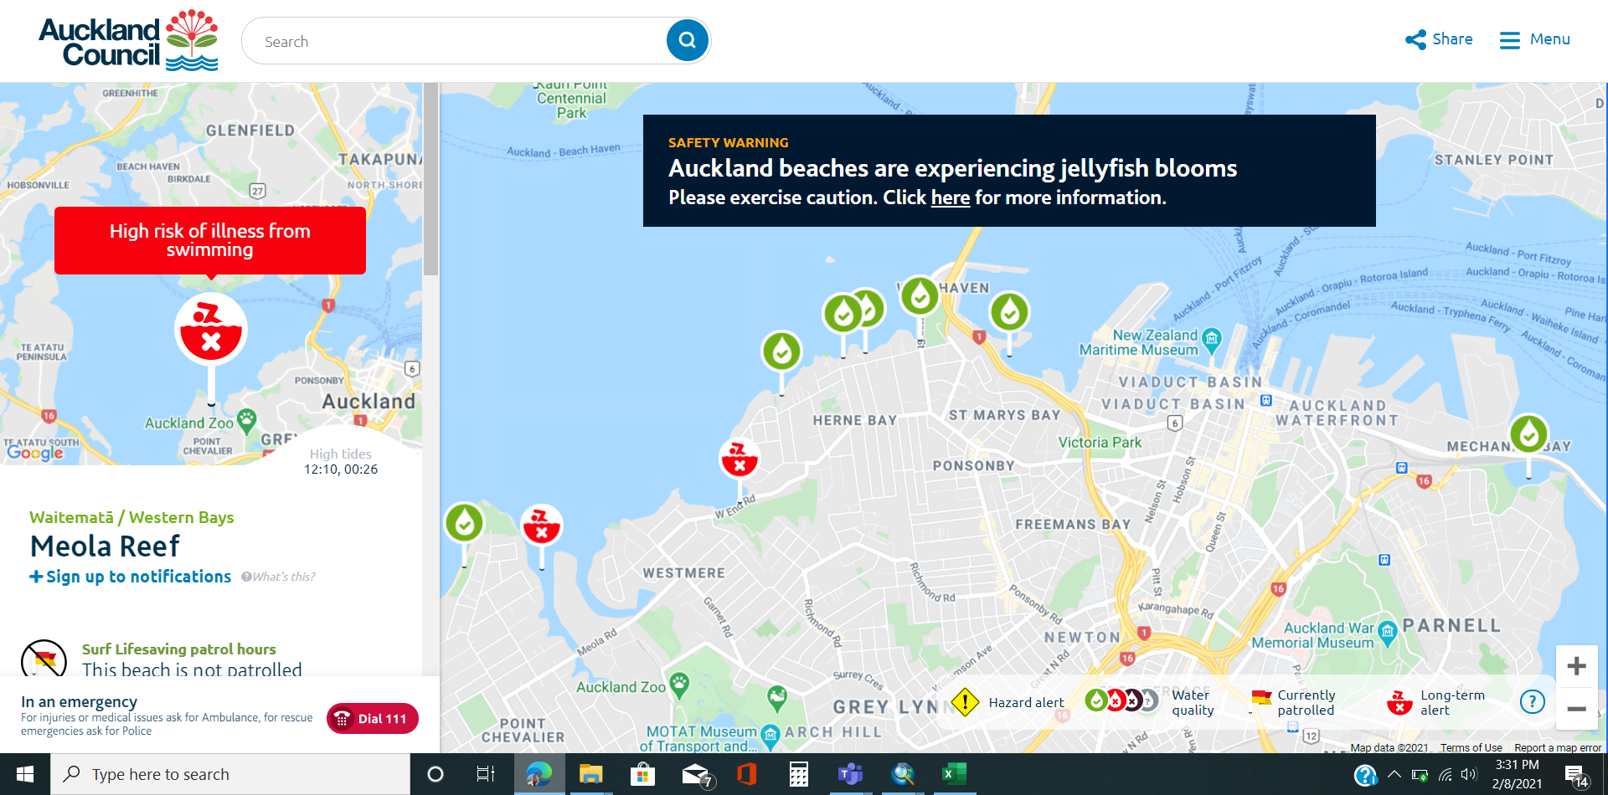

Slide 17
Vibrio vulnificus
7 cases in CT between 2010 and 2019, then 5 cases during 2020
V. vulnificus can cause wound infections when open wounds are exposed to warm salt or brackish water (mix of salt and fresh water). The bacteria, once inside the body, can infect the bloodstream causing septicemia.
People with a V. vulnificus infection can get seriously ill and need intensive care or limb amputation.
About 1 in 5 people with this type of Vibrio infection die, sometimes within a day or two of becoming ill.
People at greatest risk for illness from V. vulnificus are those with weakened immune systems, liver disease, and the elderly.
Vibrio vulnificus & Wounds | Vibrio Illness (Vibriosis) | CDC
Notes:
If you have a wound (including from a recent surgery, piercing, or tattoo), stay out of saltwater or brackish water, if possible. This includes wading at the beach.
Cover your wound with a waterproof bandage if it could come into contact with saltwater, brackish water, or raw or undercooked seafood and its juices. This contact can happen during everyday activities, such as swimming, fishing, or walking on the beach.
Wash wounds and cuts thoroughly with soap and water after they have contact with saltwater, brackish water, raw seafood, or its juices.

Slide 18
Vibrio vulnificus Working Group
Convened in 2020 to respond and plan for 2021 Vv season
DPH, DEEP and DoAG
Quarterly planning meetings
Planning on conducting baseline monitoring in 2021 at state beaches
DoAG running samples for seawater and shellfish tissue
Developing press release and guidance for anglers, crabbers and shellfish harvesters (high risk community)

