Slide 1
Connecticut’s Shellfish Program
Alissa Dragan
Supervising Environmental Analyst
CT Department of Agriculture, Bureau of Aquaculture

Slide 2
DA/BA Staff:
Administration:
David Carey, Director
Lori Scianna, Administrative Assistant
Shellfish Laboratory:
Joseph DeCrescenzo, Dairy LEO, Fisheries Biologist 2
Shellfish Sanitation Program:
Alissa Dragan, Growing Area Specialist, Supervising Environmental Analyst
Jenifer Yeadon, Shellfish Sanitation Officer, EA 2
Shannon Kelly, Aquaculture Specialist, EA 2
Michal Zuber, GIS Specialist, EA 1
Emily Marquis, HAB Specialist, Fisheries Biologist 1
Vessel Operations:
Rick Seidon, Research Vessel Engineer
Shellfish Pathologist-Vacant

Slide 3
The CT Shellfish Program operates as part of the National Shellfish Sanitation Program (NSSP)​
CT’s program falls under the jurisdiction of the CT Department of Agriculture, Bureau of Aquaculture​
NSSP is a cooperative program consisting of State, FDA, and Industry partners who agree to accept and meet specific responsibilities in order to ensure the safety of molluscan shellfish​

Slide 4
DABA NSSP-MO Responsibilities
Growing Area Classification & Management (Closures & Openings)
Regulate Shellfish Harvest, Processing, Sale, & Shipment
Biannual Harvester, Processor, & Dealer Inspections & Illness Investigations
Aquaculture Permitting, Includes Inland Fish Farming & Seaweed
Laboratory: Seawater & Shellfish Bacteriological, Viral, & Vibrio Testing, HAB Monitoring Program, Shellfish Pathology, & Evaluations for CT Dairy Industry
DOAG is the responsible Agency for ensuring the safety of molluscan shellfish for human consumption. DOAG Analysts oversee CT shellfish production from the growing areas through the distribution chain
Notes:
Growing Areas: Sanitary & Marina Surveys, Shellfish Tissue & Seawater Sampling, Annual, Triennial, and 12 Year Sanitary Survey Reporting
Inspections and licensing: All CT Shellfish Harvesters and Wholesale Dealers Biannually 71 Dealers 3 Inspectors
Patrol: CT DEEP

Slide 5
Sanitary Survey
Written evaluation of all environmental factors, including actual and potential pollution sources, which have a bearing on the water quality in a shellfish growing area

Slide 6
Shoreline of every town with classified growing areas is walked, and every property within the designated survey area is visually inspected
Individual properties are inspected for signs of failing septic systems, cross connections to stormwater system​, and other potential sources of pollution
Water pollution control facilities, industrial discharges, storm sewers, and pump stations are evaluated ​
Marina surveys are performed to evaluate the potential for contamination by boats discharging waste
Notes:
Walk beach during dry/wet weather at low tide: different sources may occur depending on conditions​
Sample pipes, storm drains, streams for bacteria testing and flow calculation​
Locate upland streams and path of flows​
Animals present (farms, wildlife, etc.)​
Development near water: sewered vs. septic​

Slide 7
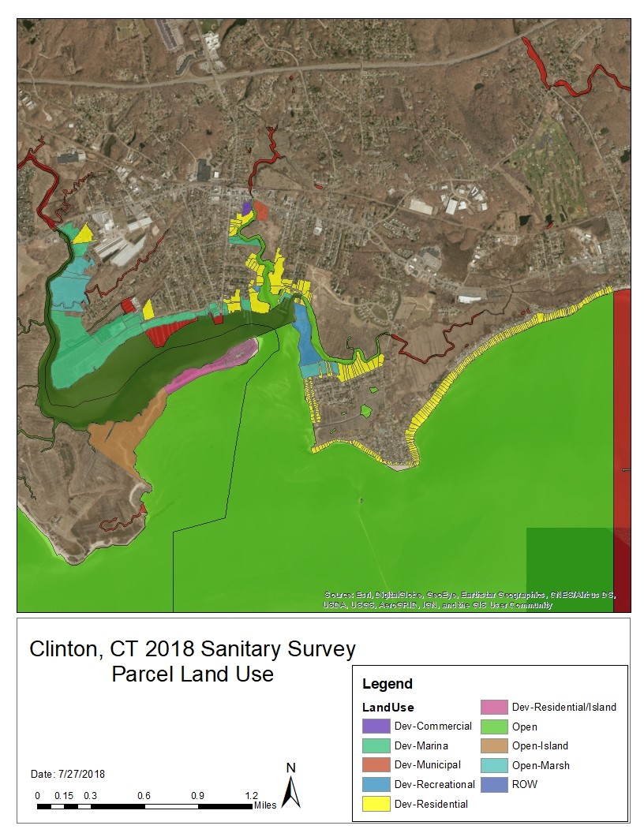
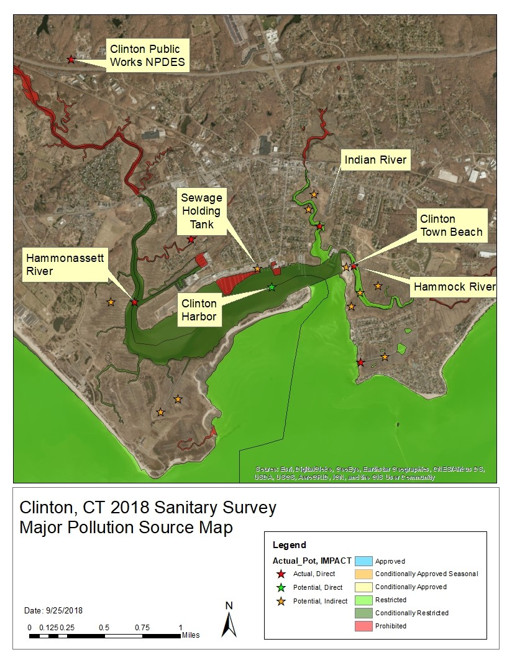

Slide 8
Sampling Requirements
Conditionally Approved Open Samples
Adverse Pollution Condition Samples(APC)
Reopening Samples
The closure time period shall be at least fourteen (14) consecutive days when environmental conditions are suitable for shellfish feeding and cleansing unless shorter time periods are demonstrated to be adequate
CT DABA policy:
Minimum 7 day closure with reopening on the 8th day following the collection of satisfactory seawater &/or shellfish tissue samples.
Monthly water samples are required when the growing area is in the open status of its conditional classification
If a monthly sample cannot be collected due to environmental constraints, the monthly sampling requirement will be satisfied if an additional water sampling run is conducted the following month
A minimum of five (5) samples shall be collected annually under adverse pollution conditions from each sample station in the growing area
A minimum of the most recent fifteen (15) samples collected under APC from each sample station shall be used to calculate the median or geometric mean and percentage to determine compliance with this standard
Notes:
APC = >=0.5” Rain withing 0-4 days of event
Reopening Samples required to reopen prior to day 14. Additional rain adds 7 days

Slide 9
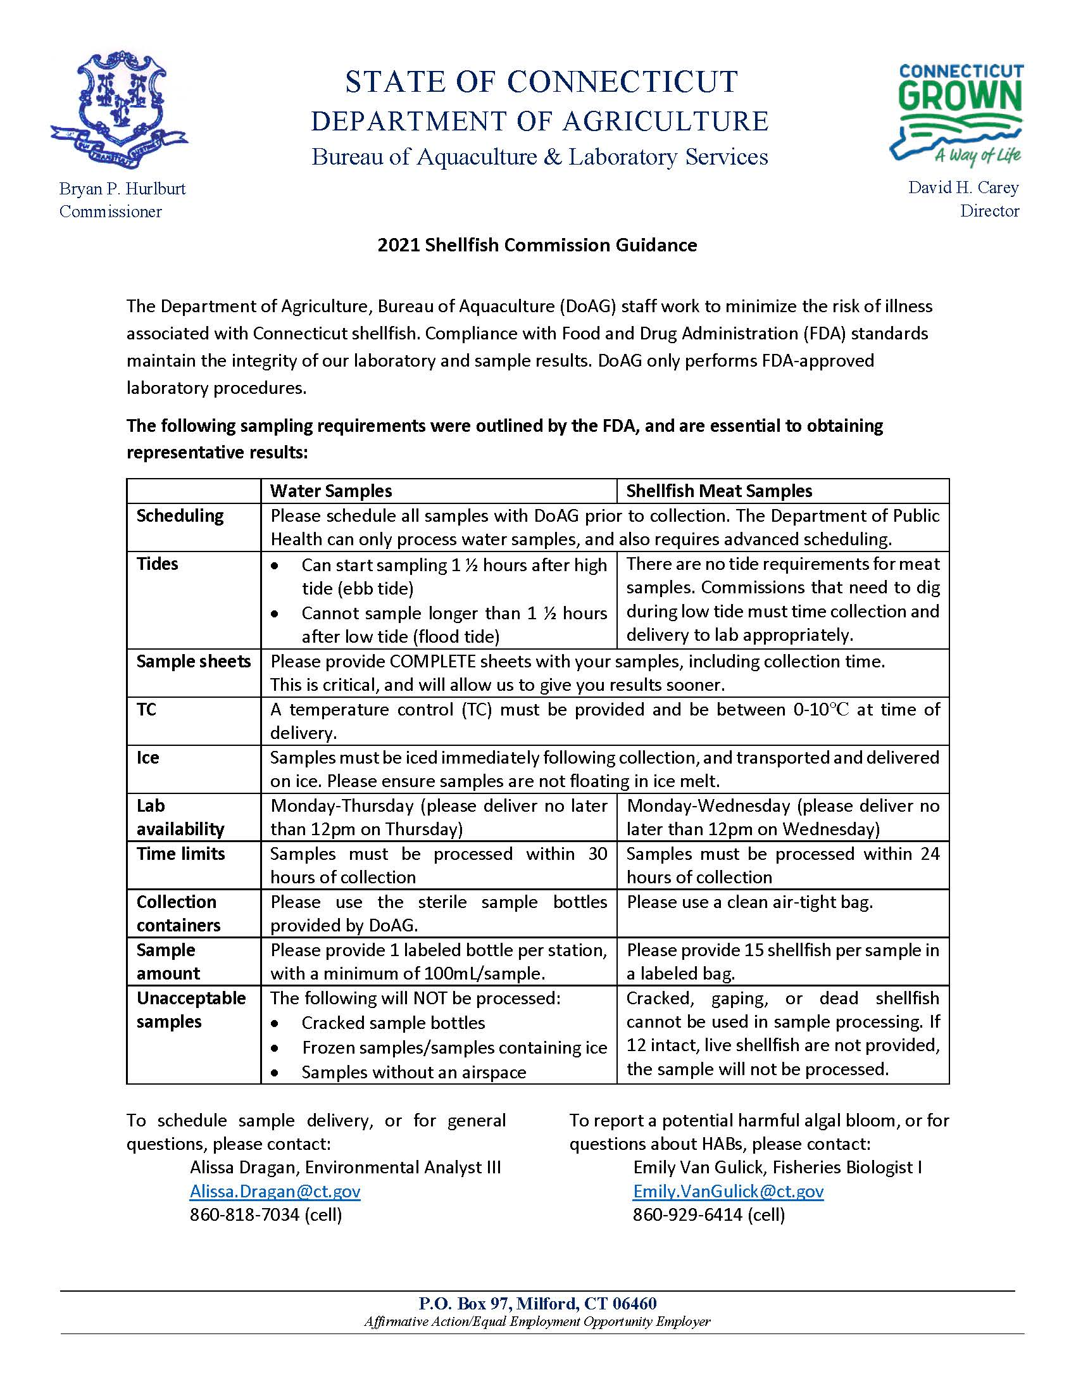

Slide 10
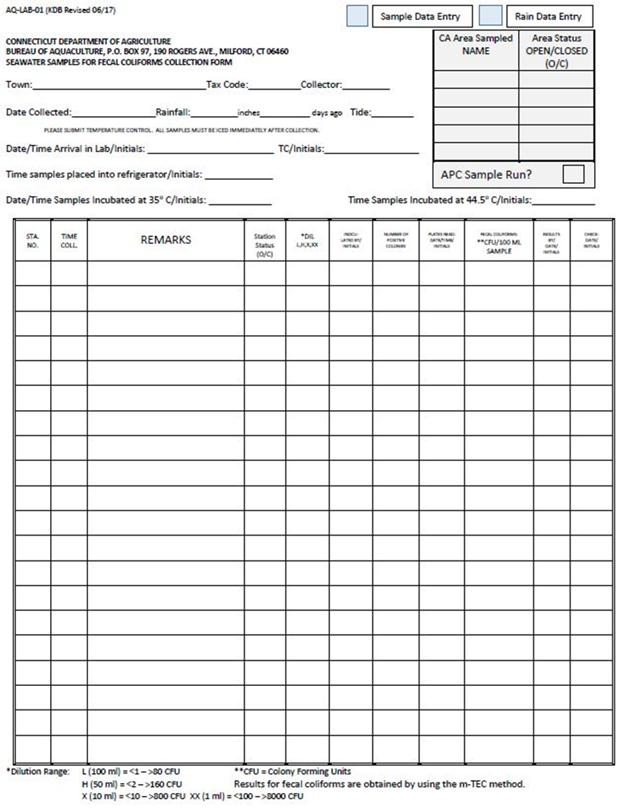
Sample Tracking
Sample Form:
Town & Tax Code
Collector(s)
Date & Tide Stage (E, L)
Station ID
Time of Collection
Area Sampled
Area Status (O/C)
APC Sample Run?
Note anything unusual, large flock of birds, odors, discolored water, etc.

Slide 11
2021 Laboratory Processing:
5901 Samples Processed
5451 Seawater Samples Processed
174 Shellfish Tissue Samples Processed
11 MSC Samples Processed
244 Plankton Samples Processed
21 PSP Samples Processed
Notes:
≥4 hours media prep time-Expiration = 14 days
Sample Holding time 30 hours
≈2 hours process (2 people)
2 hour water bath (stop time 3pm)
24 hours incubation
1-2 cleanup/autoclave
MEATS ≈4 hours Prep time
Holding time 24 Hours
48 hour test (2 24 hr portions)

Slide 12
National Shellfish Sanitation Program Bacteriological Standards
Does my area meet Approved criteria (AKA “pass”) under conditionally open conditions?
To meet the Approved Criteria, it takes 8 million cubic feet of dilution water to dilute one person’s waste in one day
59,850,779 gallons
Volume equal to 12 football fields covered in 10 feet of water
Geometric Mean of membrane filtration (MF) colony forming units (CFU) shall not exceed 14 CFU/100 mL, AND
not more than 10% of samples shall exceed an MF of 31 CFU/100mL

Slide 13
Why do we need to provide tissue samples?
A growing area temporarily placed in the closed status…, shall be returned to the open status only when:
The emergency situation or condition has returned to normal and sufficient time has elapsed to allow the shellstock to reduce pathogens or poisonous or deleterious substances that may be present in the shellstock to acceptable levels. When pathogens are of concern, studies establishing sufficient elapsed time shall document the interval necessary for reduction of coliform levels in the shellstock to pre-closure levels. Such coliform studies may establish criteria for reopening based on coliform levels in the water.
NSSP-MO Stipulates that the closure time period shall be at least fourteen (14) consecutive days when environmental conditions are suitable for shellfish feeding and cleansing unless shorter time periods are demonstrated to be adequate

Slide 14
How can we upgrade our closure trigger?
Sanitary Survey
APC Samples
Sanitary Survey must be up to date
Target sampling to include rainfall amounts greater than your current closure trigger to determine impacts of various rainfall events
Ideally on day 0-4, or
Within the 7 day closure period

Slide 15
How can we upgrade our closure trigger?
Other Considerations
The dataset should adequately cover all seasons & rainfall amounts under which the area will be open

Slide 16
What else can you do for my Commission?
Produce maps for your recreational permits and commercial shellfish lease sites
Permit shellstock restocking activities:
Recreational Relay license required to move shellstock from one area to another
Reopening license may be required depending on source of relayed product
Scientific/Resource Assessment license
Shellfish pathology

Slide 17
Questions
Alissa Dragan
Alissa.dragan@ct.gov
860-818-7034
https://portal.ct.gov/DOAG/Aquaculture1/Aquaculture/Aquaculture-Home-Page
Aquaculture_ct
This Photo by Unknown Author is licensed under CC BY-NC

