Slide 1
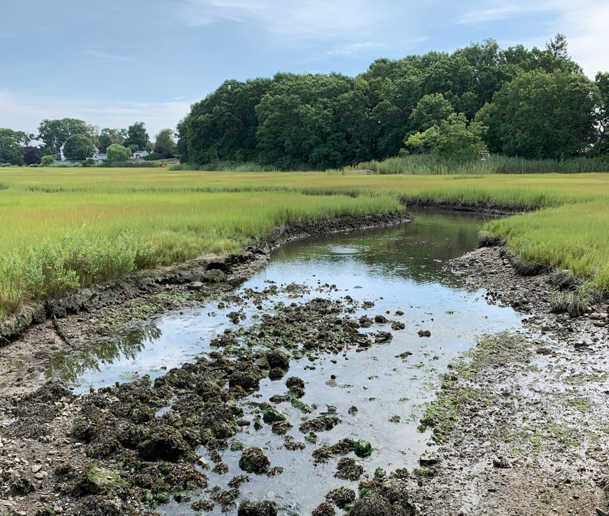
The Connecticut Shellfish Restoration Guide
Tessa L. Getchis^{1,2}, David H. Carey³, Kristin DeRosia-Banick³, Harry Yamalis⁴, Juliana Barrett^{1,2}, Aaron Kornbluth⁵, Alissa Dragan³, Katherine McFarland⁶, Katherine Hornick⁶, Zofia Baumann² & Jennifer Mattei⁷
¹Connecticut Sea Grant, ²University of Connecticut, ³Connecticut Department of Agriculture|Bureau of Aquaculture, ⁴Connecticut Department of Energy and Environmental Protection, ⁵The Pew Charitable Trusts, ⁶National Oceanic and Atmospheric Administration Fisheries Service, ⁷Sacred Heart University

Slide 2
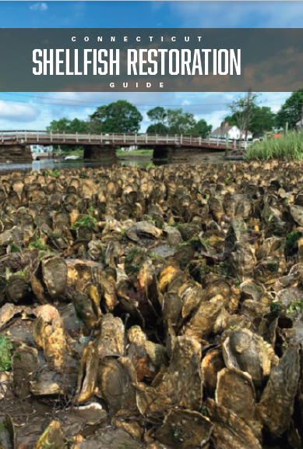
Background
2018 USDA NRCS Conservation Innovation Grant
A Plan for Restoration in Connecticut
Facilitated by state agencies
Involves diverse shellfish experts
Notes:
In 2018, the state received a grant to develop a plan for shellfish restoration.
A team that include CT Sea Grant, the University of Connecticut, the State Depts. of Agriculture and Energy and Environmental Protection,
The project brought together a steering committee of local, state and federal partners.
We also consulted with a number of people in the field including shellfish and harbor management commissions.

Slide 3
Ecosystem Services
Shellfish production
Improved water quality
Coastal habitat provision
Fisheries production
Shoreline stabilization
Notes:
Shellfish provide many ecosystem services that add value to our environment, economy, society and culture.
Those include:
Shellfish production (both commercial and recreational)
Improved water quality (via filtration and excess nutrient mitigation)
Coastal habitat provision
(non-shellfish) Fisheries production
Shoreline stabilization

Slide 4
Contents
About shellfish habitats
Decision making information
Step-by-step site selection help
Oyster habitat surveys
Potential restoration sites
Management, research, policy & outreach needs
Regulatory guidance and best management practices
Funding sources for projects
Notes:
That plan involved:
Identifying what is known about shellfish habitats, mainly oyster beds and reefs
compiling spatial and other data for decision making
surveying natural oyster habitats along the coast
Highlighting sites with potential for restoration
Identifying management, research, policy and outreach needs
Providing a step by step guide for site selection
Identifying regulatory guidance and best management practices
Pointing to potential funding sources for projects

Slide 5
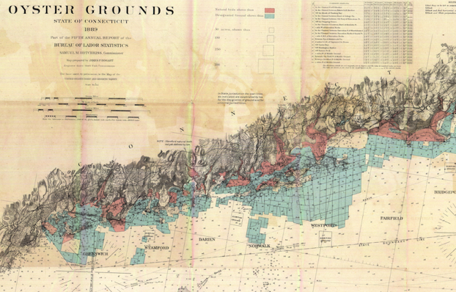
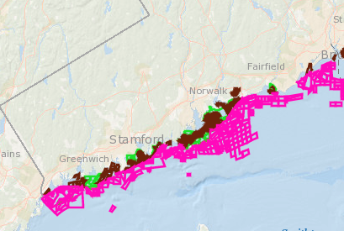
About shellfish habitats
1890
2022
Notes:
We reviewed the literature including state shellfish reports and maps dating back to the 1800s to uncover information about shellfish habitats and populations to help determine what we had versus what we have now.

Slide 6
About shellfish habitats
Area Type | Area (acres) | % Total Area
Connecticut navigable waters; all | 389,276 | 100
Connecticut shellfish areas; all | 86,997 | 22.35
Natural beds; all | 17,337 | 4.45
Natural beds; designated, state waters | 5,335 | 1.37
Bridgeport Darien Fairfield Greenwich Norwalk Stratford | 1,279 145 1,255 222 170 2,264
Natural beds, designated, town waters | 12,002 | 3.08
Branford Bridgeport Clinton Darien Fairfield Greenwich Guilford Madison Milford Norwalk Old Saybrook Stamford Stratford West Haven Westport | 80 1,254 288 516 900 1,613 33 348 1,657 1,994 129 403 1,073 1,096 618
Natural beds, undesignated, town waters | unknown | unknown
Commercial shellfish beds (all) | 61,421 | 15.78
Commercial shellfish beds (state) | 45,265 | 11.63
Commercial shellfish beds (town) | 16,156 | 4.15
Recreational shellfish beds | 10,422 | 2.68
Notes:
We also have the ability to present this graphically in terms of total acreage.
However, this table still underestimates the total shellfish habitat because we haven’t completed surveying undesignated natural oyster beds.

Slide 7
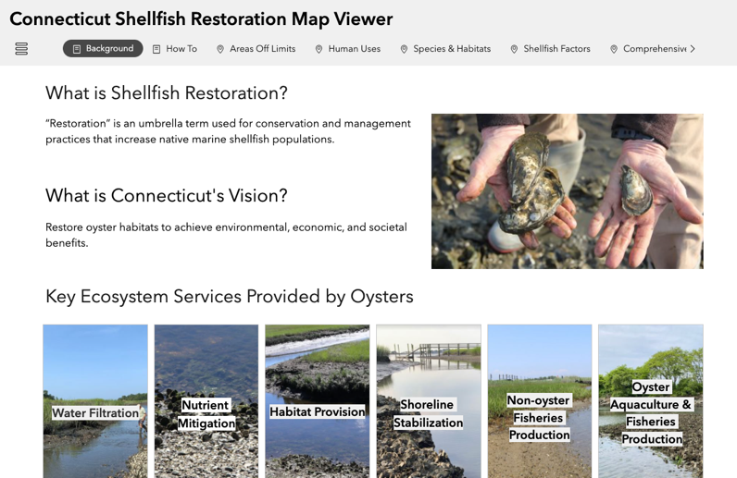
Decision making Info
https://s.uconn.edu/ctshellfishrestoration
Notes:
Interactive map viewer

Slide 8
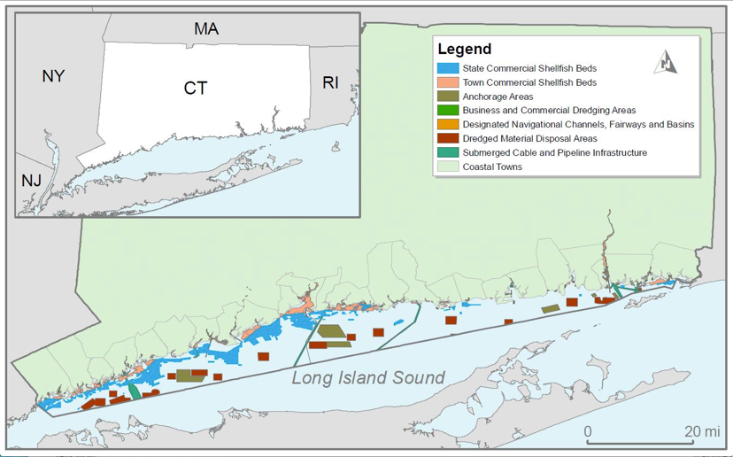
Site Selection
“Areas off limits”
Notes:
Interactive map viewer

Slide 9
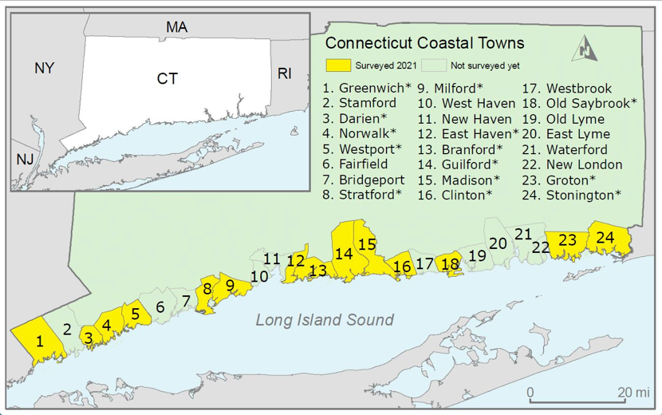
Oyster habitat surveys
Notes:
We reviewed the literature including state shellfish reports and maps dating back to the 1800s to uncover information about shellfish habitats and populations to help determine what we had versus what we have now.

Slide 10
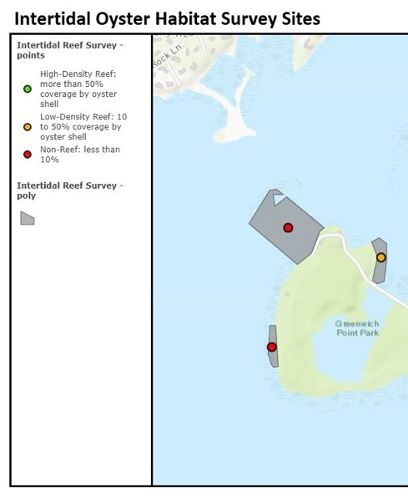
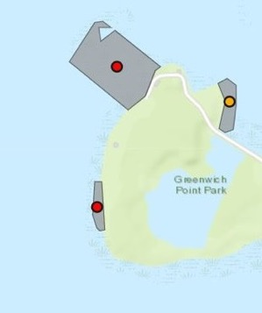
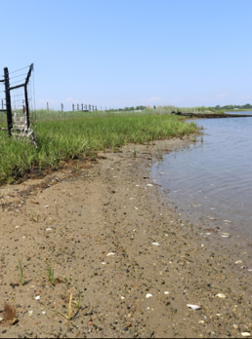
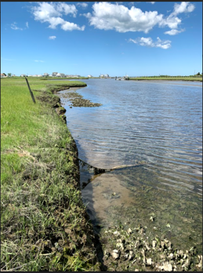
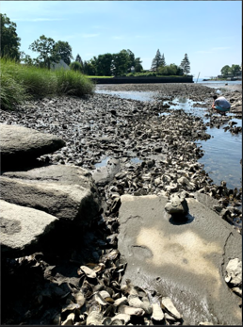
Oyster habitat surveys
Non-reef
Low density
High density
Notes:
We reviewed the literature including state shellfish reports and maps dating back to the 1800s to uncover information about shellfish habitats and populations to help determine what we had versus what we have now.

Slide 11
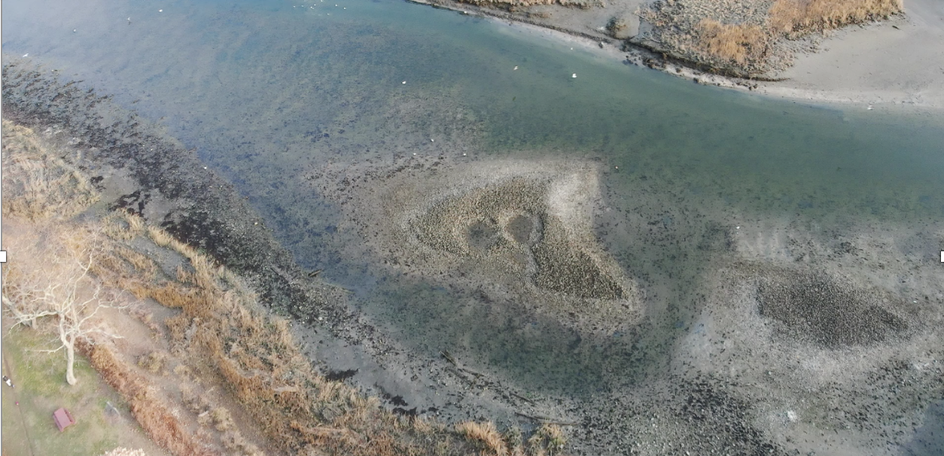
Notes:
We reviewed the literature including state shellfish reports and maps dating back to the 1800s to uncover information about shellfish habitats and populations to help determine what we had versus what we have now.

Slide 12
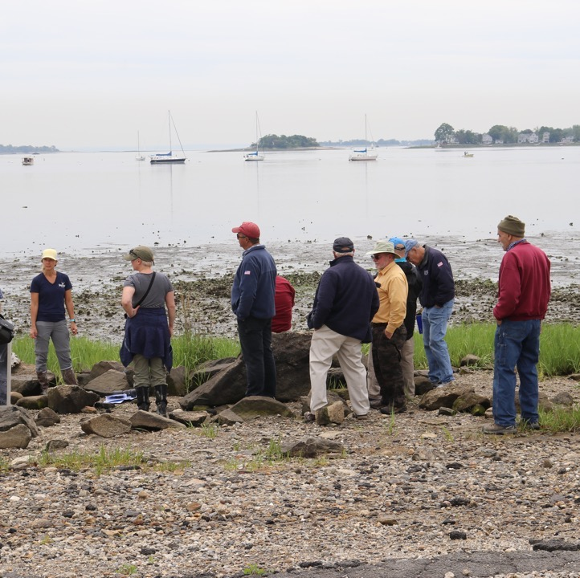
Potential Sites
Veterans Park (Norwalk
Ash Creek (Fairfield)
Bridgeport-Stratford Designated Natural Bed
Greenwich/Old Greenwich
Notes:
Interactive map viewer

Slide 13
Recommendations
Example 1
Example 2
Develop plan to expand spatial coverage of coastal zone soil survey mapping through the National Cooperative Soil Survey which includes subaqueous soils
Engage CT DEEP Commissioner to put into state regulations that shell be included on the list of products sold for which recycled content standards are to be developed
Notes:
Data management
Research & monitoring
Policy
Outreach

Slide 14
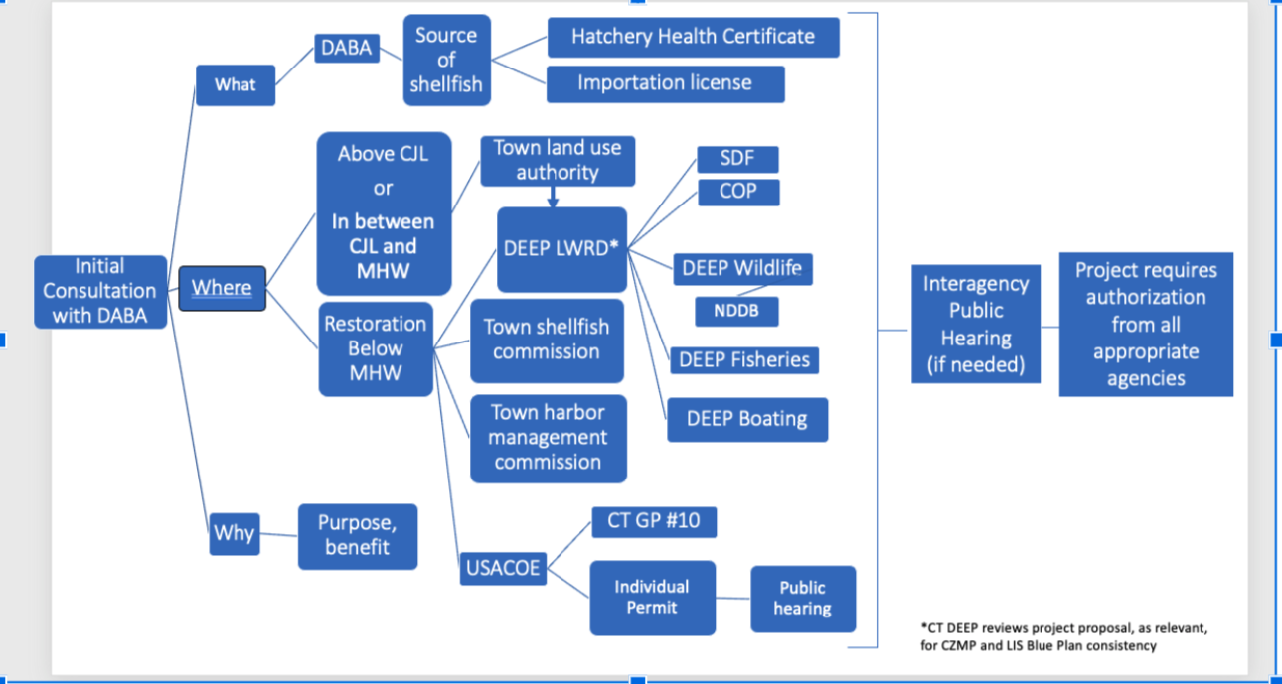
Regulatory Process

Slide 15
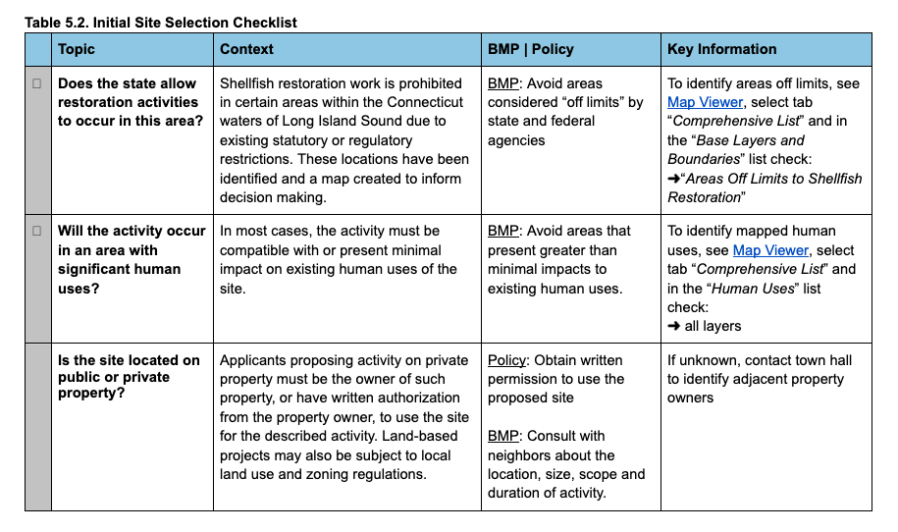
Regulations & BMPs
BMPs

Slide 16
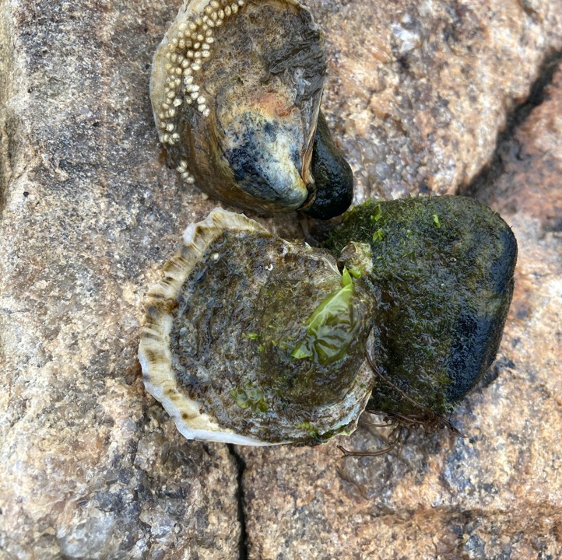
The Connecticut Shellfish Restoration Grants Directory
(see Guide or request link)

Slide 17
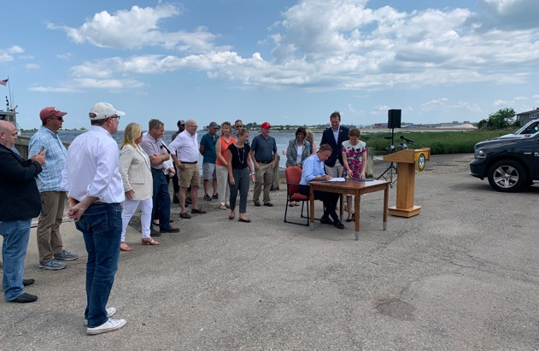
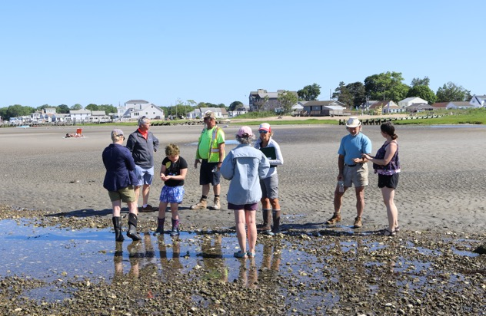
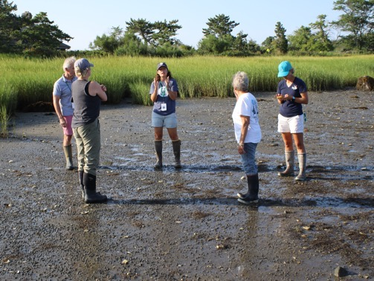
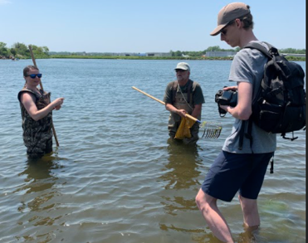
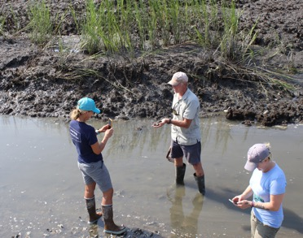
Its all about the partners…
collaboration…
learning…
listening…
sharing…

Slide 18
Acknowledgements
Funding: USDA NRCS Conservation Innovation Grant, The Pew Charitable
Trusts, Connecticut Sea Grant Communications Program
Photos: Griffin O’Neill, Tessa Getchis, Zofia Baumann
Maps: Michael Zuber
Video: Chandi Witharana
Steering Committee and Technical Consultants:
Gary Casabona, USDA Natural Resources Conservation Service
Chantal Collier, The Nature Conservancy
Sarah Crosby, Harbor Watch
Mike Davidow, resident of Trumbull, CT
Bryan DeAngelis, The Nature Conservancy
Andrew Fisk, The Connecticut River Conservancy
Christian Fox, The Nature Conservancy
Peter Francis, Connecticut Department of Energy and Environmental Protection
Boze Hancock, The Nature Conservancy
Dick Harris, Norm Bloom & Son Oysters & Clams
Bryan Hurlburt, Connecticut Department of Agriculture
Sue Jacobsen, Connecticut Department of Energy and Environmental Protection
Tony Judge, The Connecticut River Conservancy
Jay Kane, Groton Shellfish Commission
Alex Krofta, Save the Sound
Robert LaFrance, Audubon
Bill Lucey, Long Island Soundkeeper
Gwen MacDonald, Save the Sound
Peter Malinowski, Billion Oyster Project
Steering Committee and Technical Consultants (continued):
Jennifer Mattei, Sacred Heart University
Katie Mosher-Smith, Billion Oyster Project
Katie O'Brien-Clayton, Connecticut Department of Energy and Environmental Protection
Michael P. O'Neill, University of Connecticut Department of Extension
Sally Page Connelly, City Island Oyster Reef
R. Michael Payton, Connecticut Department of Energy & Environmental Protection (retired)
Lindsey Raymond, Connecticut Department of Agriculture
Judy Rondeau, Eastern Connecticut Conservation District
Cori M. Rose, U.S. Army Corps of Engineers
Denise Savageau, Connecticut Association of Conservation Districts
Chris Schillaci, NOAA GARFO Habitat Conservation and Ecosystem Management
John Short, Jr., Fairfield Shellfish Commission
Peter Solomon, The Sound School
Geoff Steadman, Stamford Harbor Management Commission
Chris Sullivan, SW Conservation District
Debbie Surabian, USDA Natural Resources Conservation Service
Mark Tedesco, EPA Long Island Sound Study
Brian Thompson, Connecticut Department of Energy and Environmental Protection
Garrett Timmons, USDA Natural Resources Conservation Service & Harmony Sea Farms
Jim Turek, NOAA GARFO Office of Habitat Conservation/ Habitat Restoration
Jamie Vaudrey, University of Connecticut
Alison Verkade, NOAA GARFO Habitat Conservation
Timothy Visel, The Sound School Regional Vocational Aquaculture Center
Penny Vlahos, University of Connecticut
Gary Wikfors, NOAA Northeast Fisheries Science Center Milford Aquaculture Laboratory

Slide 19
Acknowledgements
Field Consultants
Sue Baker, Greenwich Shellfish Commission
Alan Banister, Stonington Shellfish Commission
Eric Barrett, Advisory Commission on Coastal Waters, Town of Darien
Steve Bartush, Norwalk Shellfish Commission
Jimmy Bloom, Copps Island Oysters/Norm Bloom and Son
Norm Bloom, Copps Island Oysters/Norm Bloom and Son
Larry Bonin, Old Saybrook Shellfish Commission
Roger Bowgen, Greenwich Shellfish Commission
Bill Cavers, Advisory Commission on Coastal Waters, Town of Darien
Wayne Church, Clinton Shellfish Commission
Kevin Clark, Madison Shellfish Commission
Dave Colvin Jr., Old Saybrook Shellfish Commission
Richard Conant Jr., Groton Shellfish Commission
State Representative Joseph P. Gresko, Stratford
Kim Granbery, Leetes Island Oysters
Mark Georgian, First Water Engineering LLC
Michael Gilman, Indian River Shellfish
Rindy Higgins, Westport Shellfish Commission
Dave Hopp, Bell’s Shellfish LLC
Pete Johnson, Norwalk Shellfish Commission
Alicia Mozian, Westport Conservation Office
Stephen Nikituck, Madison Shellfish Commission
Andy Pandiani, Old Saybrook Shellfish Commission
Judy Preston, Long Island Sound Study, Old Saybrook Land Trust
David Prescott, Save the Bay
Field Consultants (continued):
Theodore Rathjen, Groton Shellfish Commission
Joe Schnierlein, Mayor’s Water Quality Committee, City of Norwalk
Joan Tracey Seguin, Greenwich Shellfish Commission
Jamie Walsh, Westport Shellfish Commission
Heather Williams, Town of Westport
Historical Maps/Documents and Legislative Material
Steve Rice, Connecticut State Library
Kayleigh Royston, Connecticut Department of Agriculture
Tim Visel, The Sound School Regional Vocational Aquaculture Center
Regulatory Guidance
David Carey, Connecticut Department of Agriculture, Bureau of Aquaculture
Yolanda Cooley, Connecticut Department of Energy and Environmental Protection
Kim Czapla, Connecticut Department of Energy and Environmental Protection
Alissa Dragan, Connecticut Department of Agriculture, Bureau of Aquaculture
Shannon Kelly, Connecticut Department of Agriculture, Bureau of Aquaculture
Cori M. Rose, U.S. Army Corps of Engineers, New England District
Brian Thompson, Connecticut Department of Energy and Environmental Protection
Bruce Williams, Connecticut Department of Energy and Environmental Protection
External Technical Reviewers:
Anne Birch, The Nature Conservancy
Boze Hancock, The Nature Conservancy

