Slide 2
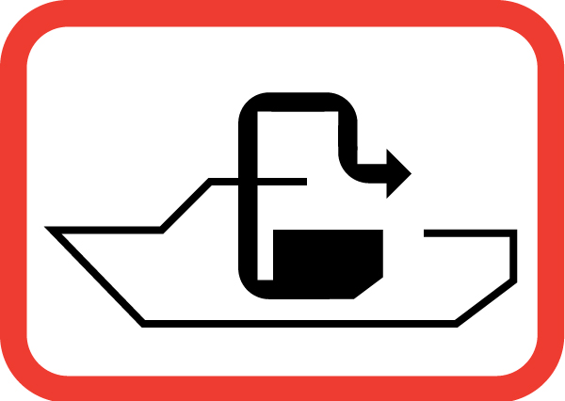
Connecticut Clean Vessel Act Program and Long Island Sound No Discharge Area
April 2, 2022
Kate Hughes Brown
BIG/CVA Program Coordinator
DEEP Boating Division

Slide 3
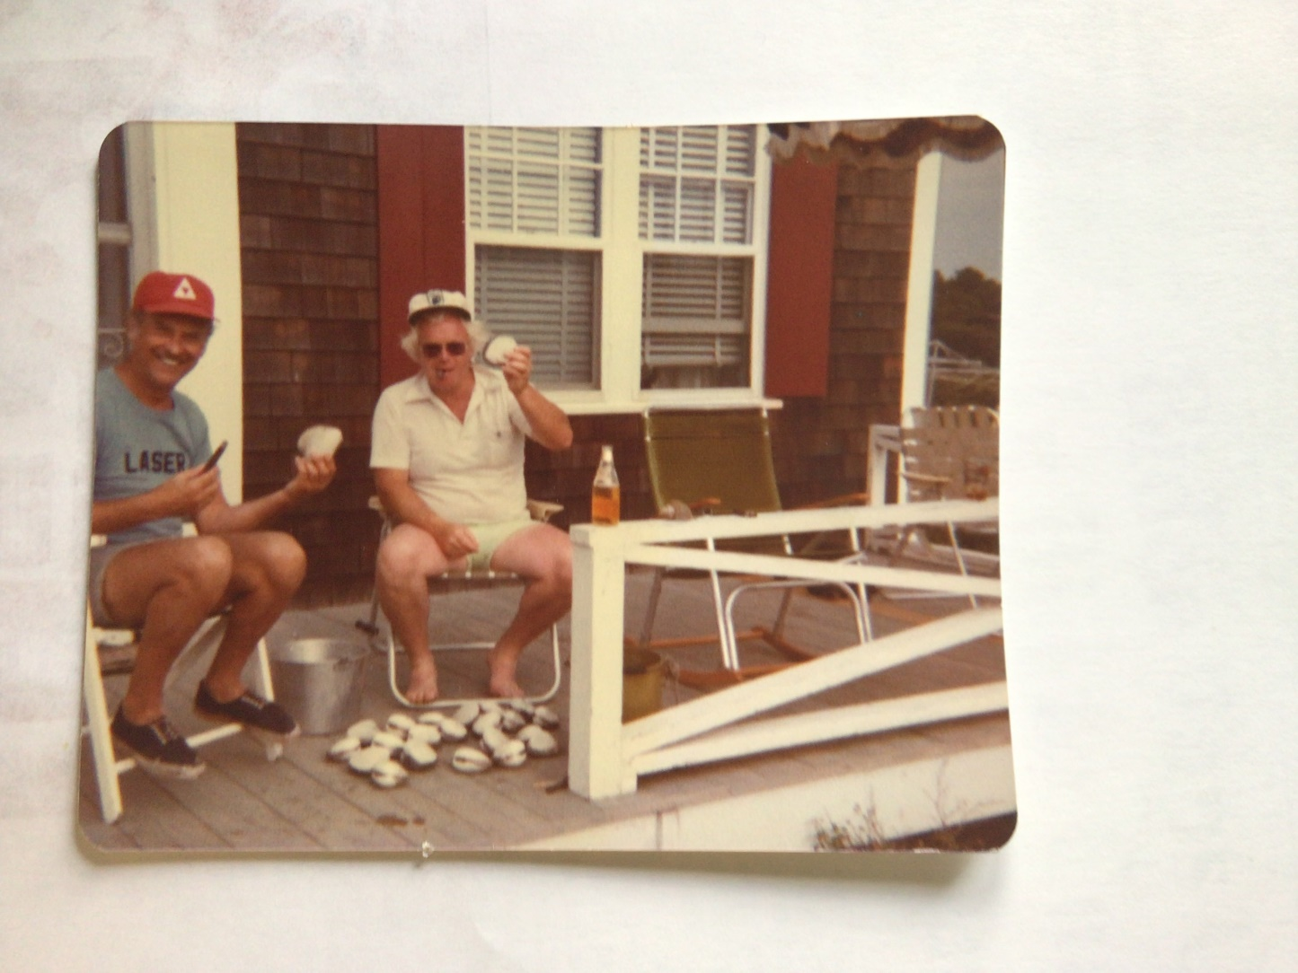

Slide 4
Connecticut’s No Discharge Area

Slide 5
Federal Clean Vessel Act (CVA) Grants Started in 1993 – 75% cost share with the USFWS Sportfish and Boating Trust Fund
Installed more than 100 pumpout stations
24 Pumpout Vessels
23 Dump Stations
Pumpout Vessel on Candlewood Lake
Extensive boater outreach and education

Slide 7
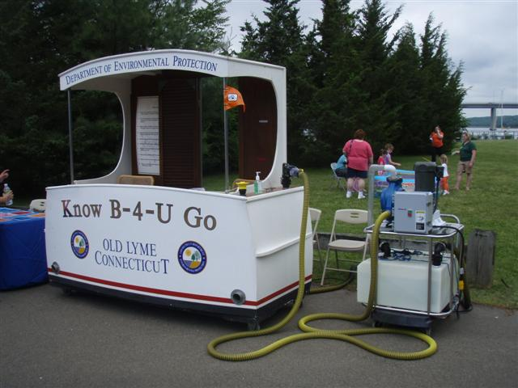
Availability of Pumpout Stations and Vessels Statewide supported EPA’s NDA Approval

Slide 8
Outreach and Education

Slide 9
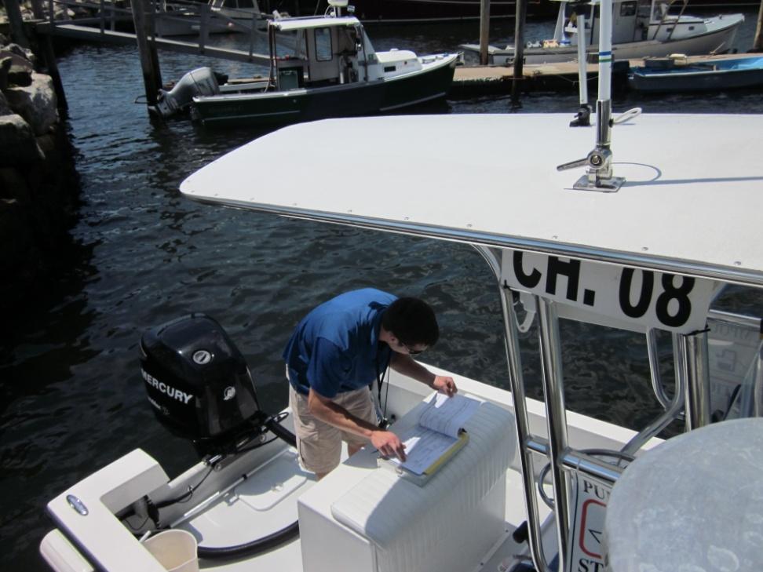
Annual Inspections for Pump Speed, Accurate Pumpout Log Records, & Safety

Slide 10
FREE PUMPOUTS!!!

Slide 11
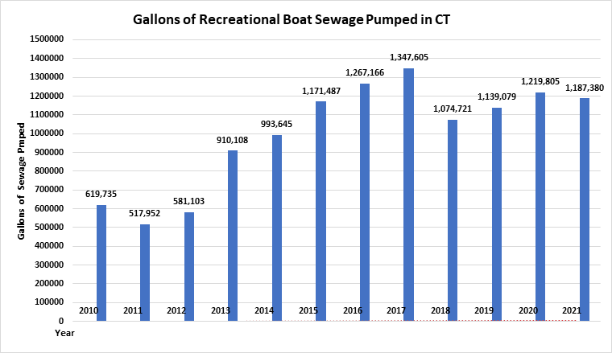
Pumpout logs from marine facilities and pumpout vessels

Slide 13
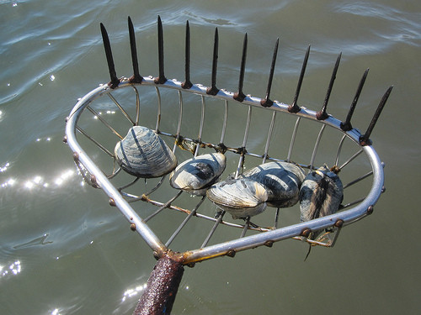
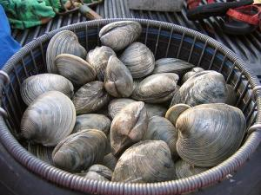
April 1, 2019 – After 35 years, the State of Connecticut reopens recreational shellfish beds in Clinton.

Slide 14
Collaborative Project Goals & Benefits
Provide high quality outdoor recreation
Robust data to inform the shellfish surveys
Opened shellfish beds for recreation = more boater support for using pumpouts
Tangible CVA Program results for the public
Recreational Shellfishing = economic driver
Community engagement and support

Slide 15
Questions or Project Ideas?
Kate Hughes Brown
BIG/CVA Program Coordinator
Kate.brown@ct.gov
860-549-2253
https://portal.ct.gov/DEEP/Boating

