Slide 1
2020 - 2022 Shellfish Restoration Funding for Natural Oyster Seed Beds
David Carey

Slide 3
2020/2021 Resource & Financial Assistance
Hard Clam transplant 2020 and 2001: Retail value $2.6 million
2020 Sea Grant Covid Response Natural bed enhancement: $52,500.00
2020 NOAA CFAP Round 1 $453,000.00
2020 USDA FSA CARES: $1,400,615.00
2021 Sea Grant Covid Response Refrigerated Units: $50,000.00
2021 NOAA CFAP Round 2: $500,000.00
2021 CT Department Agriculture Cares Loss $3,250,000.00
2022 NOAA CFAP Infrastructure Natural Bed Enhancement $250,000.00
2022 Sea Grant Covid Response Natural Bed Enhancement $100.000.00
Direct Payments $6,056,115.00
Total Assistance $8,656,115.00

Slide 4
Financial Assistance By Type

Slide 5
2022 Workplans
DOAG DA/BA will compensate participants by allowing the harvest and later sale of clams for:
Recovering and replanting shell (thereby removing silt)
DOAG DA/BA & Sea Grant have $375,000 to compensate participants for the following services:
Payment for utilizing clam suction dredge to recover, quantify and replant buried shell
Payment for stirring and removing silt with small dredges in designated area
Purchase and plant oyster/hard clam shell
Purchase and plant large oysters
Locations: Bridgeport/Stratford, Fairfield, Fish Island, Greenwich Point (requires working VMS Unit)
Timeframe:
Workplan “a” begins April 25th
Workplan “b, c” begins May 1st
Workplan “d, e” begins June 1

Slide 6
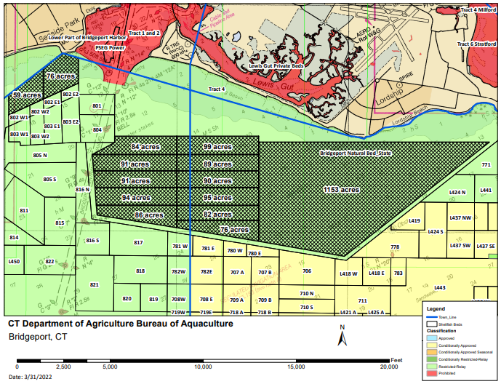

Slide 7
Proposed Compensation
Contractor Services: Each shellfish farmer contractor will work for 8 hours per day.
The calculations are as follows:
Sale of hard clams
Fixed payment for Suction Dredge Contractor
Fixed payment for Small Dredge Contractor $929.34 (8hrs); $116.17 (1hr)
d) Purchase and plant sell on designated natural beds ($3.75/bushel)
e) Purchase and plant large oysters on designated natural beds ($0.40 a piece)

