Slide 1
Connecticut’s Shellfish Sanitation Program
Adherence to National Standards and Significance for Recreational Programs
Alissa Dragan, Supervising Environmental Analyst
Department of Agriculture, Bureau of Aquaculture
Gathering of the Shellfish Commissions, February 3, 2024
Notes:
Overview of Bureau & CT Industry
Role in Administering NSSP-MO to manage growing areas
Bacteriological standards for open areas
Review sampling requirements
Reminders/emerging issues/new policies

Slide 2
Introduction to the CT Shellfish Program: DoAG Staff
Administration
Director, David Carey
Administrative Assistant, Lori Scianna
Shellfish Laboratory
Fisheries Biologist II (Marine), Dairy LEO, Joseph DeCrescenzo
Fisheries Biologist I (Marine), Andrea (Anne) Staak
Shellfish Pathologist, Dr. Lydia Bienlien
Boat Operations
Vessel Captain, Rick Seiden
Shellfish Sanitation Program
Supervising Environmental Analyst, Alissa Dragan
EA III, Shellfish Sanitation Officer, Jenifer Yeadon
EA II, HAB Specialist, Emily Marquis
EA II, GIS Specialist, Michal Zuber
EA I, Aquaculture Permitting, Matt Bartell
EA I, Vacant

Slide 3
Introduction to the CT Shellfish Program: DoAG Responsibilities
Growing Area Classification
Growing Area Management (Closures & Openings)
Regulate Shellfish Harvest, Processing, Sale, & Shipment
Biannual Harvester, Processor, & Dealer Inspections & Illness Investigations
Aquaculture Permitting, Including Inland Fish Farming & Seaweed
Laboratory: Seawater & Shellfish Bacteriological, Viral & Vibrio Testing, HAB Monitoring Program, Shellfish Pathology, & Evaluations for the CT Dairy Industry
DoAG is the responsible Agency for ensuring the safety of molluscan shellfish for human consumption. DoAG Analysts oversee CT shellfish production from the growing areas through the distribution chain

Slide 4
Introduction to the CT Shellfish Program: Industry Profile
Hard Clam
Mercenaria mercenaria
Eastern Oyster
Crassostrea virginica

Slide 5
Introduction to the CT Shellfish Program: Industry Profile
Shellfishing is an important component of the State’s economy, recreation, and tourism industries. CT shellfishing generates over $30 million in farm-gate sales annually
The CT shellfishing industry provides over 300 jobs statewide
More than 61,000 acres are under cultivation in CT’s coastal waters
Licensed Shellfish Harvesters 48
Shellfish Harvest Vessels 110
Licensed Seed Oysterers 23
Licensed Seed Helpers 127
Licensed Seed Boats 53
Licensed Wholesale Firms 24
CT oysters have a reputation for quality & an outstanding safety record

Slide 6
Introduction to the CT Shellfish Program: Industry Profile

Slide 7
Introduction to the CT Shellfish Program: NSSP
Under the jurisdiction of the CT Department of Agriculture, Bureau of Aquaculture
NSSP is a cooperative program consisting of State, FDA, & Industry partners who agree to accept & meet specific responsibilities to ensure the safety of molluscan shellfish
The CT Shellfish Program operates as part of the National Shellfish Sanitation Program (NSSP)

Slide 8
Introduction to the CT Shellfish Program: NSSP
Model Ordinance
Oversight
FDA
Interstate Shellfish Sanitation Conference
Responsibilities
SSCA
Industry
Research

Slide 9
Why do we need a Shellfish Sanitation Program?
Introduction to the CT Shellfish Program: NSSP
Shellfish are effective filter feeders & can concentrate pathogens or other contaminants as they feed. One oyster can filter 240 liters of water in a day
Shellfish are often consumed RAW with no cook step to kill any pathogens that may be present
Toxins formed by HABs are often heat stable & are not inactivated by cooking
Shellfish are often grown near shore
They are sessile or have limited mobility & cannot move away from contaminants
Contaminants may be pollution-related or naturally occurring
Ambient water in open growing areas must be free from hazardous &/or deleterious substances

Slide 10
Introduction to the CT Shellfish Program: Growing Area Classification
Marina/Mooring Survey
Shoreline Survey
Water & Tissue Sample Results

Slide 11
Introduction to the CT Shellfish Program: Growing Area Classification, Shoreline Survey
Written evaluation of all environmental factors, including actual and potential pollution sources, meteorological, and hydrographic influences which have a bearing on the water quality in a shellfish growing area
Required every 12 years. Shoreline of each shellfish producing town is walked at low tide to locate pipes and other features
Assess factors such as topology, hydrography, development patterns, sewage handling, domestic & wild animal populations
Sample pipes, storm drains, catch basins, streams, etc. for bacterial testing & conduct flow calculations where necessary
Individual properties are inspected for signs of failing SSDS, cross connections to stormwater systems, or other pollution sources

Slide 12
Introduction to the CT Shellfish Program: Growing Area Classification, Shoreline Survey
Evaluate WPCF and collection system performance
Assess impacts of industrial discharges & historic pollution sources
Perform marina & mooring area dilution calculations to evaluate the potential for contamination & appropriately size closure areas
Document the presence of bird & domestic & wild animal populations (farms, wildlife, etc.)
Locate & map outfalls, pump stations, CSO’s, & other features with the potential to impact growing areas
Notes:
If an area cannot be accessed during the survey field work that area must be classified as prohibited.
Access is becoming an issue state wide.

Slide 13
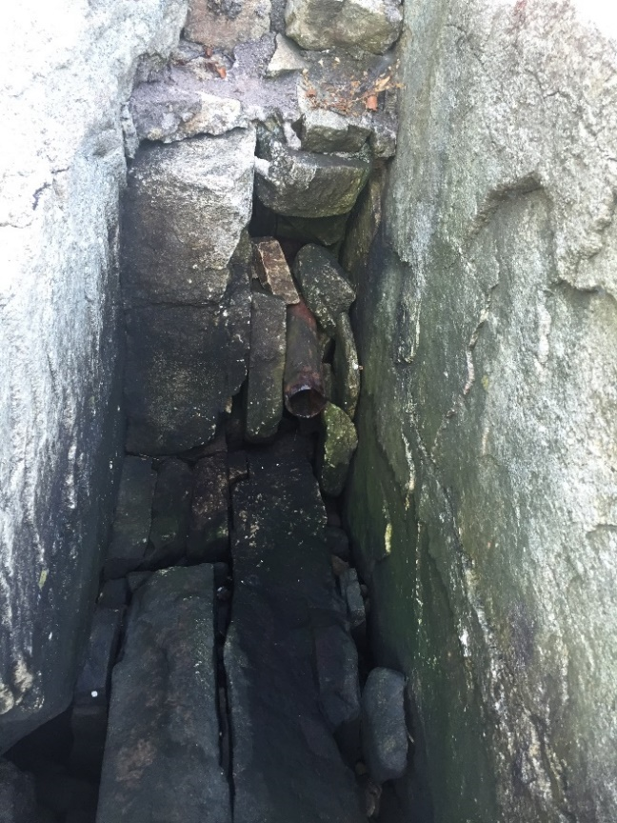
Introduction to the CT Shellfish Program: Growing Area Classification, Shoreline Survey
Notes:
Example of types of things we look for as part of survey
Potential sewage plume
Straight pipe from bathroom to rock ledge
Pipe with >8000 CFU/100mL suggesting sewage impact

Slide 14
Introduction to the CT Shellfish Program: Growing Area Classification
Growing area classifications based on sanitary survey findings. Water sample results should support classifications
Water Quality Monitoring: Performed on a routine basis, & after specific events impacting water quality - rain, elevated river stages, or disruptions in sewage treatment
Water & shellfish samples are tested for fecal coliform bacteria, the indicator of sewage contamination utilized by the NSSP
Shellfish are also sampled for the viral indicator male specific coliphage (MSC), and Vibrio bacteria
Additional laboratory sampling for Hazardous Algal Blooms & saxitoxin (toxin responsible for Paralytic Shellfish Poisoning) is conducted
There are 480 water quality monitoring stations located throughout the Sound

Slide 15
Introduction to the CT Shellfish Program: Growing Area Classifications
Approved:
Conditionally Approved:
Meets NSSP Bacteriological Standards
No direct discharges of wastewater effluent
Not indirectly impacted by wastewater effluent
Not subject to contamination from human or animal fecal matter at levels of public health concern
Not contaminated with: Pathogenic organisms Poisonous or deleterious substances Marine biotoxins
Meets NSSP Bacteriological Standards under specific conditions (rainfall, seasonal, etc.)
No direct discharges of wastewater effluent
May be indirectly impacted by wastewater effluent
Not subject to contamination from human or animal fecal matter at levels of public health concern
Not contaminated with: Pathogenic organisms Poisonous or deleterious substances Marine biotoxins
Notes:
Essentially 4 Classifications used in CT
Approved should meet standards under all conditions
CA must meet standards in the OPEN status

Slide 16
Introduction to the CT Shellfish Program: Growing Area Classifications
Restricted:
Prohibited:
Does not meet NSSP Approved Bacteriological Standards under most conditions
May be indirectly impacted by wastewater effluent
May be impacted by a limited degree of pollution
Shellfish are relayed, i.e., transplanted onto a direct harvest bed for a minimum of 2 weeks
Following relay, shellfish tissues are sampled for fecal coliform bacteria prior to market harvest
Does not meet NSSP Approved Bacteriological Standards under most conditions
Growing area is adjacent to a WPCF outfall or other significant point source of pollution
Pollution sources that contaminate the areas are unpredictable
Growing area is contaminated with fecal waste
Concentrations of biotoxin have been found in the shellfish
Area contaminated with poisonous or deleterious substances (PCB’s, heavy metals, etc.)
Notes:
Six month relay when less than 50
Otherwise 2 weeks

Slide 17
Introduction to the CT Shellfish Program: Growing Area Classification, NSSP Bacteriological Standards
NSSP Fecal Coliform Criteria for an Approved area:
Geometric Mean of a station’s sample results shall not exceed 14 CFU/100 mL
AND
no more than 10% of all samples at a sample station shall exceed 31 CFU/100mL

Slide 18
Introduction to the CT Shellfish Program: Growing Area Classification, NSSP Bacteriological Standards
To meet the Approved Criteria, it takes 8 million cubic feet of dilution water to dilute one person’s waste in one day
OR
59,850,779 gallons
OR
Volume equal to 12 football fields covered in 10 feet of water

Slide 20
Introduction to the CT Shellfish Program: Sampling Requirements
Vary Depending on Classification
Approved Stations – APC
Conditionally Approved – Open Status, APC, & Reopening
Conditionally Approved Seasonal – Open Status, APC & Reopening
Restricted & Prohibited – No Samples Required

Slide 21
Introduction to the CT Shellfish Program: Sampling Requirements
Adverse Pollution Condition Samples (APC)
A minimum of five (5) samples shall be collected annually under adverse pollution conditions from each sample station in the growing area
A minimum of the most recent fifteen (15) samples collected under APC from each sample station shall be used to calculate the median or geometric mean and percentage to determine compliance with this standard
Conditionally Approved Open Samples
Monthly water samples are required when the growing area is in the open status of its conditional classification
If a monthly sample cannot be collected due to environmental constraints, the monthly sampling requirement will be satisfied if an additional water sampling run is conducted the following month

Slide 22
Introduction to the CT Shellfish Program: Sampling Requirements
Reopening Samples
Satisfactory fecal coliform seawater and tissue samples are required prior to reopening a growing area following a rainfall closure
In addition to satisfactory seawater samples:
Shellfish tissue samples are required if there is no verification study
Following a sewage closure, MSC tissue samples must be collected with results ≤50 PFU/100gm, to open impacted areas prior to 21 days
The closure time period shall be at least fourteen (14) consecutive days when environmental conditions are suitable for shellfish feeding and cleansing, unless shorter time periods are demonstrated to be adequate
CT DoAG policy:
Minimum 7 day closure with reopening on the 8th day following the collection of satisfactory seawater &/or shellfish tissue samples
Notes:
We are currently reviewing seawater & tissue data to determine if the closure time-frame can be shortened in any of the state’s growing areas.
Tissue verification studies will be required to make these changes, if possible

Slide 23
Shellfish Tissue Verification Studies
A growing area temporarily placed in the closed status…, shall be returned to the open status only when:
The emergency situation or condition has returned to normal and sufficient time has elapsed to allow the shellstock to reduce pathogens or poisonous or deleterious substances that may be present in the shellstock to acceptable levels. When pathogens are of concern, studies establishing sufficient elapsed time shall document the interval necessary for reduction of coliform levels in the shellstock to pre-closure levels. Such coliform studies may establish criteria for reopening based on coliform levels in the water.
NSSP-MO Stipulates that the closure time period shall be at least fourteen (14) consecutive days when environmental conditions are suitable for shellfish feeding and cleansing unless shorter time periods are demonstrated to be adequate
Notes:
In light of the number of rainfall closures over the past year, and possibility the this is our new weather pattern here in CT, The DoAG is in the process of reviewing our seawater and tissue sample data to determine if the typical 7 day closure time frame can be reduced in any of the state’s growing areas.
This change will not be possible without tissue verification studies that demonstrate that the shellfish are purging any contaminants within the closure time period.

Slide 24
Introduction to the CT Shellfish Program: Sampling Requirements
Important
Status Open/Closed?
Rainfall APC?
Schedule samples by NOON on Friday with DoAG Analyst or Lab staff or at least 24 hours prior to collection
Tides Start - 1.5 hours after high Stop - 1.5 hours after low
Processing Time Limits Seawater – 30 hours Shellfish – 24 hours

Slide 25
Sample Form & Tracking
Town & Tax Code
Collector(s)
Date & Tide Stage (E, L)
Station ID
Time of Collection
Area Sampled
Area Status (O/C)
APC Sample Run?
Note anything unusual, large flock of birds, odors, discolored water, etc. Be specific

Slide 26
Common Sampling Mistakes
Not scheduling ahead with lab/weekend scheduling
Incomplete or no sample sheet provided
TC: is tap water, from a refrigerator, not collected with first sample, not provided, too hot, frozen
Bottles/ Samples : cracked on bottom, do not touch the inside of bottle or lid, lid not securely affixed, paper seal is in cup, no air space/too much airspace, sediments & debris in sample, frozen, submerged in ice melt in cooler, holding time exceeded
Notes:
In summer ice packs/frozen water bottles are useless except for keeping bottles out of cooler melt water. Supplement with ice
In cold weather be careful the samples don’t freeze

Slide 27
Laboratory Processing
2023
Total Samples 6120
Seawater Samples 5641
Tissue Samples 225
MSC Samples 26
HAB Samples 195
PSP Samples 13
Vibrio Samples 20
2022
Total Samples 5276
Seawater Samples 4884
Tissue Samples 136
MSC Samples 11
HAB Samples 216
PSP Samples 15/ASP Samples 6
Vibrio Samples 8
Notes:
844 more samples of all types
A difference of 757 samples due to excessive rain
89 more meats

Slide 28
Reminders
Samples for existing areas will be prioritized over those collected for establishing a new area. Commercial samples always take priority
Sampling for the following week must be planned by FRIDAY at NOON at the latest. No sample runs may be planned over the weekend
Samples cannot be delivered on Fridays, weekends, or holidays
Only DoAG trained samplers can collect. DoAG maintains a list of authorized Commission members

Slide 29
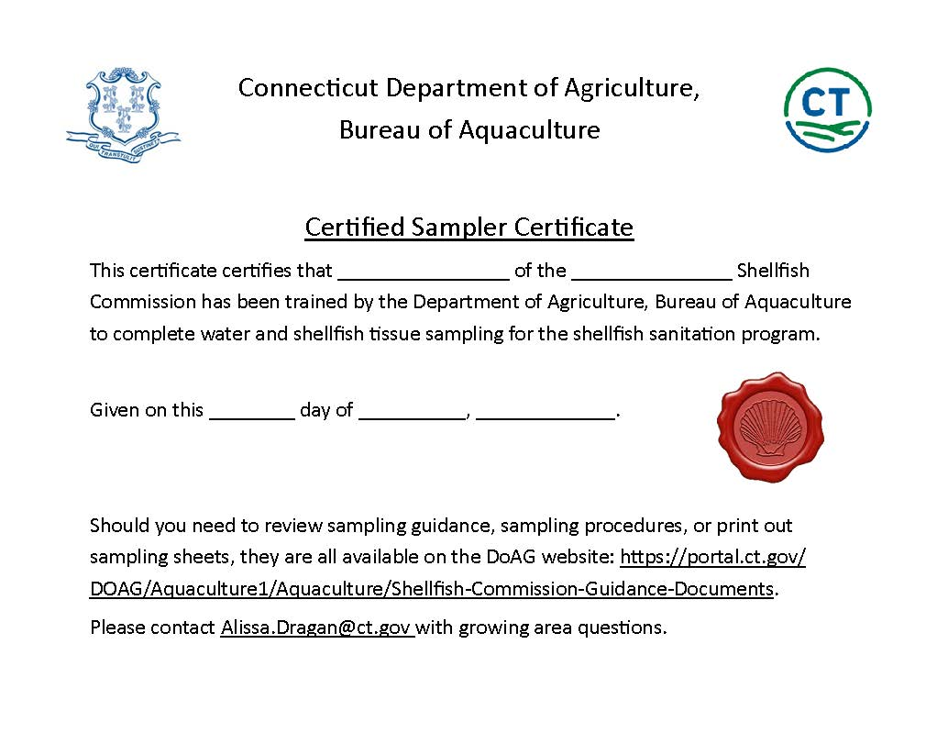

Slide 30
Emerging Issues: 2023 NSSP-MO Update
2019 NSSP-MO
Mooring Area Definition:
Any water area that is used to provide temporary or permanent anchorage for more than 20 boats. Mooring areas do not include any structures for docking boats.
2023 NSSP-MO
Mooring Area Definition:
Any water area that is used to provide temporary or permanent anchorage for more than twenty (20) boats with marine sanitation devices. Mooring areas do not include any structures for docking boats.
Notes:
This change requires verification of heads & that valves are sealed
Modern boats have hidden heads – center console
Analysts do not have authority to board vessels for inspections
Therefore we have to assume that every boat has a head capable of discharging and that any empty mooring will be occupied by same
DoAG is seeking to meet with the state harbormasters to discuss how they might assist. Authority may vary by town
Many areas that must be reclassified are small (~25) FDA IS LOOKING

Slide 31
Other Services
Produce maps for your recreational permits and commercial shellfish lease sites
Permit shellstock restocking activities:
Recreational Relay license required to move shellstock from one area to another
Reopening license may be required depending on source of relayed product
Scientific/Resource Assessment license
Shellfish pathology

Slide 32
Questions?

