Slide 1
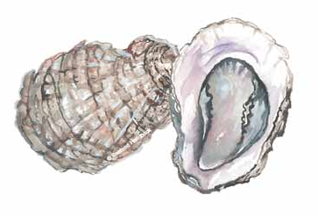
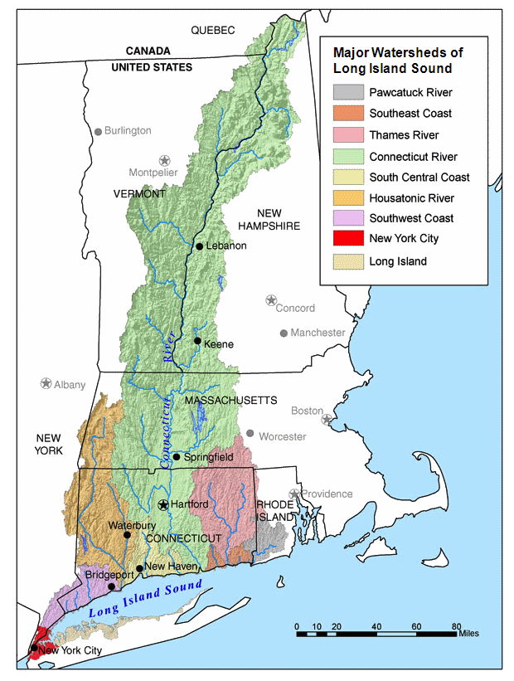
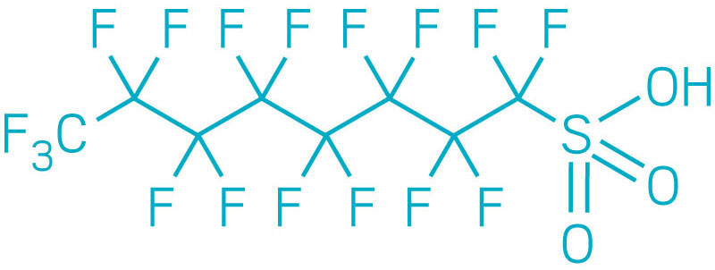


Recent studies on PFAS in coastal CT fish and shellfish
Margot Grimmelpont
Kaitlyn Campbell
Zosia Baumann
Christopher Perkins
Anthony Provatas
Jess Brandt, PhD
University of Connecticut
Dept. of Natural Resources and the Environment
Center for Environmental Science and Engineering
CT Sea Grant
jess.brandt@uconn.edu

Slide 2
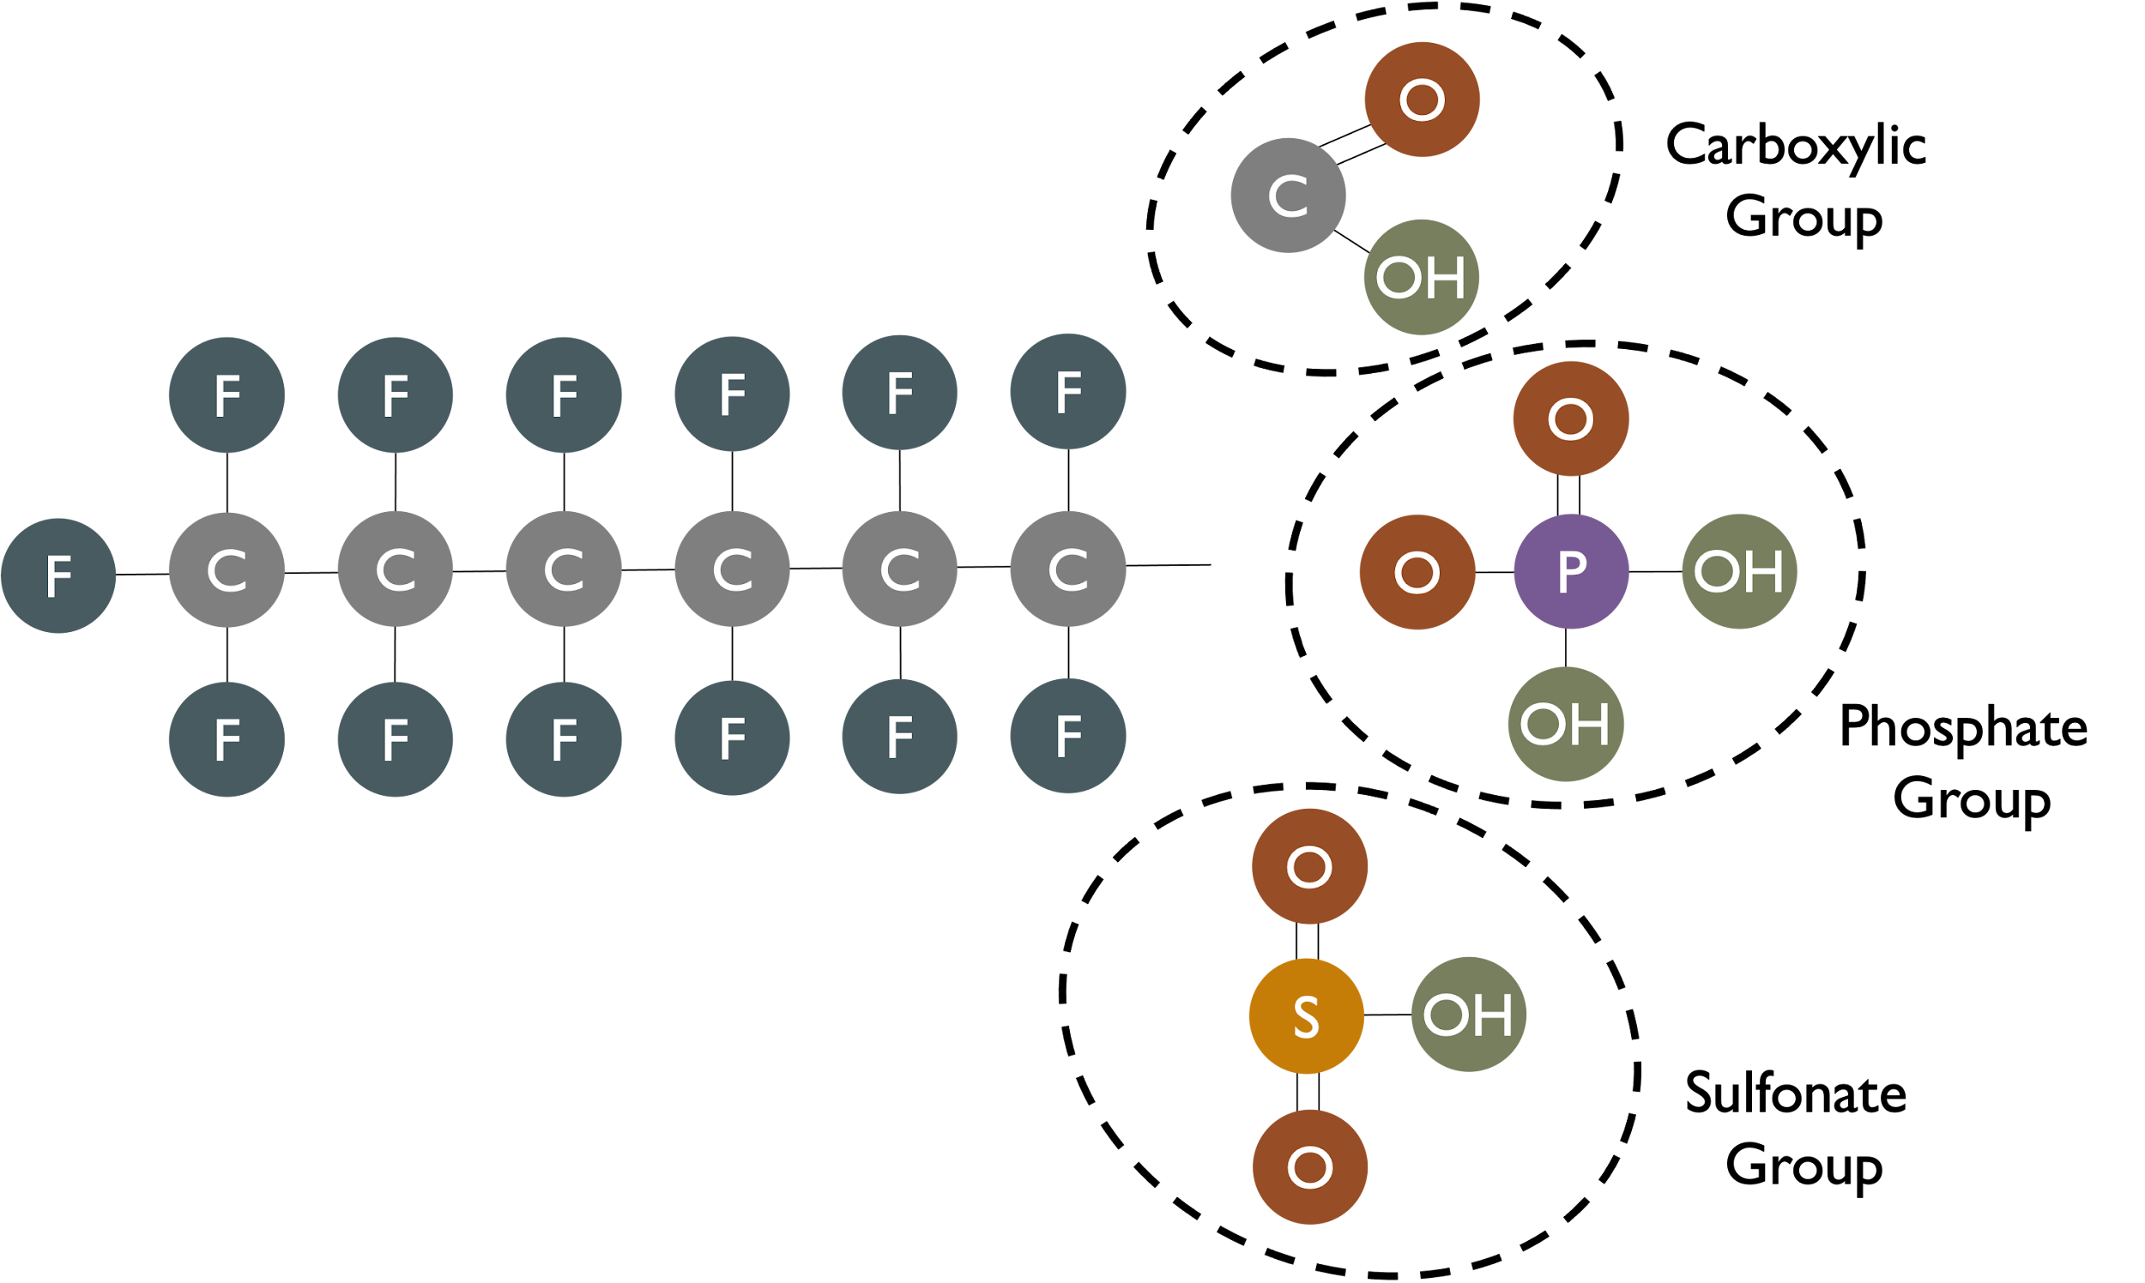
What are PFAS, “the forever chemicals”?
The per- and polyfluoroalkyl substances
Fluorinated carbon chains of varying lengths, different types of functional “head” groups
15,000+ compounds depending on definition
Long-chain vs short chain compounds
PFOS and PFOA (long chain) are most widely used and studied

Slide 3
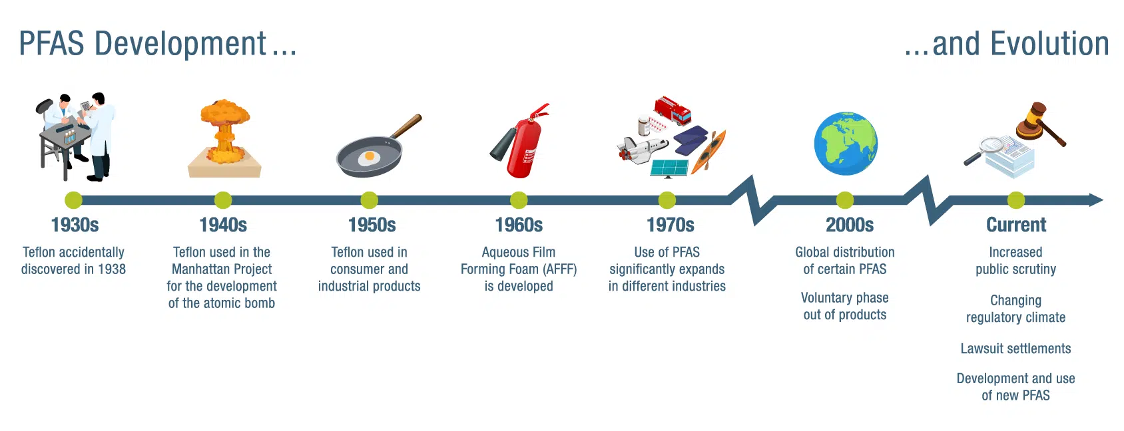
Where did they come from?
PFAS are entirely man-made
PFAS are not new, but they are considered contaminants of emerging concern because the science, policy, and regulation of PFAS are emerging
https://www.kimley-horn.com/news-insights/perspectives/what-is-pfas/

Slide 4
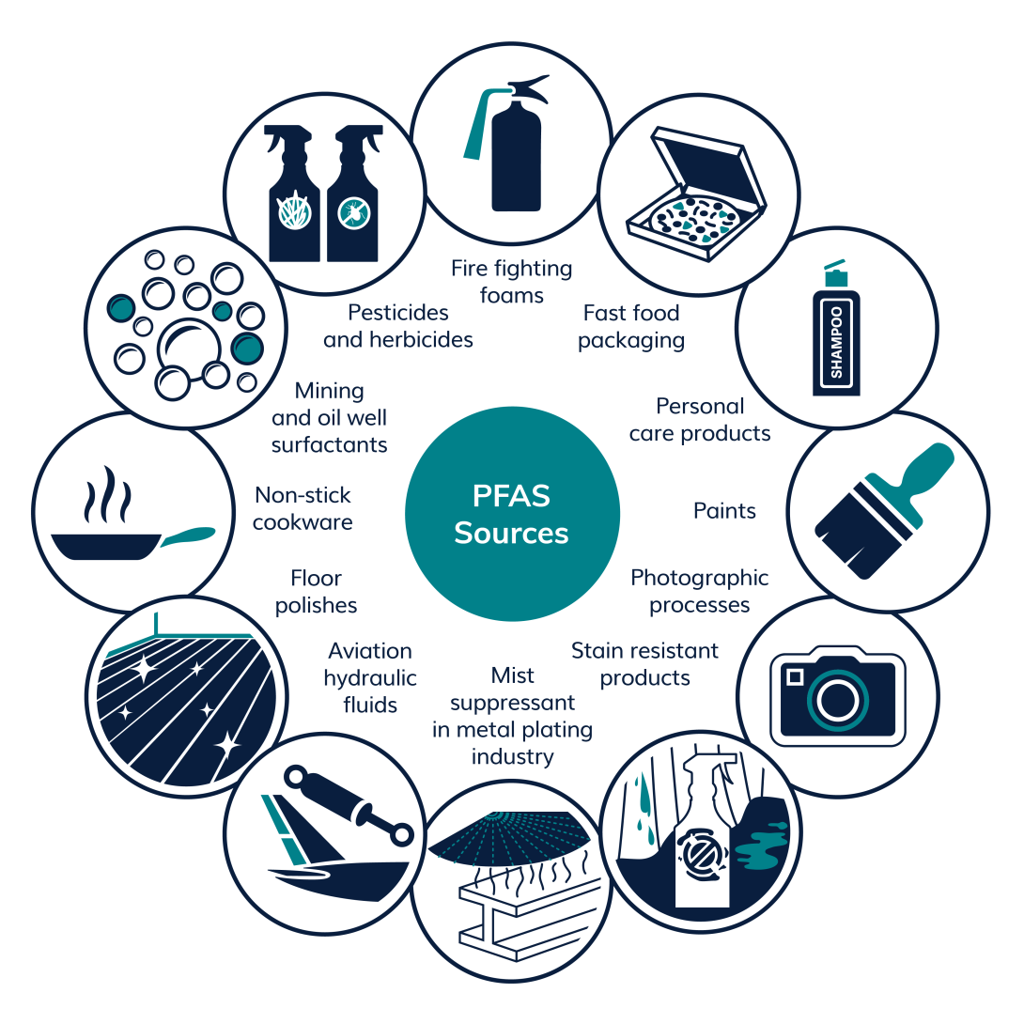
What are they used for?
PFAS are incredibly useful because of their surfactant properties
Surfactants are chemicals that reduce surface tension between liquids, liquids and gases, or liquids and solids

Slide 5
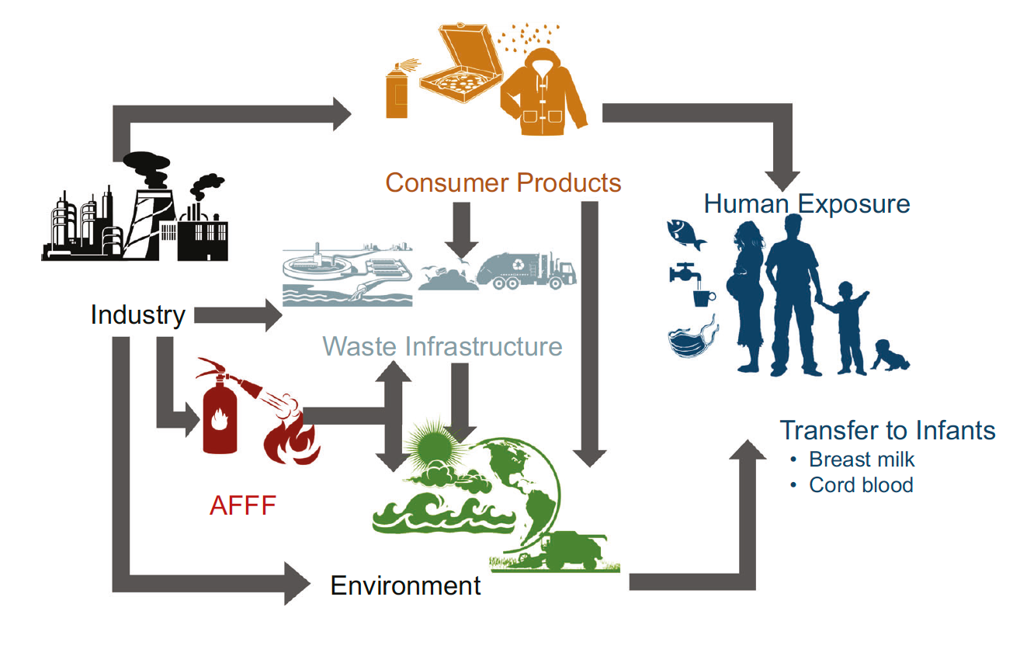
Sources and distribution of PFAS – the “forever chemicals”
Sunderland et al. (2019); Lein et al. (2023)

Slide 6
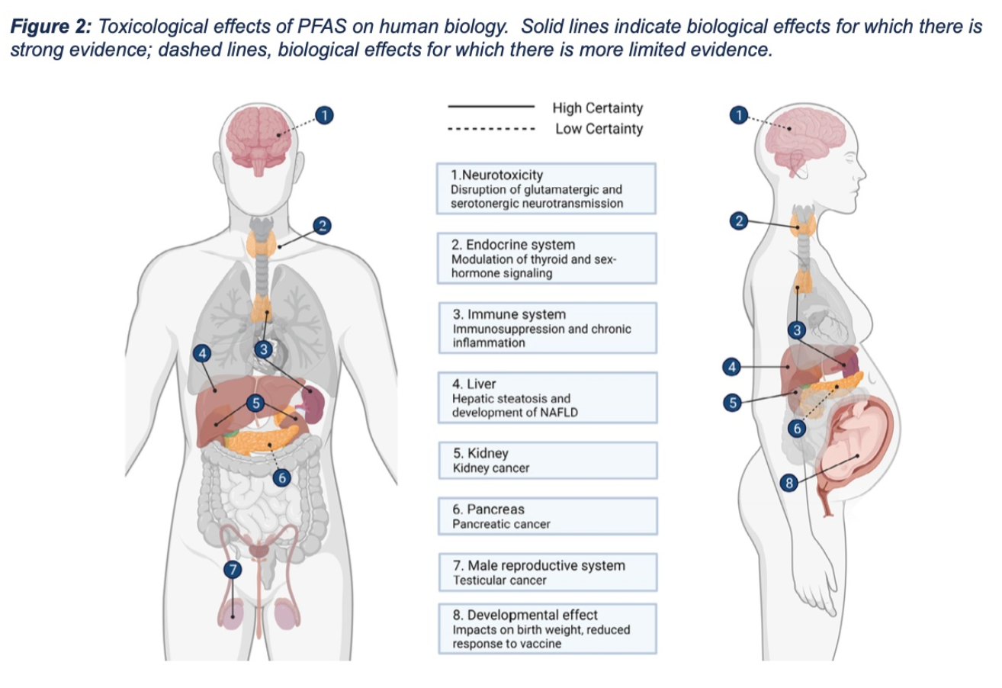
PFAS and human health effects
Lein et al. (2023)

Slide 7
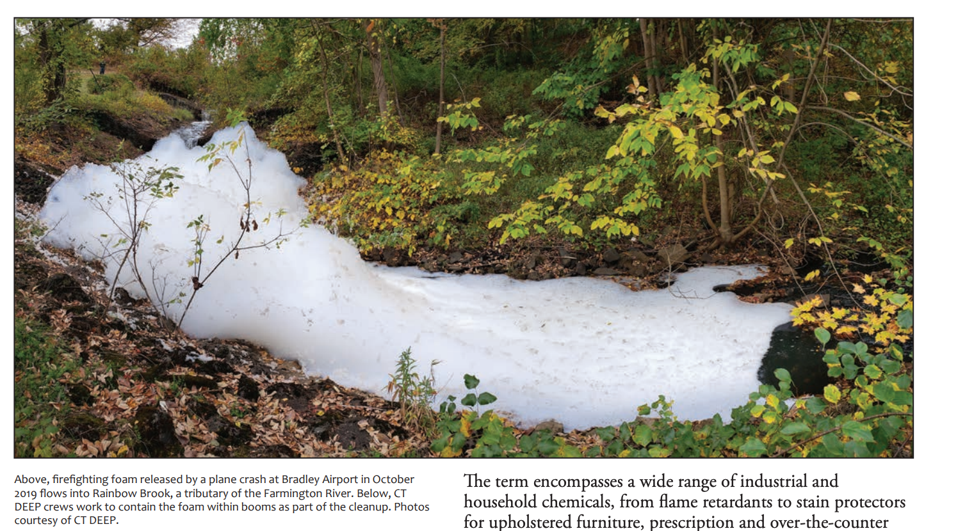
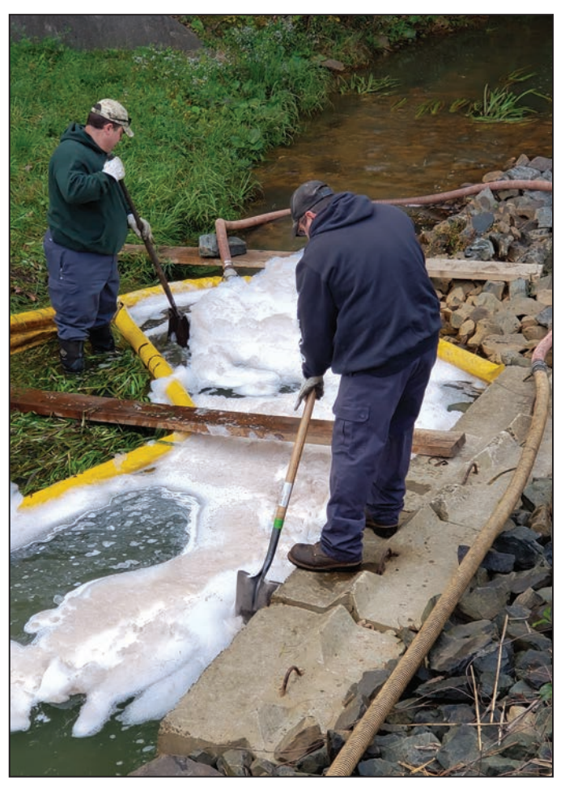
PFAS in Connecticut
Large volume releases to Farmington River in 2019 (Bradley spill, plane crash)
https://seagrant.uconn.edu/2022/12/15/read-articles-about-cecs-project-pfas-in-wrack-lines-magazine/

Slide 8
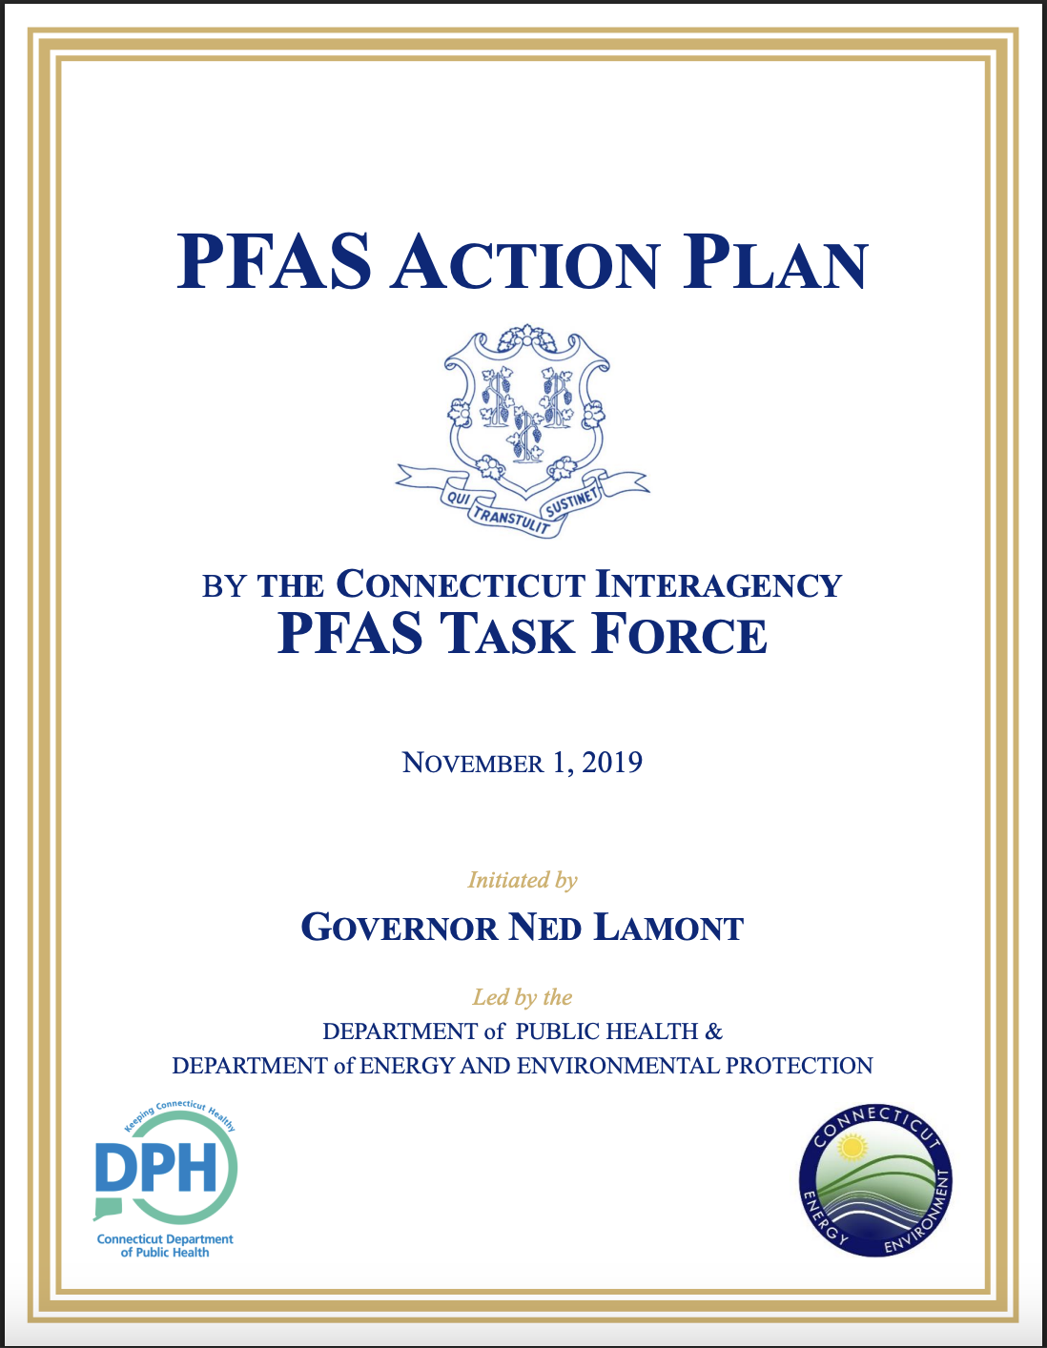
PFAS in Connecticut
Interagency Task Force and Action Plan
Minimize environmental exposure to PFAS for Connecticut residents (including from fish and shellfish consumption)
Minimize future releases of PFAS to the environment
Identify, assess, and clean up historical releases of PFAS to the environment.

Slide 9
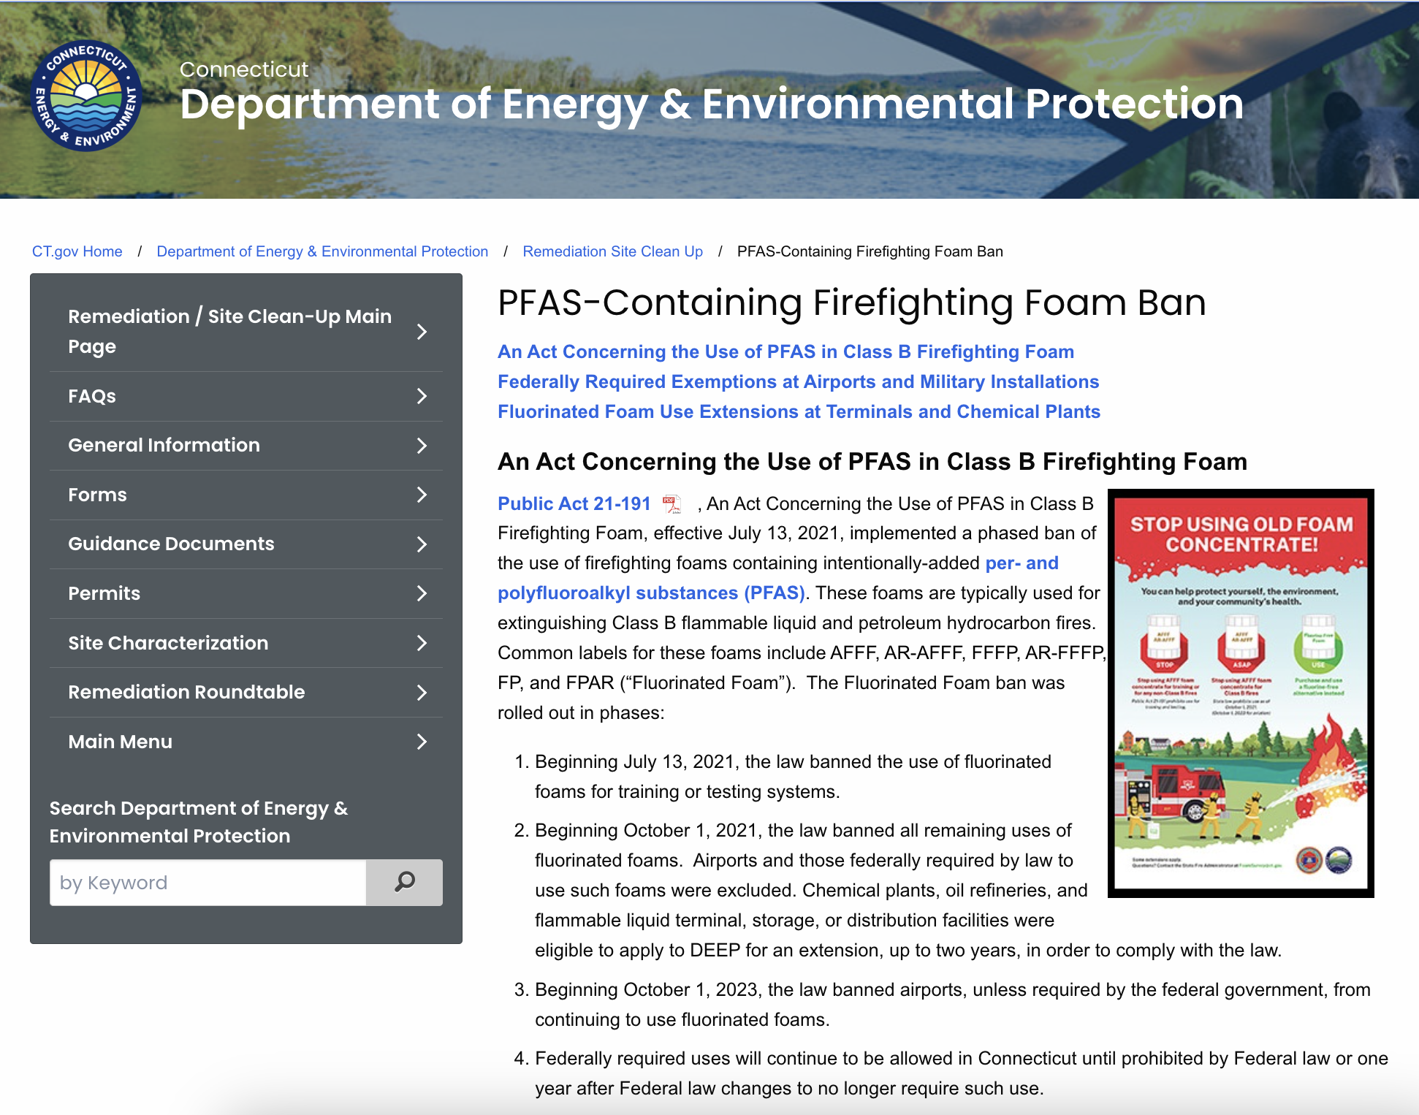
AFFF with PFAS now banned in CT, buy-back program, alternatives introduced
https://portal.ct.gov/deep/remediation--site-clean-up/contaminants-of-emerging-concern/pfas-in-class-b-firefighting-foam#takebackprogram

Slide 10
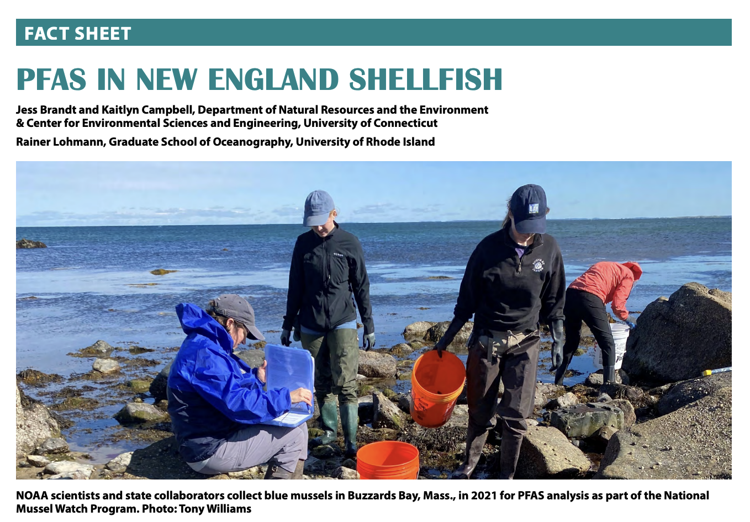
PFAS in coastal Long Island Sound food webs associated with coastal CT airports
Potential for PFAS bioaccumulation in coastal food webs
1. Groton-New London Airport:
  water, bivalves
  regulated shellfish areas
2. Tweed-New Haven Airport:
  water, bivalves, forage fish, carnivorous fishes
  Public health, airport expansion

Slide 11
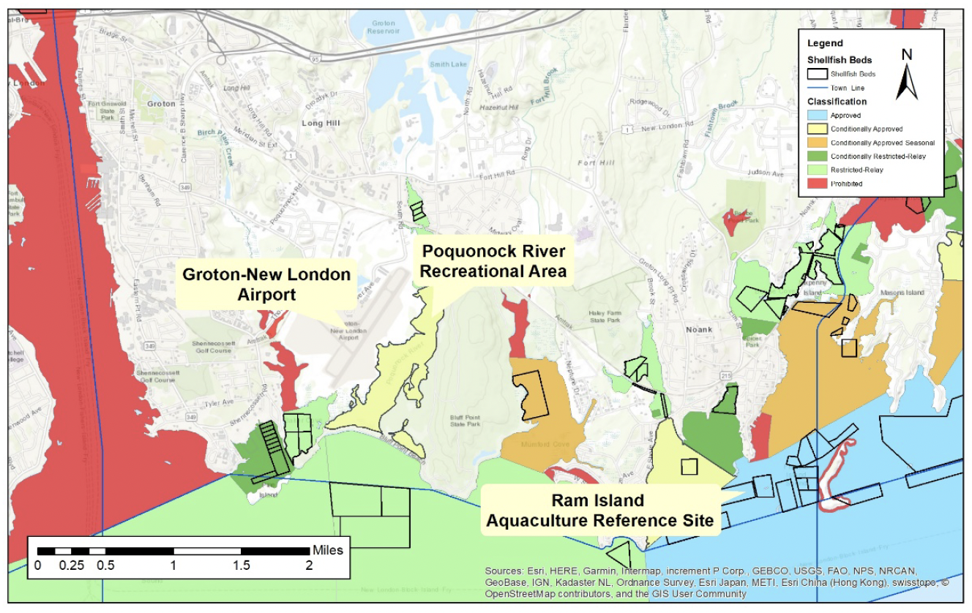
Assessment of PFAS food web uptake in priority shellfish areas associated with the Groton Airport
2022-2023, Groton-New London Airport
Project aims:
  Assess spatial and temporal PFAS patterns in phytoplankton and shellfish
  Quantify PFAS enrichment by shellfish
Site 1 north of airport, restricted-relay area
Sites 2 and 3 on the east and west sides of airport
Site 4 south of Pine Island, off-shore reference
1
3
2
4
Partners
Groton Shellfish Commission
CT DEEP, CT DPH, CT DoAG Bureau of Aquaculture
Mystic Oysters
CT Sea Grant Project #R/ER-31

Slide 12
Approach: Shellfish deployed in lantern nets, emphasis on water-column uptake. Deployed in April, June, August (2022 and 2023) for two months before collection. Shellfish samples are composites of n = 7 individuals.
  Baseline samples (April 2022) showed low concentrations:
  Eastern oysters and ribbed mussels co-deployed in year 1. Eastern oysters had similar yet slightly higher concentrations than ribbed mussels and more complex PFAS mixtures; only Eastern oysters used for year 2

Slide 13
Approach: Shellfish deployed in lantern nets, emphasis on water-column uptake. Deployed in April, June, August (2022 and 2023) for two months before collection. Shellfish samples are composites of n = 7 individuals.
  Baseline samples (April 2022) showed low concentrations:
  Eastern oysters and ribbed mussels co-deployed in year 1. Eastern oysters had similar yet slightly higher concentrations than ribbed mussels and more complex PFAS mixtures; only Eastern oysters used for year 2
Detection frequencies:
  PFAS detected in 24/31 samples (77%)
    PFAS detected in 17/36 ribbed mussel composites (47%)
    PFAS detected in 47/69 oyster composites (68%)
Compounds detected:
  Between 4 and 8 compounds detected among sample types
  More compounds detected in water and Eastern oysters than in ribbed mussels
Type | n | PFHxA | PFHpA | PFOA | PFNA | PFPeS | PFHxS | PFOS | PFOSA | # of cpds
Water | 31 | 52% | 71% | 23% | 23% | 23% | 23% | 26% | - | 7
Ribbed mussels | 36 | 2.8% | 22% | 19% | - | - | - | 17% | - | 4
Eastern oysters | 69 | 29% | 15% | 20% | 8.7% | 8.7% | 2.9% | 25% | 1.4% | 8

Slide 14
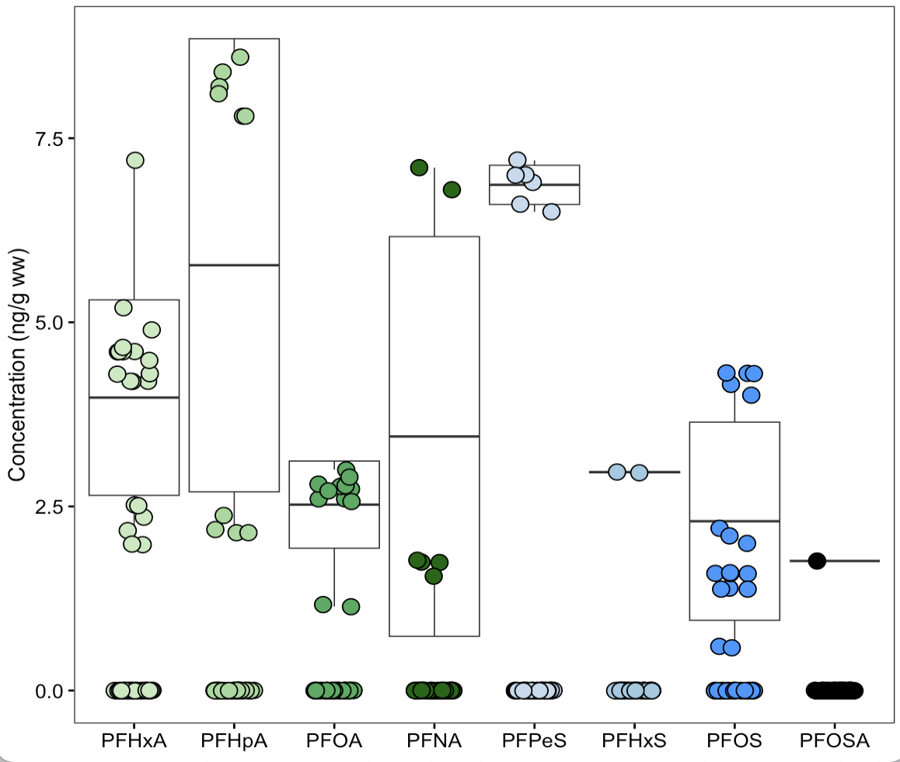
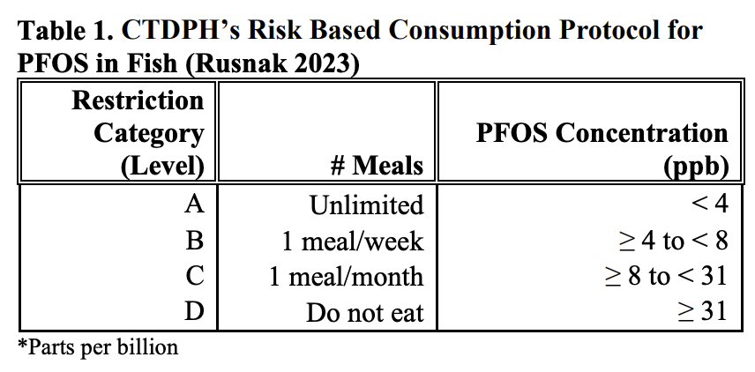
Compound-specific concentrations (ppb, ng g⁻¹ ww) in Eastern oysters
 | Range (all samples) | Mean ± SD (samples with detections)
PFHxA | bdl – 8.60 | 5.78 ± 3.1
PFHpA | bdl – 7.20 | 3.98 ± 1.3
PFOA | bdl - 3.00 | 2.53 ± 0.59
PFNA | bdl – 7.10 | 3.45 ± 2.7
PFPeS | bdl – 7.20 | 6.87 ± 0.27
PFHxS | bdl – 2.97 | 2.97 ± 0.0071
PFOS | bdl – 4.31 | 2.30 ± 1.3
PFOSA | bdl - 1.76 | 1.76 ± 0
Boxplots correspond to samples with detections only

Slide 15
Compound-specific concentrations (ppb, ng g⁻¹ ww) in Eastern oysters
 | Range (all samples) | Mean ± SD (samples with detections)
PFHxA | bdl – 8.60 | 5.78 ± 3.1
PFHpA | bdl – 7.20 | 3.98 ± 1.3
PFOA | bdl - 3.00 | 2.53 ± 0.59
PFNA | bdl – 7.10 | 3.45 ± 2.7
PFPeS | bdl – 7.20 | 6.87 ± 0.27
PFHxS | bdl – 2.97 | 2.97 ± 0.0071
PFOS | bdl – 4.31 | 2.30 ± 1.3
PFOSA | bdl - 1.76 | 1.76 ± 0
Boxplots correspond to samples with detections only
    PFOS concentrations > 4 ppb CT threshold for limited consumption (1 meal per week):
    5/69 Eastern oyster composites
    4/36 ribbed mussel composites

Slide 16
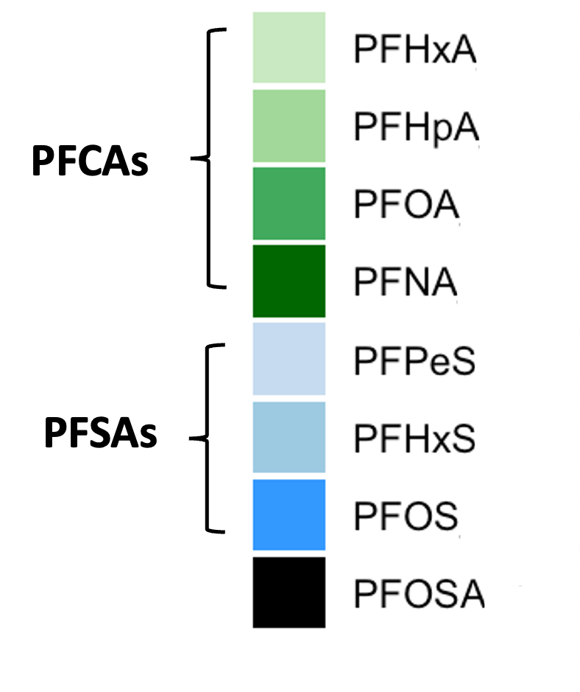
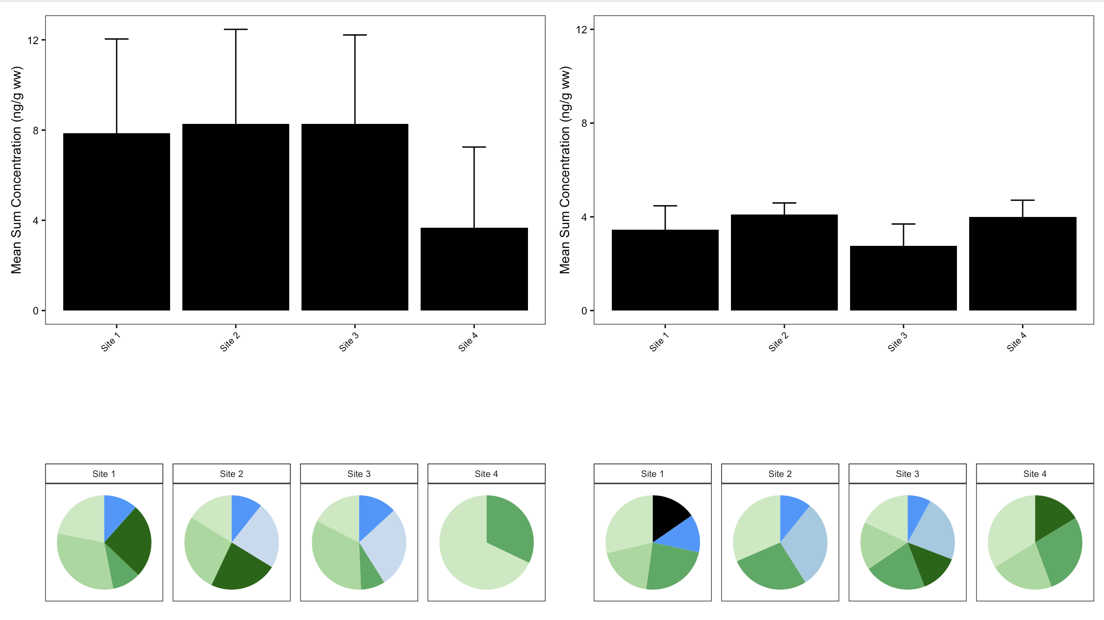
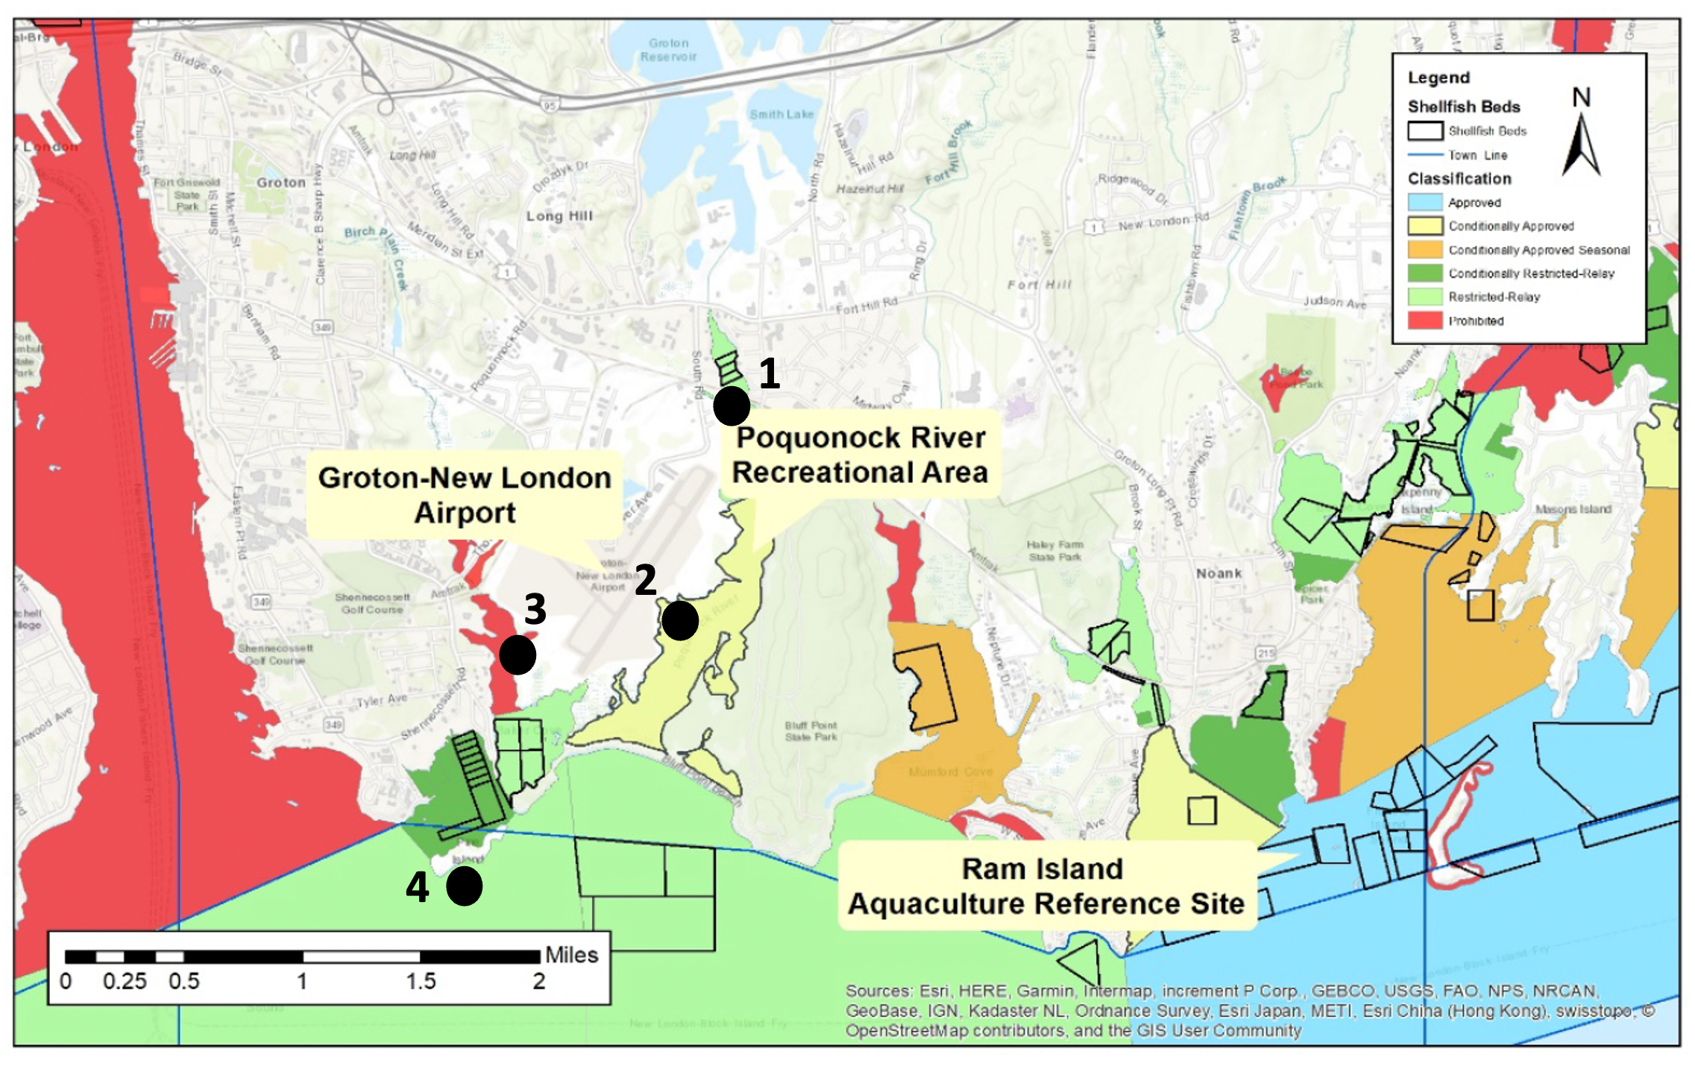
Sum concentrations and proportional compositions
∑PFAS concentrations among samples
  ∑₇ [PFAS] in water samples = bdl – 0.0441 ng mL⁻¹
  ∑₄ [PFAS] in ribbed mussel composite samples = bdl – 10.9 ng g⁻¹ ww
  ∑₈ [PFAS] in Eastern oyster composite samples = bdl – 18.8 ng g⁻¹ ww
More temporal than spatial variation
Proportional composition among oyster composite samples (n=3 per site) with at least one compound detected
2022
2023

Slide 17
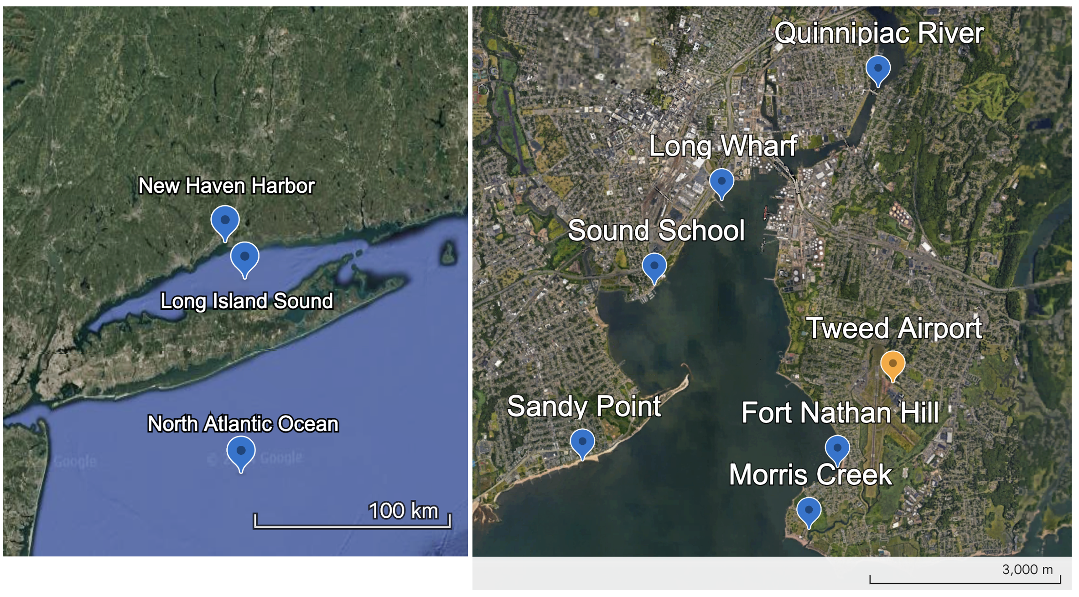
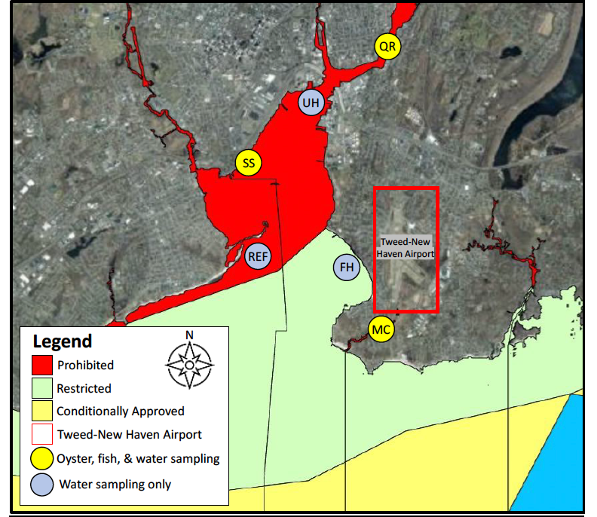

Assessment and uptake of PFAS in shellfish and fish from coastal areas associated with
Tweed New Haven Airport
2023-2024, Tweed- New Haven Airport
- New Haven Harbor shellfish collection is restricted if not prohibited
- NHH supplies oyster seed for commercial aquaculture
- Angling in NHH, with consumption advisories
Project aims:
  Characterize PFAS in water and biota (3 sites)
  Provide baseline PFAS concentration data prior to the expansion of the Tweed-New Haven Airport
Acknowledgments
Mary Beth Decker
C. Mulligan and G. Baldwin, students of the Sound School’s angler’s club
L. Bonnett for field assistance
P. Chmelar and C. O’Donnell for sample collection
Sea Grant Project #NA21OAR4170400

Slide 18
Approach: Water, finfish, and oysters were collected three times in 2023 from restricted and prohibited shellfish areas adjacent to the Tweed-New Haven Airport. Oyster and silverside samples are composites of n = 3- 7 individuals.
  Porgy, tautog, and striped bass were collected as representative of popular catch in New Haven Harbor
  Atlantic silversides (high site fidelity) collected for comparison between trophic levels
  Eastern oysters (sedentary) as bioindicators of bioavailable contaminants
Type | n | PFHxA | PFHpA | PFOA | PFNA | PFDA | PFUnA | PFDoA | PFBS | PFPeS | PFHxS | PFOS | NEtFOSAA | PFOSA | # cpds
Water | 57
Eastern oysters | 45
Silversides (adult only) | 36 (12)
Porgy | 10
Striped bass | 10
Tautog | 10

Slide 19
Approach: Water, finfish, and oysters were collected three times in 2023 from restricted and prohibited shellfish areas adjacent to the Tweed-New Haven Airport. Oyster and silverside samples are composites of n = 3- 7 individuals.
  Porgy, tautog, and striped bass were collected as representative of popular catch in New Haven Harbor
  Atlantic silversides (high site fidelity) collected for comparison between trophic levels
  Eastern oysters (sedentary) as bioindicators of bioavailable contaminants
Type | n | PFHxA | PFHpA | PFOA | PFNA | PFDA | PFUnA | PFDoA | PFBS | PFPeS | PFHxS | PFOS | NEtFOSAA | PFOSA | # cpds
Water | 57 | 77% | 40% | 46% | 30% | 19% | - | - | 47% | 23% | 47% | 74% | - | - | 13*
Eastern oysters | 45 | 14% | 21% | 9% | 4% | - | - | 2% | - | - | 2% | 33% | - | 58% | 8
Silversides (adult only) | 36 (12) | 31% (25%) | 42% (42%) | 19% (8%) | 25% (8%) | 3% (-) | - | 3% (-) | - | 25% (-) | 36% (67%) | - | - | 47% (17%) | 9 (6)
Porgy | 10 | 10% | - | 20% | - | - | - | - | 20% | - | 10% | - | - | 20% | 5
Striped bass | 10 | 10% | 10% | 10% | - | - | 10% | - | - | - |  | 50% | - | 10% | 6
Tautog | 10 | 10% | - | 10% | 10% | - | 10% | - | - | - | - | 20% | 10% | - | 6

Slide 20
Overall observations:
  Different biota show different bioaccumulation patterns
  More likely to detect PFAS in juvenile silversides than adult silversides
  Only a few PFAS compounds were detected in >1 porgy, striped bass, or tautog
  No samples exceeded CT’s 4 ppb threshold for limited fish consumption
Type | n | PFHxA | PFHpA | PFOA | PFNA | PFDA | PFUnA | PFDoA | PFBS | PFPeS | PFHxS | PFOS | NEtFOSAA | PFOSA | # cpds
Water | 57 | 77% | 40% | 46% | 30% | 19% | - | - | 47% | 23% | 47% | 74% | - | - | 13*
Eastern oysters | 45 | 14% | 21% | 9% | 4% | - | - | 2% | - | - | 2% | 33% | - | 58% | 8
Silversides (adult only) | 36 (12) | 31% (25%) | 42% (42%) | 19% (8%) | 25% (8%) | 3% (-) | - | 3% (-) | - | 25% (-) | 36% (67%) | - | - | 47% (17%) | 9 (6)
Porgy | 10 | 10% | - | 20% | - | - | - | - | 20% | - | 10% | - | - | 20% | 5
Striped bass | 10 | 10% | 10% | 10% | - | - | 10% | - | - | - |  | 50% | - | 10% | 6
Tautog | 10 | 10% | - | 10% | 10% | - | 10% | - | - | - | - | 20% | 10% | - | 6

Slide 21
Comparison with other CT and regional studies
  Testing in Greenwich, CT in 2020 for 14 PFAS compounds in surface water, shellfish, sediment – no PFAS detections

Slide 22
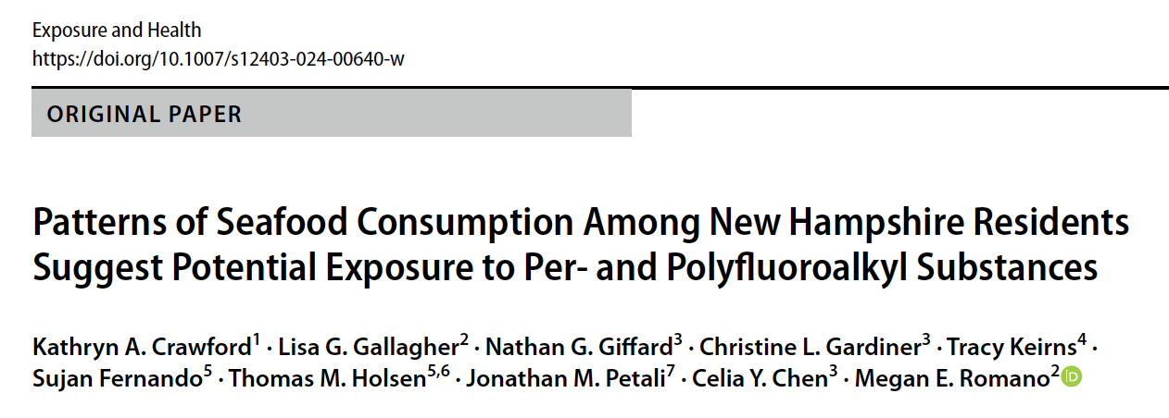
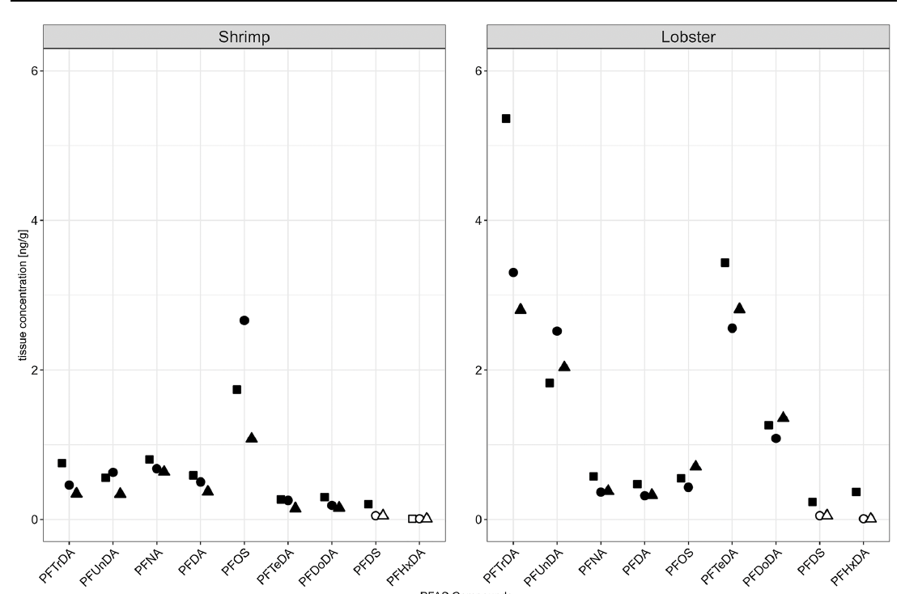
Comparison with other CT and regional studies
  Testing in Greenwich, CT in 2020 for 14 PFAS compounds in surface water, shellfish, sediment – no PFAS detections
  2024 Portsmouth NH seafood market “market basket” study reports low concentrations

Slide 23
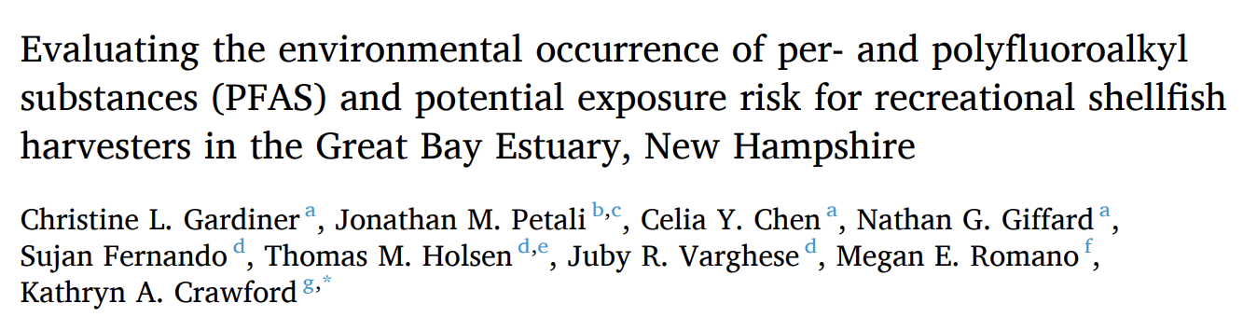
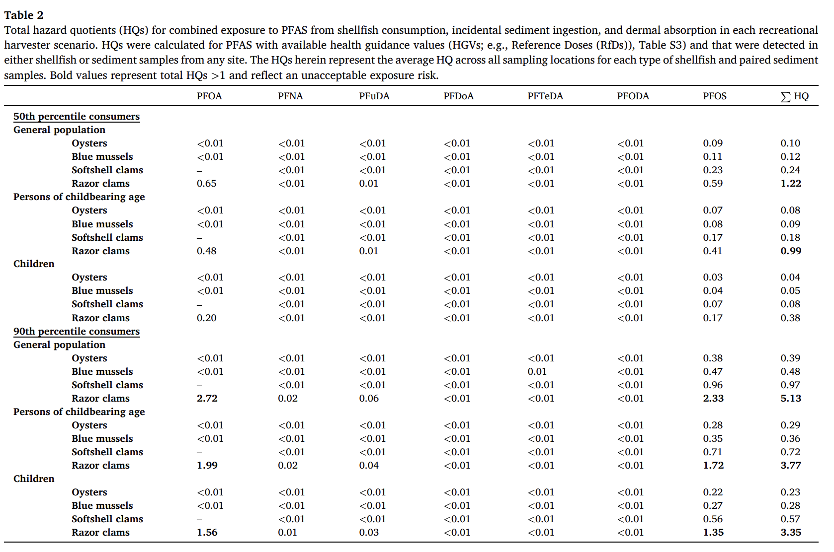
Comparison with other CT and regional studies
  Testing in Greenwich, CT in 2020 for 14 PFAS compounds in surface water, shellfish, sediment – no PFAS detections
  2024 Portsmouth NH seafood market “market basket” study reports low concentrations
  2025 Great Bay Estuary NH field study also measured low concentrations (all compounds < 1 ppb) in softshell clams, oysters, blue mussels, razor clams with moderate predicted health risks for frequent shellfish consumers

Slide 24
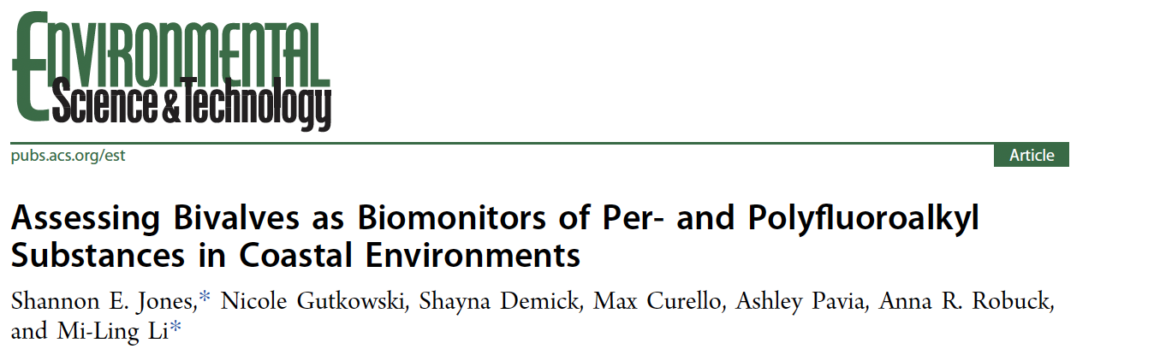
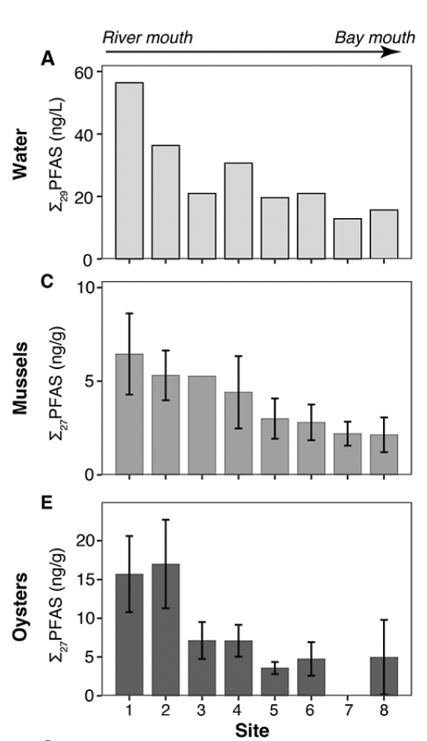
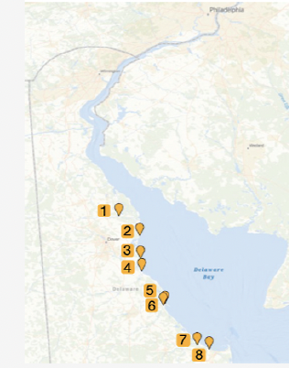
Comparison with other CT and regional studies
  Testing in Greenwich, CT in 2020 for 14 PFAS compounds in surface water, shellfish, sediment – no PFAS detections
  2024 Portsmouth NH seafood market “market basket” study reports low concentrations
  2025 Great Bay Estuary NH field study also measured low concentrations (all compounds < 1 ppb) in softshell clams, oysters, blue mussels, razor clams with moderate predicted health risks for frequent shellfish consumers
  2025 Delaware Bay (PFAS industries) field study reported higher concentrations in oysters than mussels, low PFOS concentrations

Slide 25
Comparison with other CT and regional studies
  Testing in Greenwich, CT in 2020 for 14 PFAS compounds in surface water, shellfish, sediment – no PFAS detections
  2024 Portsmouth NH seafood market “market basket” study reports low concentrations
  2025 Great Bay Estuary NH field study also measured low concentrations (all compounds < 1 ppb) in softshell clams, oysters, blue mussels, razor clams with moderate predicted health risks for frequent shellfish consumers
  2025 Delaware Bay (PFAS industries) field study reports higher concentrations in oysters than mussels, low PFOS concentrations
PFAS concentrations measured so far in CT and New England shellfish are low. Industrialized areas show relatively higher, but still low, concentrations.
Most studies are focused on public health risks, we know little about PFAS effects on shellfish health.

Slide 26
Questions?
Margot Grimmelpont
Kaitlyn Campbell
Zosia Baumann
Christopher Perkins
Anthony Provatas
Jess Brandt, PhD
University of Connecticut
Dept. of Natural Resources and the Environment
Center for Environmental Science and Engineering
CT Sea Grant
jess.brandt@uconn.edu

