Slide 1
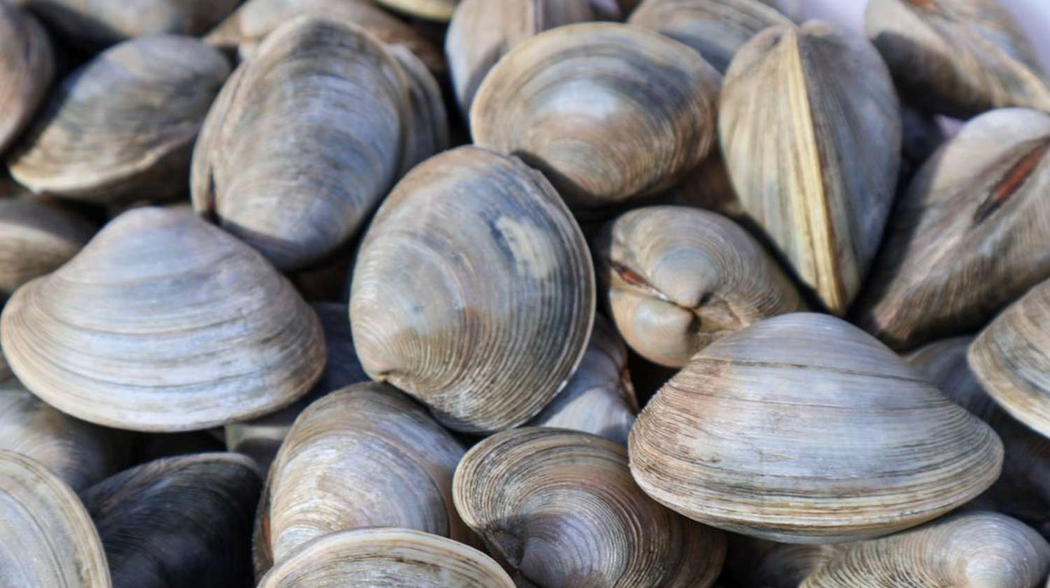
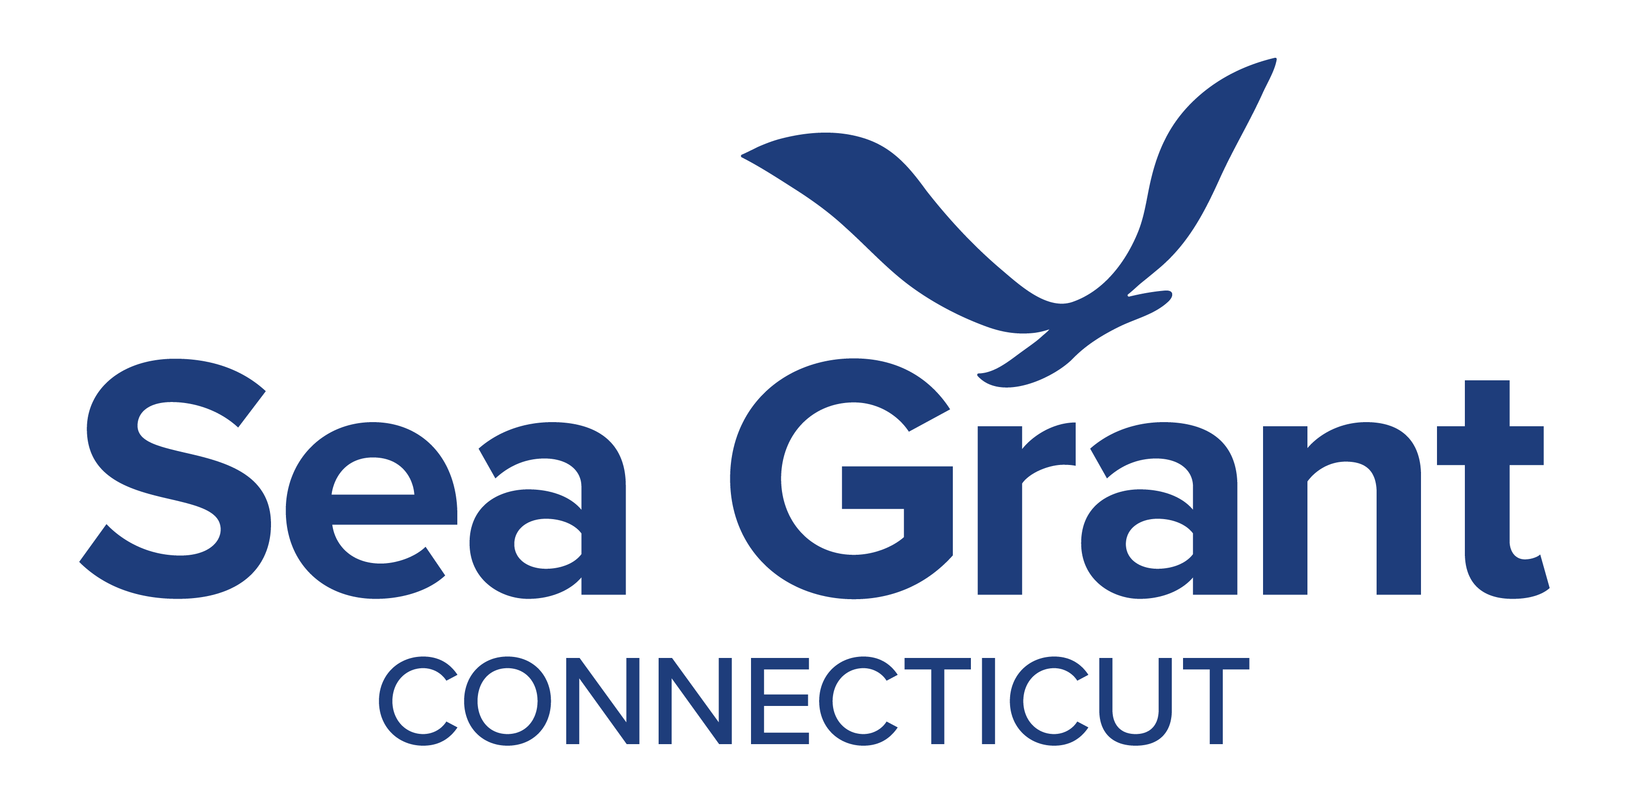
Addressing Emerging Issues of Connecticut's Shellfish and Seaweed Farming Sectors
Background:
Although the northern quahog (Mercenaria mercenaria) is an important aquaculture species in Connecticut, over the past decade production has decreased.
Industry members have voiced concerns over harvest declines and increasingly infrequent catches of the smallest market size clam, littlenecks (1.5 - 2.0" wide).
A number of theories have been suggested, however, there is limited population and environmental data available to validate them.
Photo Credit: https://www.foodandwine.com/quahog-rhode-island-8713573

Slide 2
Goal:
To identify and gather data that will provide industry members with a better understanding of the population status of Northern quahogs in Connecticut.
Objectives:
Review the current state of the data
Hold a series of stakeholder workshops to:
discuss currently available data
identify and prioritize new data to be collected
design and implement a preliminary field study.
Outcomes:
Evaluate if the recent decline in landings can be attributed to one or more causes.
Provide information to help future management of northern quahog populations, harvest, and aquaculture in Connecticut.
Photo Credit: https://www.foodandwine.com/quahog-rhode-island-8713573

