Slide 1
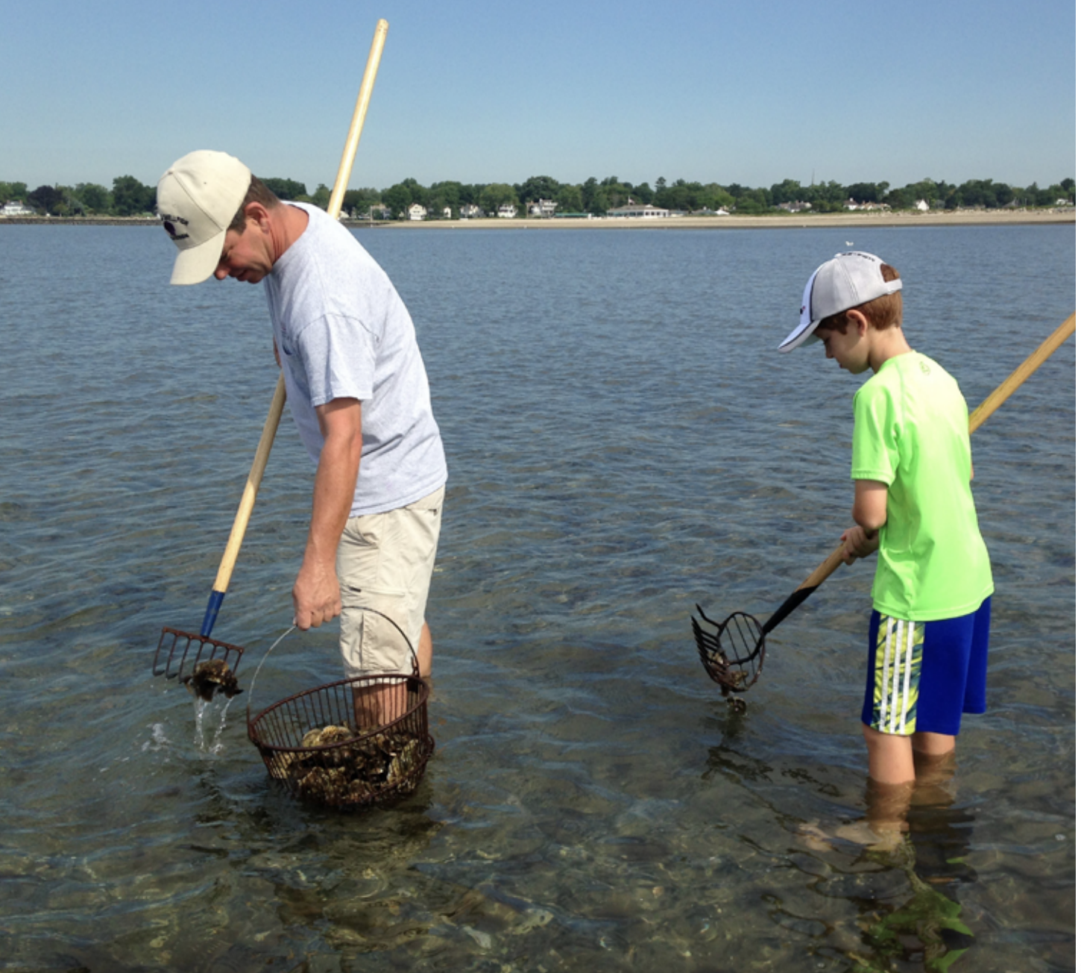
Economic Valuation of recreational shellfishing
Tessa L. Getchis
Connecticut Sea Grant
UConn Extension
tessa.getchis@uconn.edu
Angela Zhang
UConn Dept of Agriculture Resource Economics
angela.zhang@uconn.edu
Luis Seonane Estruel Sr.
UConn Dept of Agriculture Resource Economics
luis.estruel@uconn.edu
Rigoberto Lopez
UConn Dept of Agriculture Resource Economics
rigoberto.lopez@uconn.edu

Slide 2
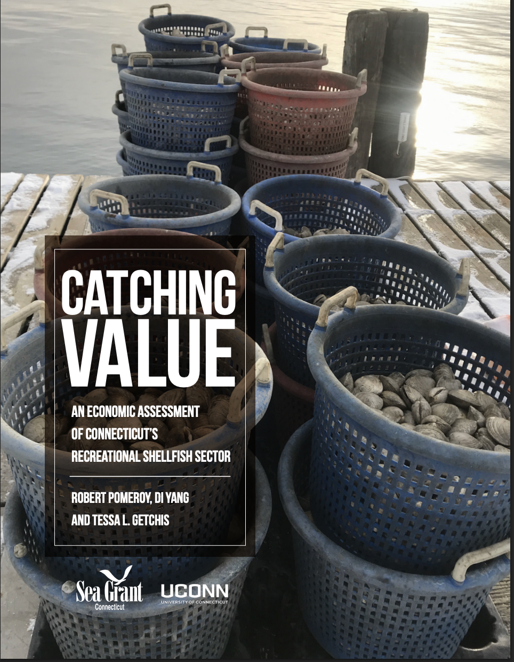
background
REPORT HIGHLIGHTS:
Culturally important activity
Important part of maritime economy
17 coastal towns
100K permit sales annually
$2M contribution to CT economy

Slide 3
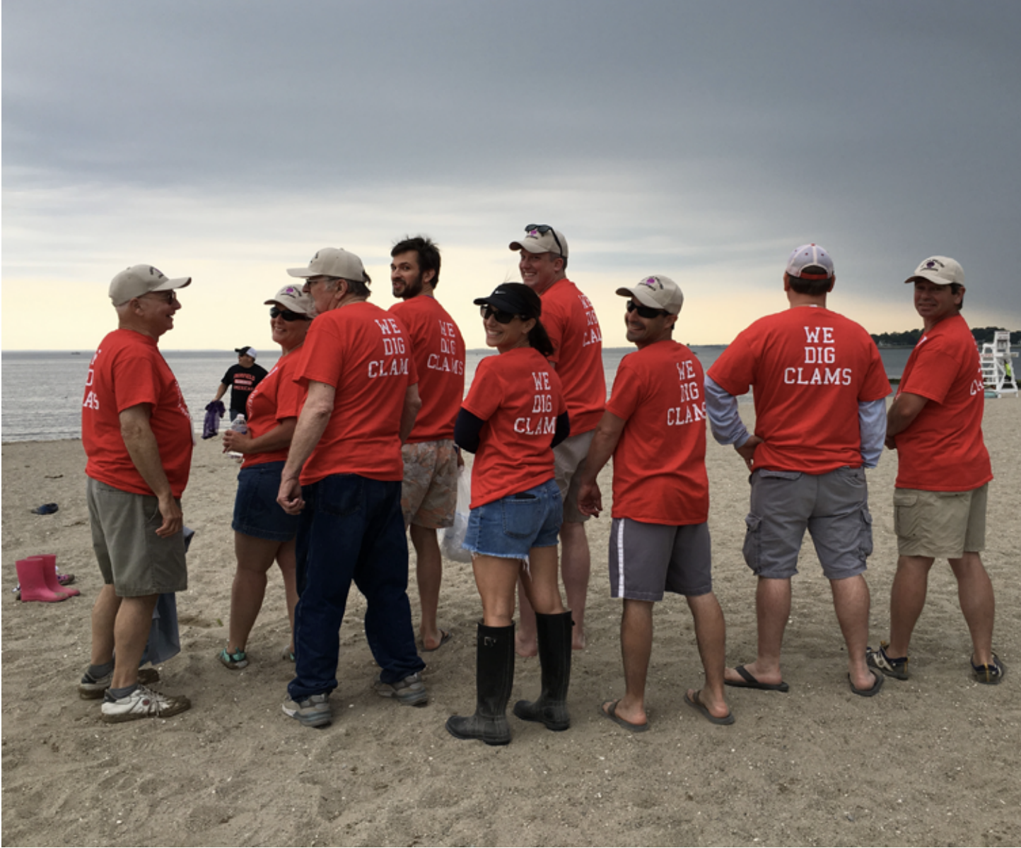
Project
GOAL:
Determine trends in shellfishing; increase awareness of value of shellfishing
ACTIVITIES:
Collect permit sales and related data
Conduct economic analysis
Prepare and distribute report
COMMISSION ROLE:
Submit table with permit sales data
Participate in call to help us identify
ancillary costs of shellfishing
Notes:
GOAL:
Increase awareness of economic & cultural value of recreational shellfishing
OBJECTIVE:
Determine economic and other trends in recreational shellfishing activity
ACTIVITIES:
Collect permit sales data
Collect xxx
Conduct economic analysis
Prepare report

Slide 4
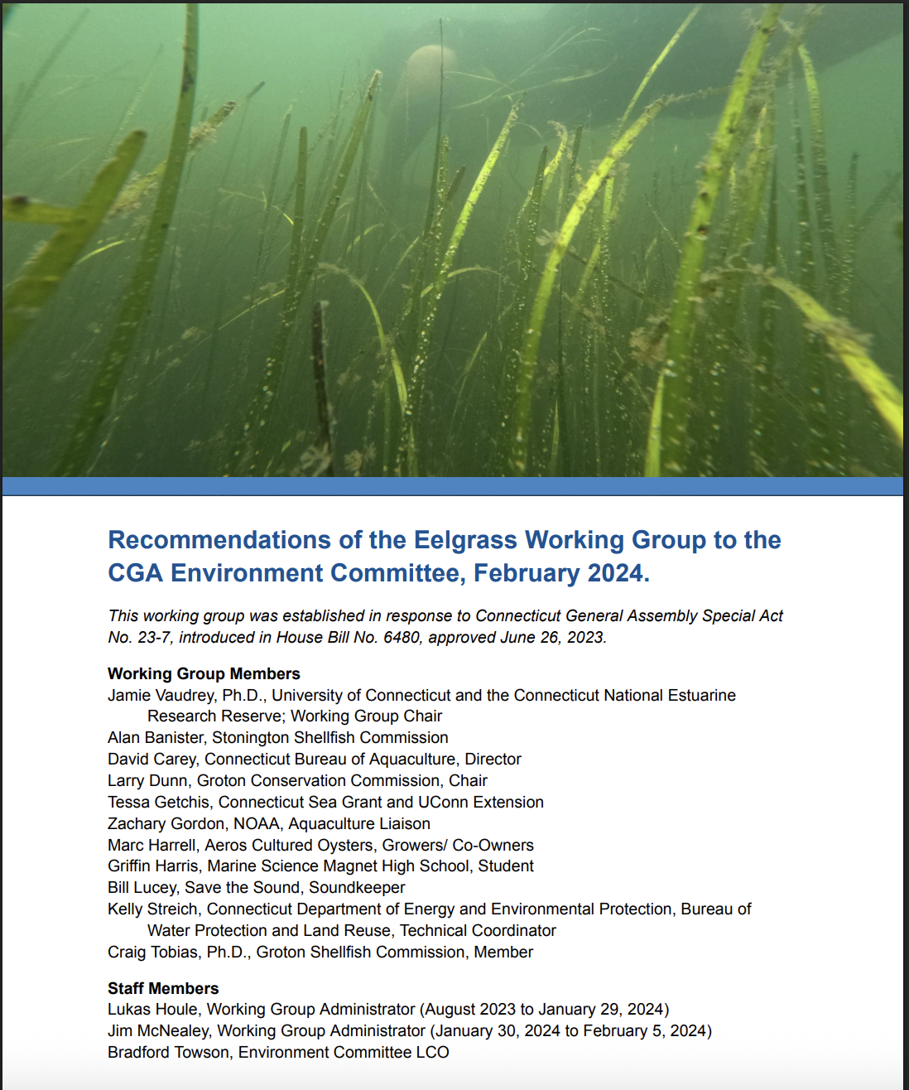
Aquaculture and Eelgrass Interactions
Katie Lund
Connecticut National Estuarine Research Reserve
katie.lund@uconn.edu
Tessa L. Getchis
Connecticut Sea Grant
UConn Extension
tessa.getchis@uconn.edu
Cary Chadwick
UConn Center for Landuse Education & Research | UConn Extension
luis.estruel@uconn.edu

Slide 5
background
REPORT HIGHLIGHTS
Public Act 23-7 Legislative Report
Establish a LIS Eelgrass Workgroup
Identify suitable areas for restoration
  Eelgrass habitat suitability index
Identify potential barriers to restoration
  Ex. use conflicts such as shellfisheries
Determine next steps for restoration

Slide 6
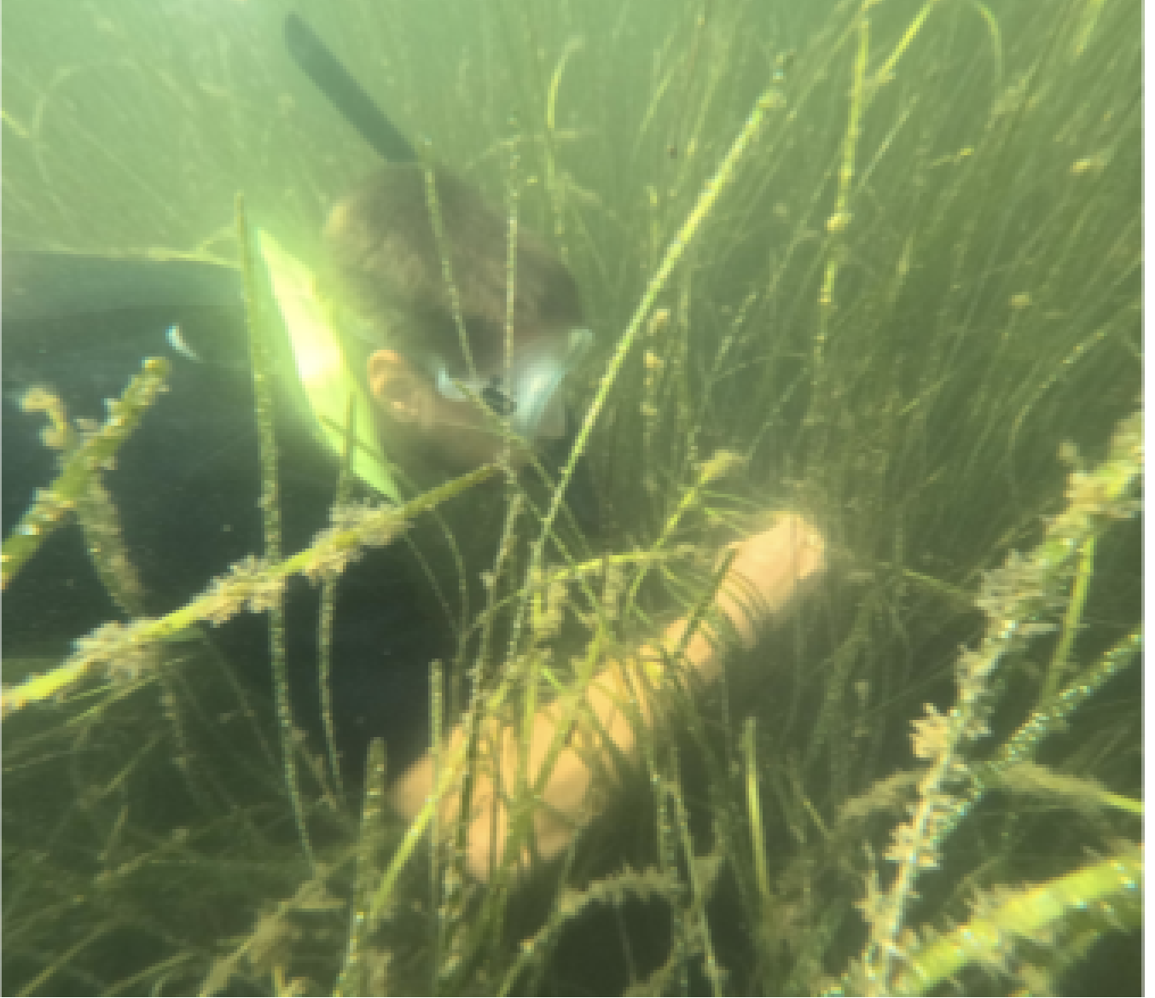
Project
GOAL:
Better understand perceived threats and opportunities for restoration; minimize negative interactions with other maritime uses (e.g. aquaculture, shellfisheries)
ACTIVITIES:
GIS exclusionary analysis
Identify potential restoration sites
Prepare report
COMMISSION ROLE:
Participate in workgroup meetings to provide insight on site selection for eelgrass restoration
Notes:
GOAL: Restore eelgrass habitat
OBJECTIVE: To better understand the perceived threats opportunities related to eelgrass restoration:
ACTIVITIES:
Review the eelgrass habitat suitability index (this tells us where eelgrass will potentially thrive in Long Island Sound)
Conduct an exclusionary analysis (this tells us which significant human uses including aquaculture and shellfisheries should be avoided)
Discuss these spatial data and identify potential restoration sites that either avoid conflicts with aquaculture and shellfisheries

